Slide 1
Recycling in the Netherlands
MADE BY: TOM BACKX, RENS EN KOEN

Slide 2
Waste Separation.
There are 4 different types of waste in the Netherlands:
Greenery
Plastic
Paper
Other waste

Slide 3
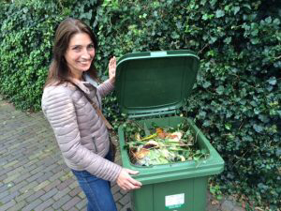
Waste disposal of greenery
Greenery: Gets transported to a central location
It is sorted from any items that don’t belong there
It is put in a room where it fermentates
It is composted

Slide 4
Waste disposal of plastic
Most types of plastic can be recycled
Plastic can be recycled by melting it and reshaping it into something new
8% of all plastic can’t be recycled
Less than 50% of all plastic in the Netherlands is recycled
Plastic is hard to recycle because there are many different types
When plastic gets recycled the first step is weighing it to see if it is only plastic, otherwise it is burned up.
After the sorting the plastic gets cut into small spheres and is melted into its new form.

Slide 5
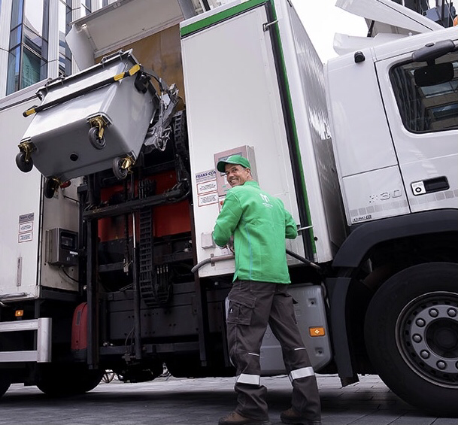
Waste Disposal of paper
PAPER IS TAKEN FROM THE BIN AND DEPOSITED IN A LARGE RECYCLING CONTAINER ALONG WITH PAPERFROM OTHER RECYCLING BINS. THE PAPER IS TAKEN TO A RECYCLING PLANT WHERE IT IS SEPARATED INTO TYPES AND GRADES. THE SEPARATED PAPER IS THEN WASHED WITH SOAPY WATER TO REMOVE INKS, PLASTIC FILM, STAPLES AND GLUE

Slide 6
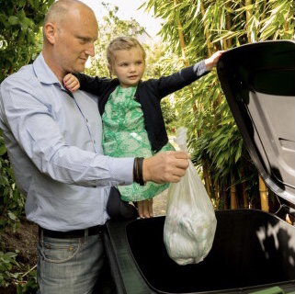
Other waste
All other waste that does not fall into one of the recycling categories is burned.
The waste is burned at 850 degrees celcius
The oven is powered by natural gas

Slide 7
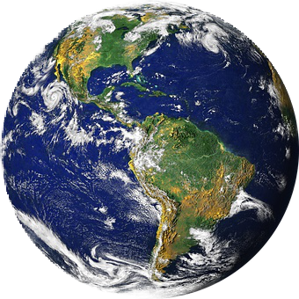

hhww project
Netherlands
MADE BY: NIK, FABIAN, KICK EN TEUN
W2B

Slide 8


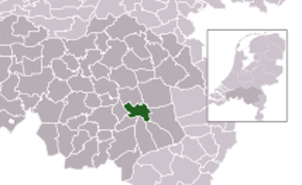
Recycling in Helmond
•MILIEUSTRAAT
•CYCLE
•GOOD SEPARATION IN HELMOND

Slide 9
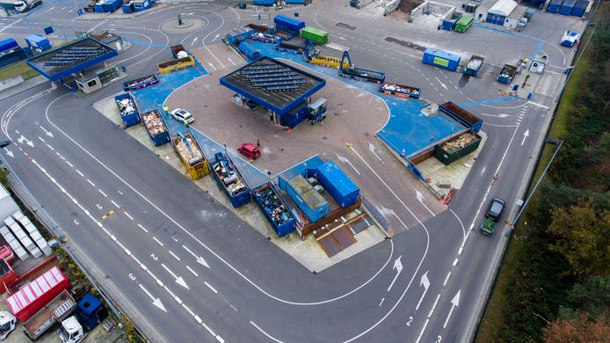
MILIEUSTRAAT
•RECYLCE COMPANY
FEW DIFFERENT CATEGORIES
PAY
DROP ALL YOUR TRASH

Slide 10
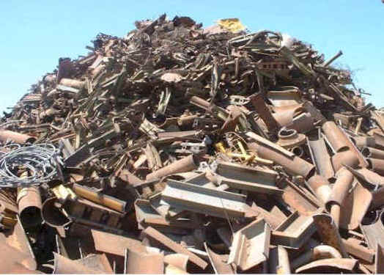
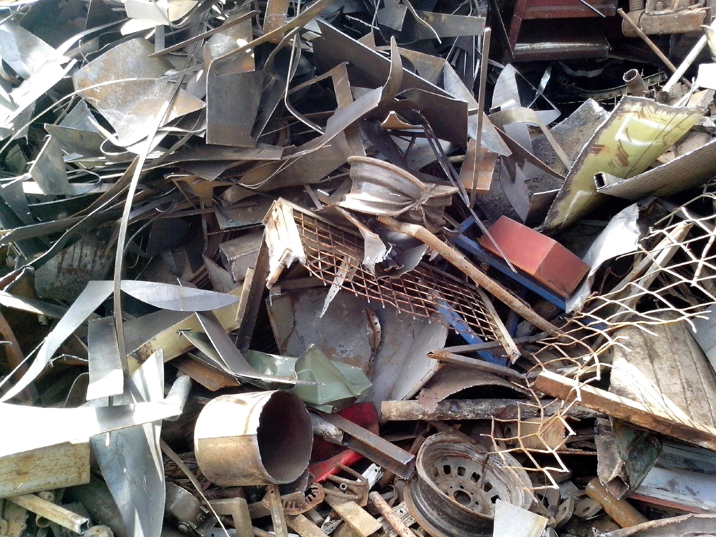
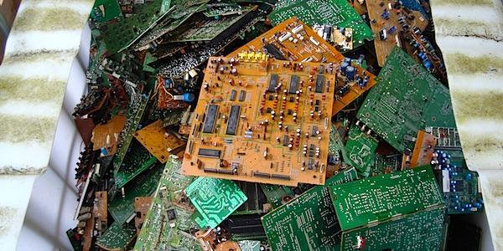
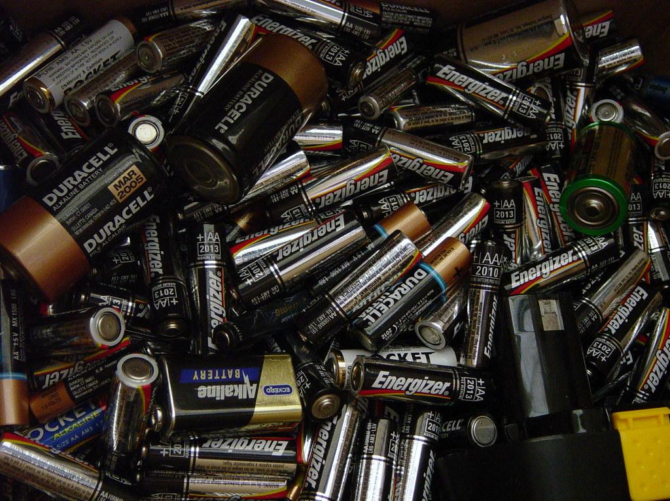
After milieustraat
Klikken om tekst toe te voege
-Construction waste
-Chemical waste
- Electrical waste
-Metal

Slide 11


CYCLE
-WASTE GETS PICKED.
-THE WASTE GETS RECYCLED.
-PRODUCTS GET USED AGAIN.
-THEY GET RECYCLED AGAIN.

Slide 12
Recycling at our school
BY: MINH LOI, JUSTIN, TOM AND ROEL

Slide 13

Recycling
Bins
Separate use

Slide 14

Chores
Chores students
Leftover garbage
Garbage recycling

Slide 15
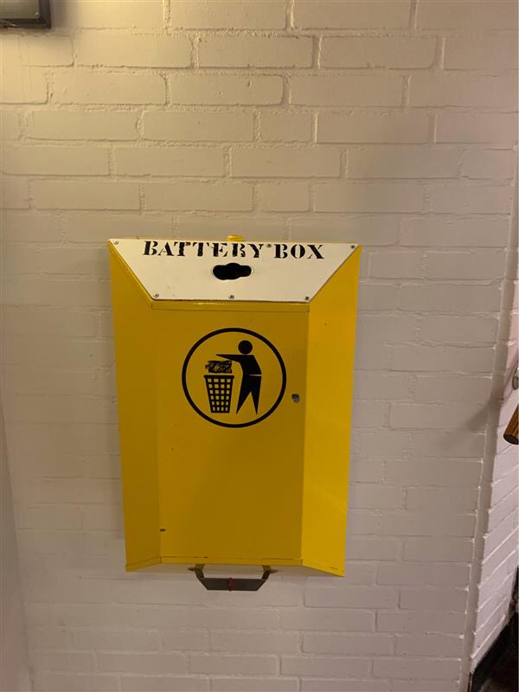
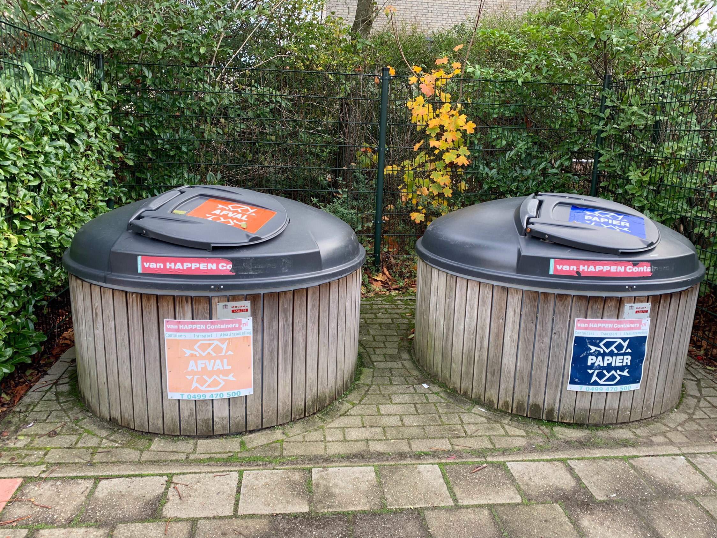
Garbage, Batteries and Papier
The Yellow box
The bin on the left
The bin on the right

Slide 16
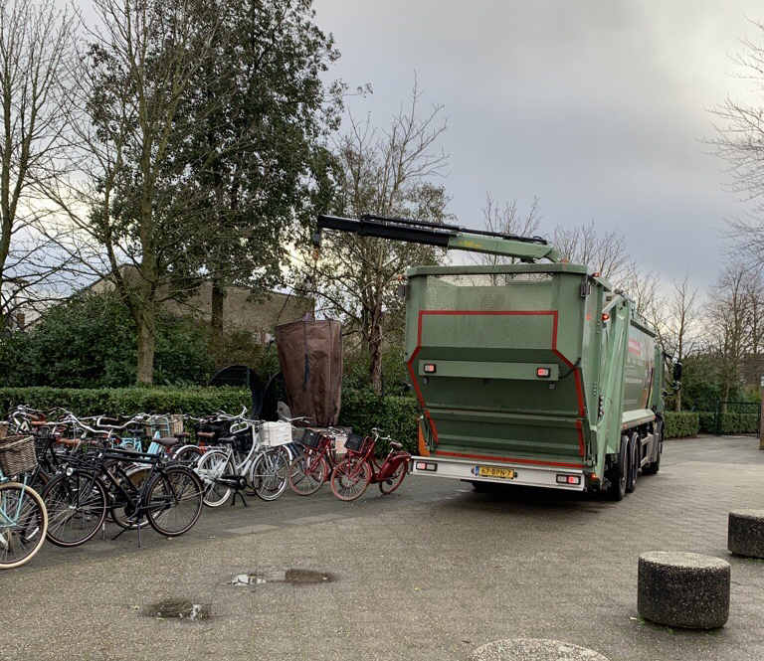
Garbage truck
garbage truck
Trash

Slide 17

THANKS FOR LISTENING!!!!!!

