Slide 1
RECYCLING IN THE CZECH REPUBLIC - MATERIALS AND CONTAINERS The Netherlands - Silvie Menšíková, Tereza Partyšová, Markéta Lužová, Tereza Kedroňová, Simona Kaláčová
Notes:
(Terka K.) Hello everybody, we are a team from the Czech Republic and my name is..... and this is rest of our group:.........
We would like to talk about our common topic ,,recycling". Let's get started!

Slide 2
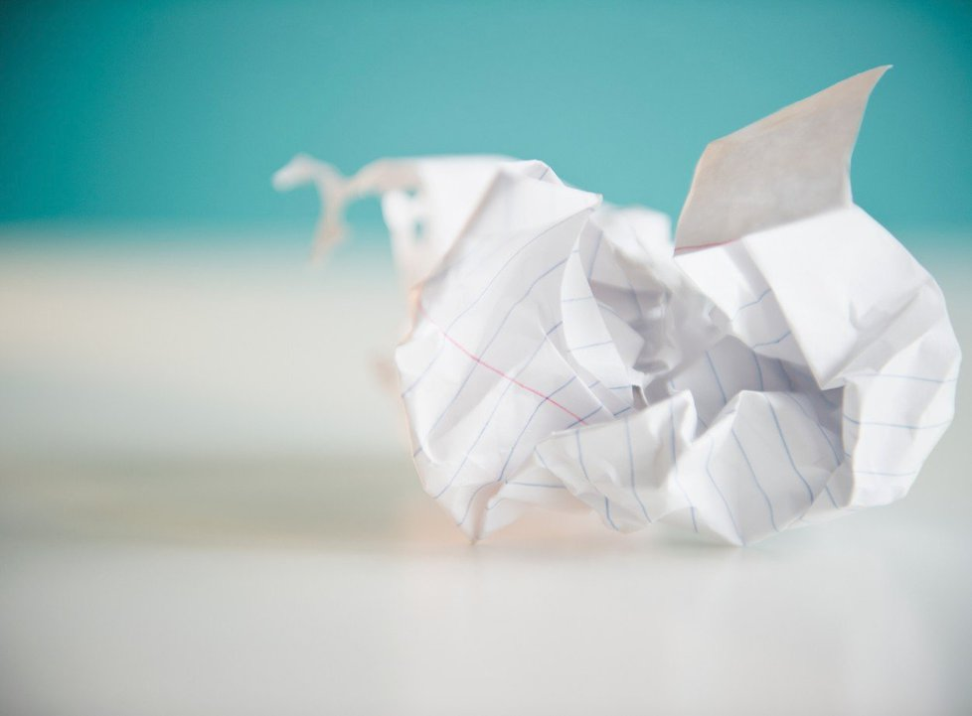
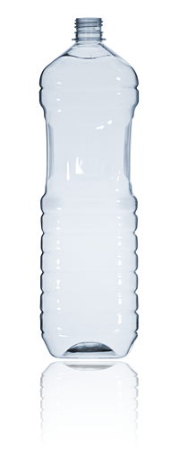
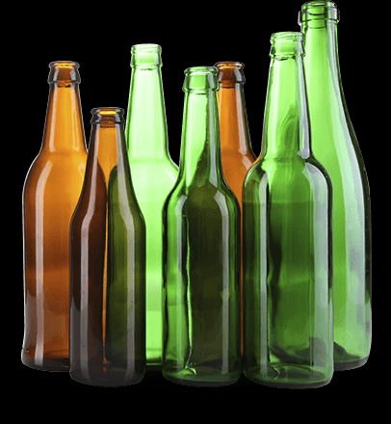
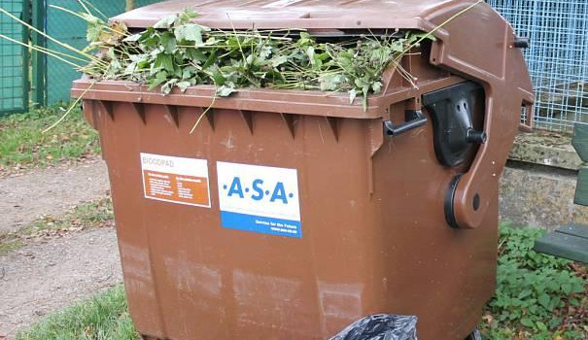
In the Czech Republic there are the many things to recycle.
Plastic
Paper
Glass
Bio waste (biodegradable organic waste)
Notes:
Peggy, what do you think about recycling in the Czech Republic?
Do young/old people recycle?
In general, people don't recycle much?
Is the environment important?
THE BASIC MATERIALS THAT ARE USUALLY RECYCLED ARE THE FOLLOWING...do you agree?
Yes, absolutely.

Slide 3
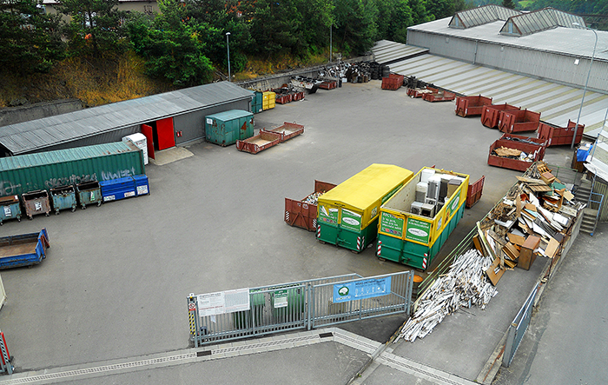
Batteries and electronic equipment
Metal ....
We transport a large amount of paper and metal to collections yards.
We have a many containers to separate the waste.
Notes:
Do you know where the nearest recycling centre is? Is there one in your hometown?
(Peggy)

Slide 4
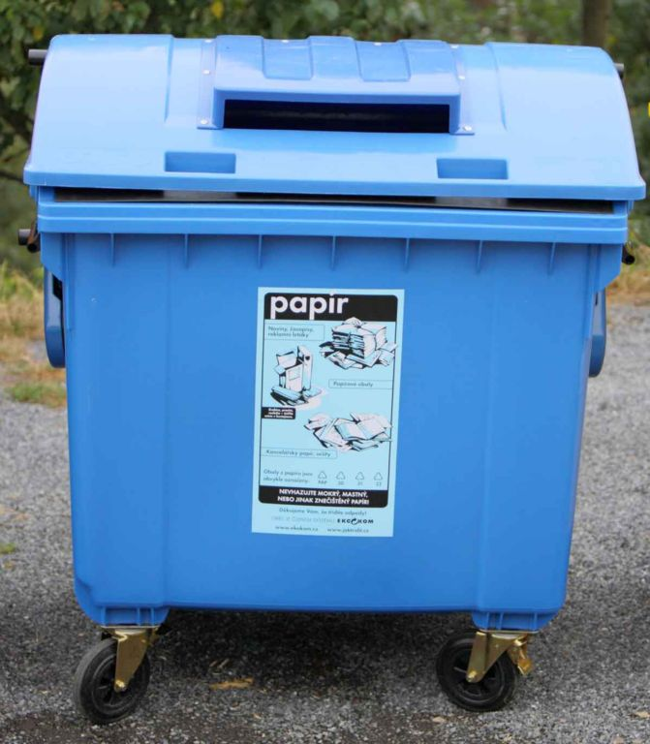
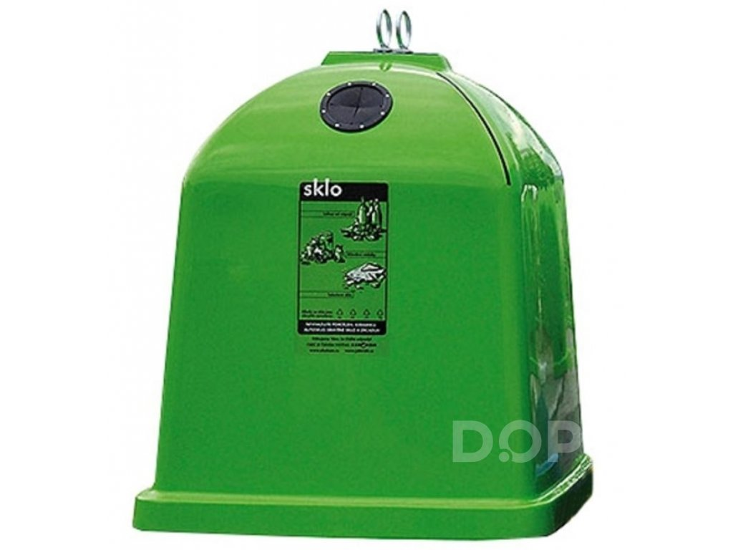
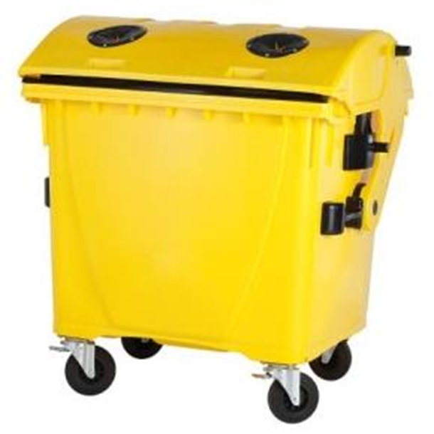
BINS AND CONTAINERS
PAPER
Bins for paper are blue.
In the Czech Republic, we also throw newspapers, exercise books and boxes into a paper container.
GLASS
Bins for glass are green and white. (for coloured glass and clear glass)
We throw bottles, glass shards but we don´t throw glass from cars and light bulbs into a glass container.
PLASTIC
Bins for plastic items are yellow.
We throw PET bottles and bags into a plastic container . We don´t throw away tyres.
BEVERAGE CARTONS
Bins for beverage cartons are orange.
We don´t have many bins for beverage cartons in the Czech Republic.
Notes:
Silvi, can we play a game now? I will say an example of waste and you will tell me, which container you throw it into, OK?
A cardboard box....blue-it is paper
An iron pipe......grey-it is made of metal
...........
It is easy ,isn't it? Anybody can recycle!

Slide 5
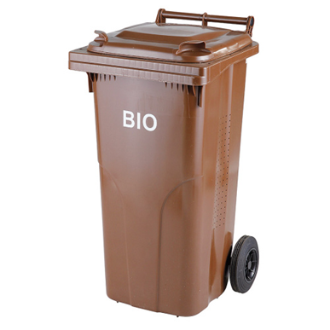
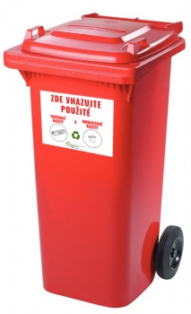
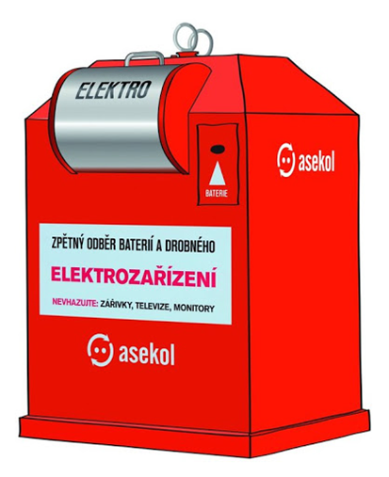
BIO WASTE
Bins for bio waste are brown.
In these we put vegetables, fruit, grass and flowers from garden.
HAZARDOUS WASTE
Bins for hazardous waste are red.
Hazardous waste includes medicines and flashlights.
ELECTRICAL PRODUCTS
Bins for electrical products are red with stickers.
This waste contains hazardous substances ( mercury and lead )
Notes:
(Silvi) It is easy ,isn't it? Anybody can recycle!

Slide 6
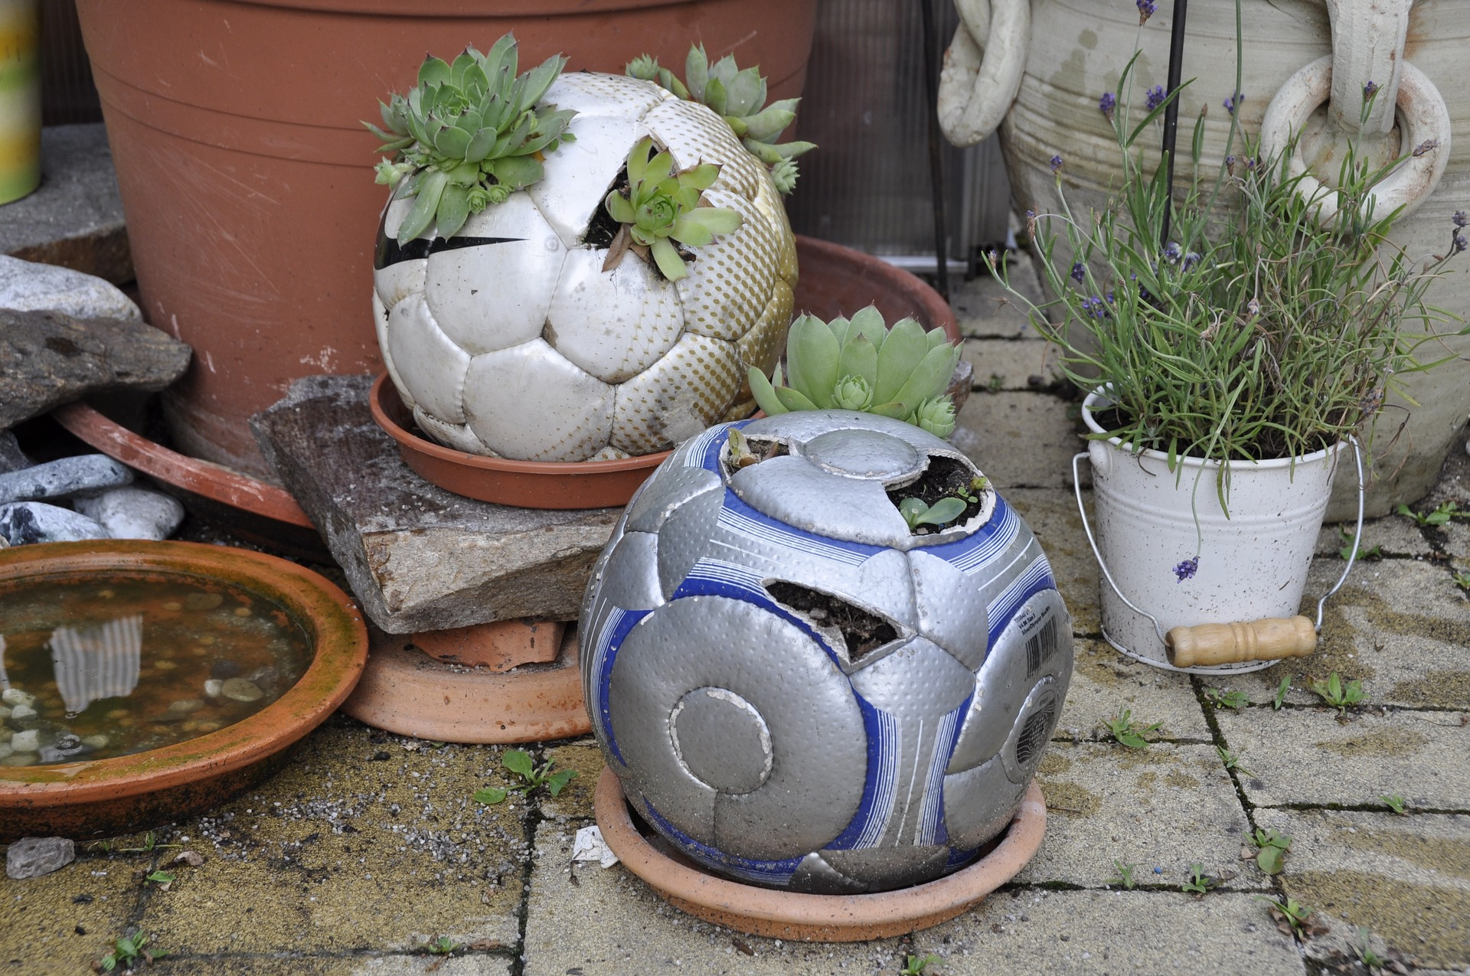
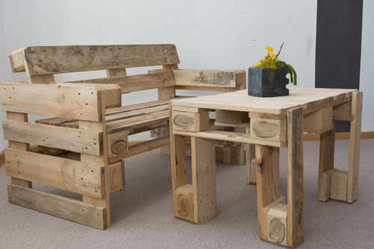
UPCYCLING
Upcycling is one of the postmodern concepts of the world.
In general terms, upcycling is a direction aimed at transforming old and unnecessary products into products with a higher utility value than the original product.
At its core is this way of transforming products one level above recycling.
Because in Recycling, old materials are transformed and formed into new materials, which are again thrown into the production-exchange-consumption cycle.
Notes:
Upcycling-that is something, I do not understand very much...can you explain it to me?
(Terka P.)Old materials are transformed into new ones: e.g. there is some cupboard packaging and if you left it in nature it will decompose. If there are some seeds added into the packaging itself, then there will be new plants in nature!
Oh!, interesting!

Slide 7
DOWNCYCLING
Downcycling is a term that describes the reprocessing of materials or things that are not as full-fledged or not as reusable as typical recycling
typical example of material :
multi-layer boxes , mixed pallets and similar Rubber, paper and others can be recycled according to broader criteria
Notes:
Terka P.

Slide 8
Notes:
Now you can see three signs that represents recycling
(Terka P.)
The first one shows recycling in general.
The second is the process of upcycling.
And the last one is the most common-called downcycling.

Slide 9
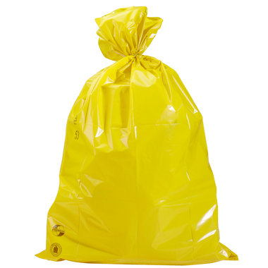
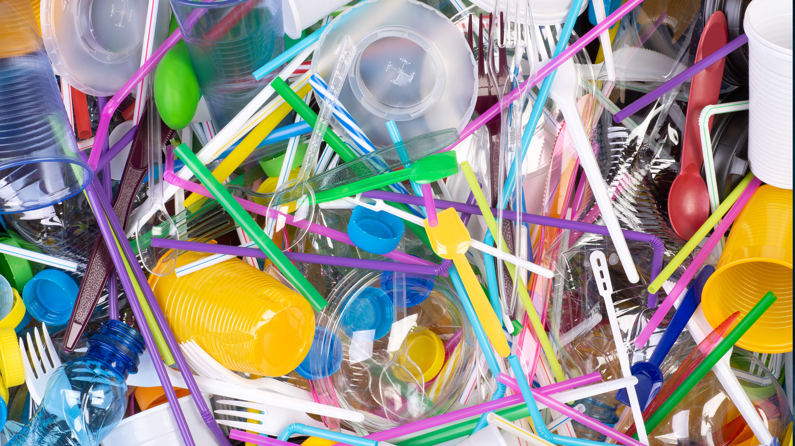
WHEN ARE CONTAINERS EMPTIED?
Bins are emptied once or twice a week
Plastic containers are emptied once every two weeks
Municipal waste is emptied once a week
I think it is enough, because we never have full containers
Notes:
How often are containers emptied?
(Peggy)
Twice a week
Is it enough?
I think so, yeah, it´s quite OK.

Slide 10
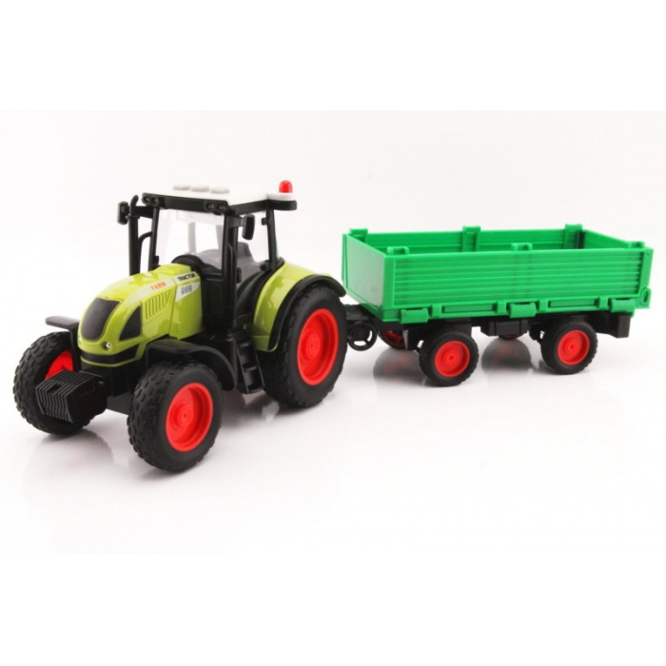
Every second week some men from my village drive a tractor with trailer to pickup plastic bags with plastic waste and then they take them to a collection yard.
Notes:
Markétka…..

Slide 11
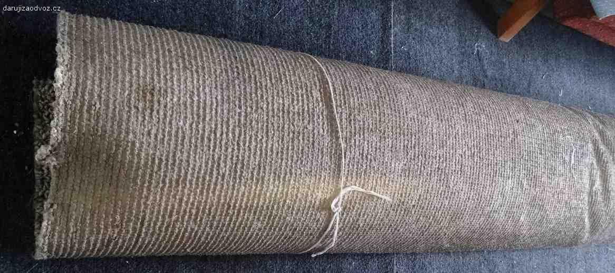
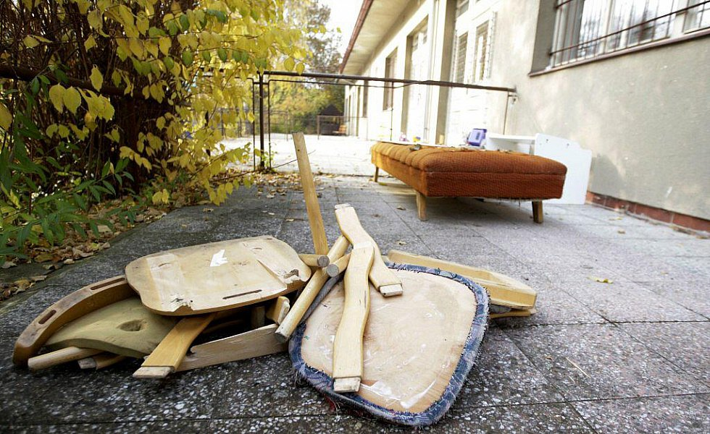
OVERSIZE WASTE
waste that cannot be put into a container and rubbish bins due to its weight and size
for example furniture, carpets, sanitary ware, etc.
therefore, it is transported to a large-volume container and then onto a collection yard
Notes:
I have got an old bike at home and the containers are in front of my block of flats are too small. What should I do?
(Simča) There are two options:
You can either take the oversize waste to recycling centre yourself.
Or a huge container is placed at certain locations around the town, this happens once in the middle of the year.
Wow, I didn’t know that!

Slide 12
THANKS FOR YOUR ATTENTION
Notes:
So, that is all we wanted to talk about. Do you have any questions?
Thanks for your attention!

Slide 13
Information source
https://en.wikipedia.org/wiki/Waste_container
https://en.wikipedia.org/wiki/Upcycling
https://en.wikipedia.org/wiki/Downcycling
https://en.wikipedia.org/wiki/Recycling
https://en.wikipedia.org/wiki/Waste_container
https://www.google.com/search?q=popelnice+recyklace&sxsrf=ALeKk02dxNwrAkQ_2k_ZTlGwWpr7s1cRaQ:1606375980443&source=lnms&tbm=isch&sa=X&ved=2ahUKEwjRlMLt2J_tAhWKxIUKHWZ3BPQQ_AUoAXoECAMQAw&biw=1366&bih=625
https://lh3.googleusercontent.com/proxy/i9n5w_ua2m39vkG3722cGxFAGwKHd9CoQosFATRYj64raRwpq3KEl9-TRJOSXBCWQtMTdKYRb7Q2BDjBlSMnIAKAfJwgbsnAMlLusSLrS4CLjnY0bQFYNOlhipXMBRhurr-nJv9rECycO6IU
https://g.denik.cz/45/3e/ftg_1_ms_kamarad_tepleho_kradez_pce_denik-630-16x9.jpg
https://www.darujizaodvoz.cz/images/com_adsmanager/contents/koberec-3-x-5-m-stary_91196_1.jpg
https://www.ajom.cz/133533-large_default/traktor-s-vleckou-svetelne-a-zvukove-efekty-40cm.jpg
https://www.transpaksro.cz/cosmoshop_cz/pix/a//n/8160051.jpg
https://webunwto.s3.eu-west-1.amazonaws.com/2020-01/plastic.jpg
https://media.istockphoto.com/vectors/vector-recycling-upcycling-and-downcycling-signs-green-reuse-symbols-vector-id1223035466?k=6&m=1223035466&s=170667a&w=0&h=ToMIPe0dCRfFKukEsez2g51GAy_FYCI1nIBIBWlU7cs=
https://technologystudent.com/prddes1/downcyc3.png
https://st3.depositphotos.com/27111398/36566/v/1600/depositphotos_365664484-stock-illustration-downcycling-sign-isolated-white-background.jpg
https://nmcdn.io/e186d21f8c7946a19faed23c3da2f0da/8ed2672177464f2e9b193130d1000c50/files/diy-2804816_1920.jpg
https://youmatter.world/app/uploads/sites/2/2019/11/whats-upcycling-definition.jpg

Slide 14
Information source
https://media.istockphoto.com/vectors/vector-upcycling-sign-green-reuse-symbol-for-ecological-design-zero-vector-id1223035234?b=1&k=6&m=1223035234&s=170667a&h=eD-Jeg8X5GEjyNygiSETUEUmY2bp-EK9cmpmutQ8Jjc=
https://www.mevatec.cz/fotky2340/fotos/_vyrn_36140005-5bio.jpg
https://lh3.googleusercontent.com/proxy/i9n5w_ua2m39vkG3722cGxFAGwKHd9CoQosFATRYj64raRwpq3KEl9-TRJOSXBCWQtMTdKYRb7Q2BDjBlSMnIAKAfJwgbsnAMlLusSLrS4CLjnY0bQFYNOlhipXMBRhurr-nJv9rECycO6IU
https://www.praha9.cz/sites/default/files/styles/350x250/public/popelnice-plastova-240l-meva-cervena_final.jpg?itok=--kvxzSK
https://katalog.ambra.cz/kontejner-na-plasty-1100-l-bez-zamku-kulate-viko-img-5040086100074-fd-2.png
https://cdn.myshoptet.com/usr/www.dopner.cz/user/shop/big/381-1_2-1-sklo.jpg?5cd46c44
https://jaktridit.cz/uploads/images/Gallery/fotogalerie/papir/kontejnery/Kontejner-papir.jpg
https://www.novinyvm.cz/obr/nvm/202004/17463.png
https://lh3.googleusercontent.com/proxy/NmCUiE-jsYFJqhdhJ2l-cIzs4dXD8s9pmq1WpRMceUk6jVXpWsjBfO0wd9PygfhYP5aaUnL29frEuDwqwCI
https://old.samosebou.cz/img/cyklustv/glass/stats-package.png
https://www.google.com/url?sa=i&url=https%3A%2F%2Fwww.blesk.cz%2Fclanek%2Fzpravy-svet%2F583179%2Fk-cemu-je-vedcum-zmackany-papir-muze-pomoci-pochopit-tvorbu-dna-tvrdi-fyzik.html&psig=AOvVaw1VFxiXFTNg6GxIj07CbWT0&ust=1607156826341000&source=images&cd=vfe&ved=0CAIQjRxqFwoTCLihkfDzs-0CFQAAAAAdAAAAABAE
https://www.praha.eu/public/14/a/2e/2023330_579597_bioodpad_popelnice.jpg
https://s3.amazonaws.com/pix.iemoji.com/images/emoji/apple/ios-12/256/smiling-face-with-smiling-eyes.png

