Slide 1





Recycling system in our town.
Abarán (Spain)
ERASMUS+
“HAPPY, HEALTHY, WISE AND WEALTHY”
Candela Gómez Giménez
Jimena García Molina
Iván Jesús Tenepaguay Cueva
Pablo Ríos Carrasco
Gabriel Sebastian Nuñez Zambrano.
IES. Villa de Abarán (Spain)

Slide 2

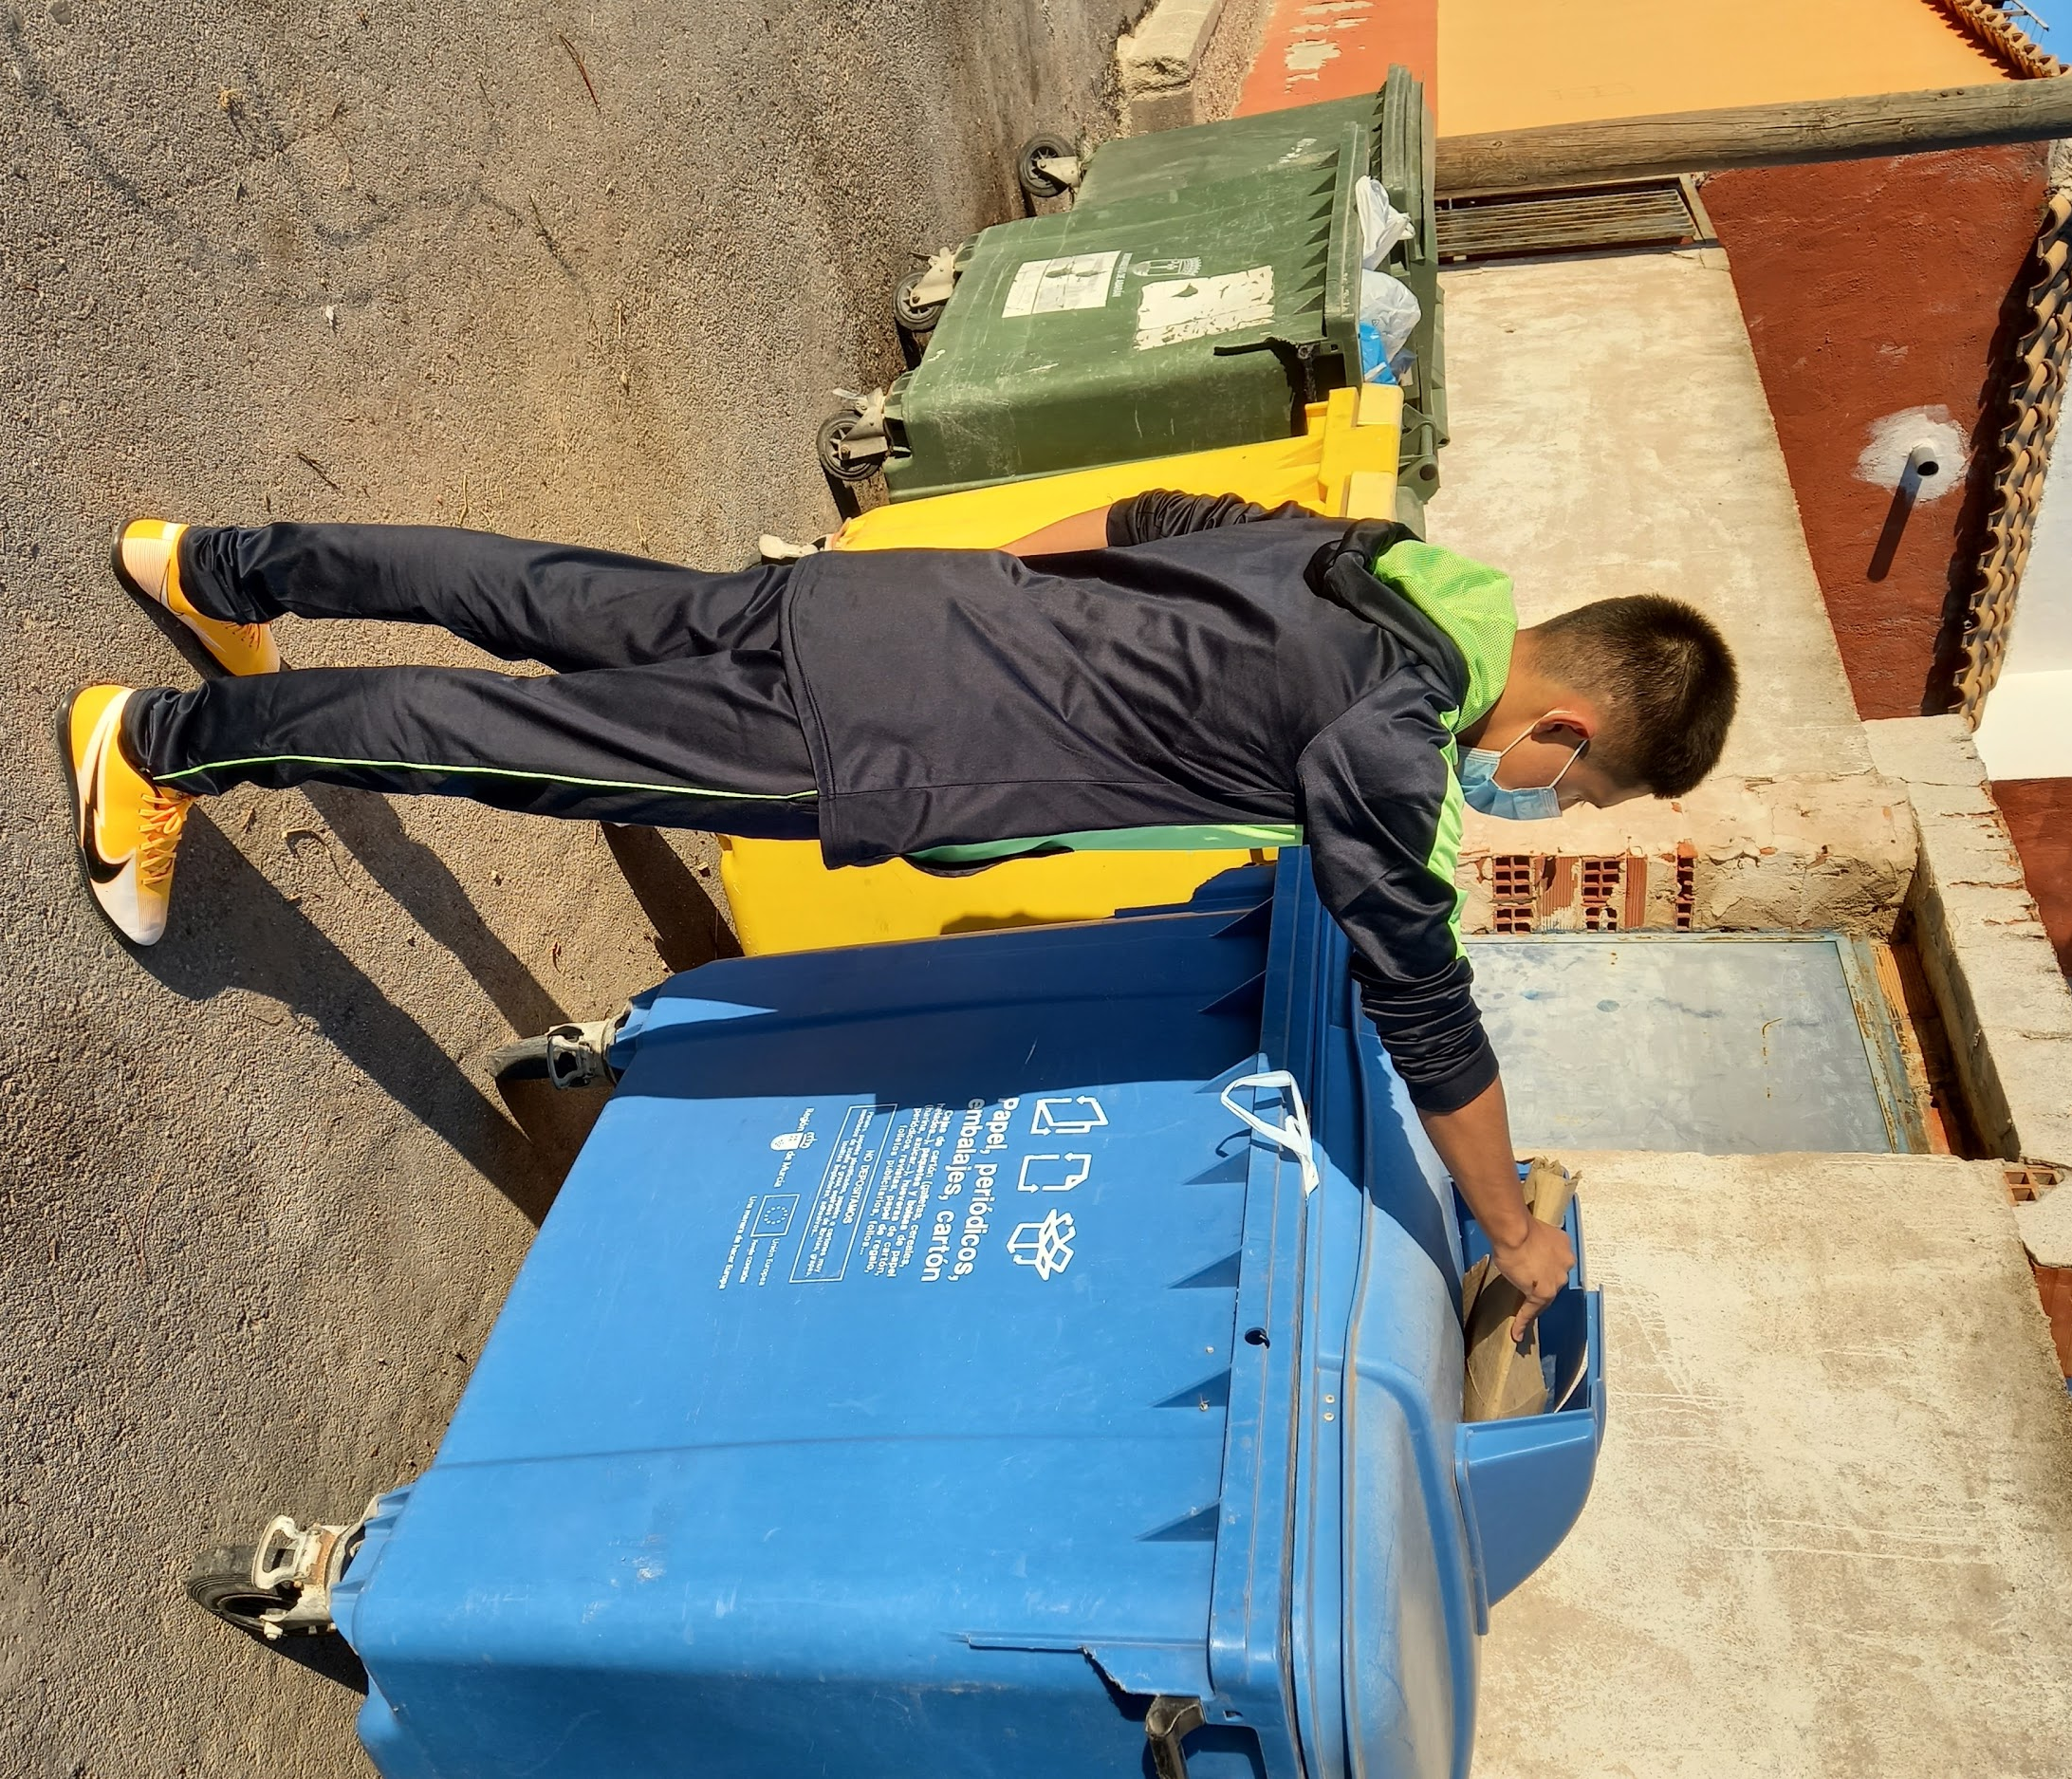
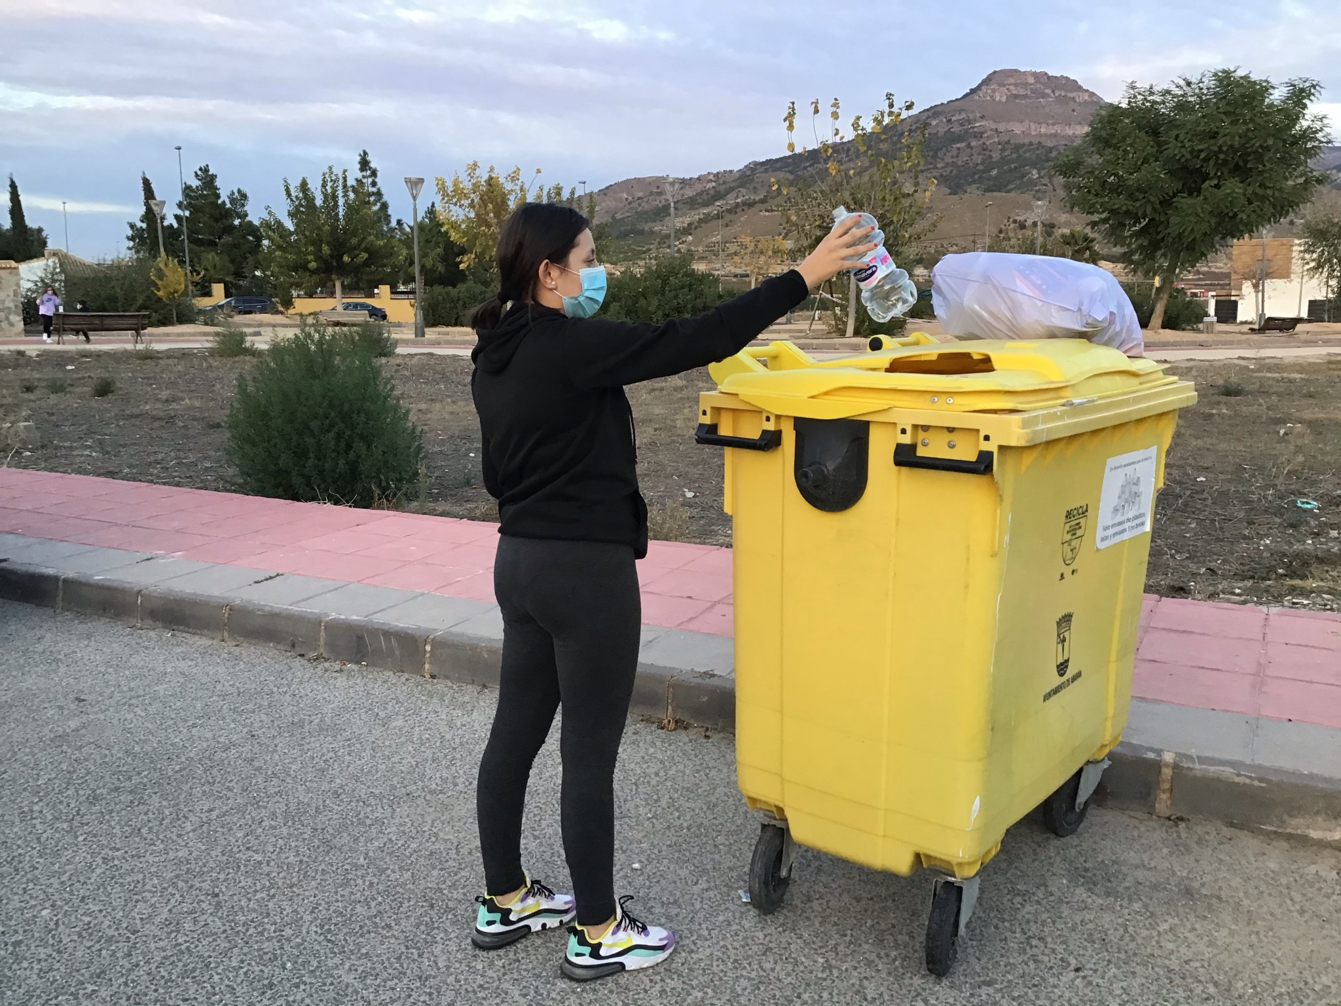
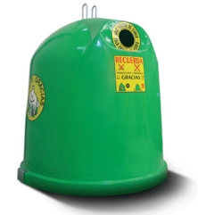
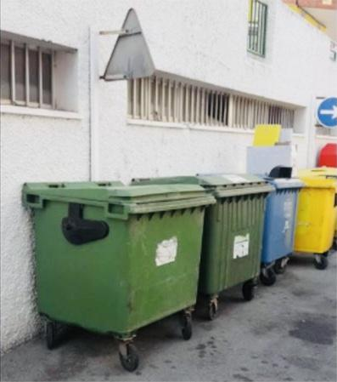
Recycling containers
On the street of Abarán we have four differents containers where we throw residues. Here are the examples:
The blue container that is for paper and paperboard.
The yellow container that is for plastic, tins and bricks.
The dark green that is for organics waste.
The igloo green is for glass (bottles, jars...)

Slide 3
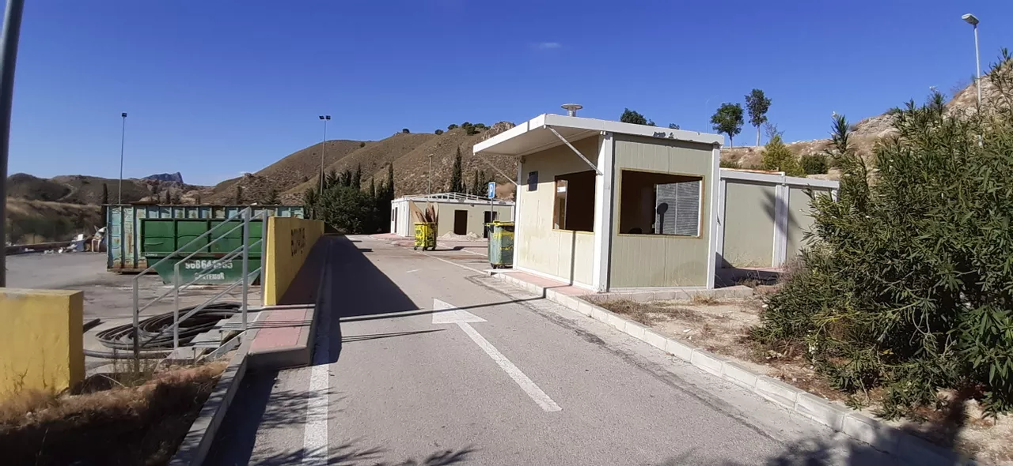
Ecopark
There is an eco-park near Abaran (1 Km), in which we can throw some things that could not be thrown into a normal container like a door, sofa, computer, lamp ...
People have to go with their car to deposit them, but the local government has a garbage collection plan as well.

Slide 4
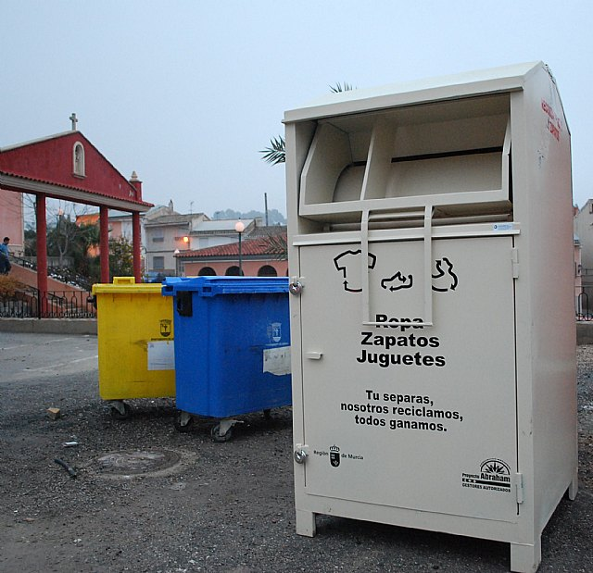
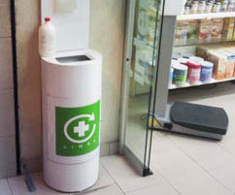
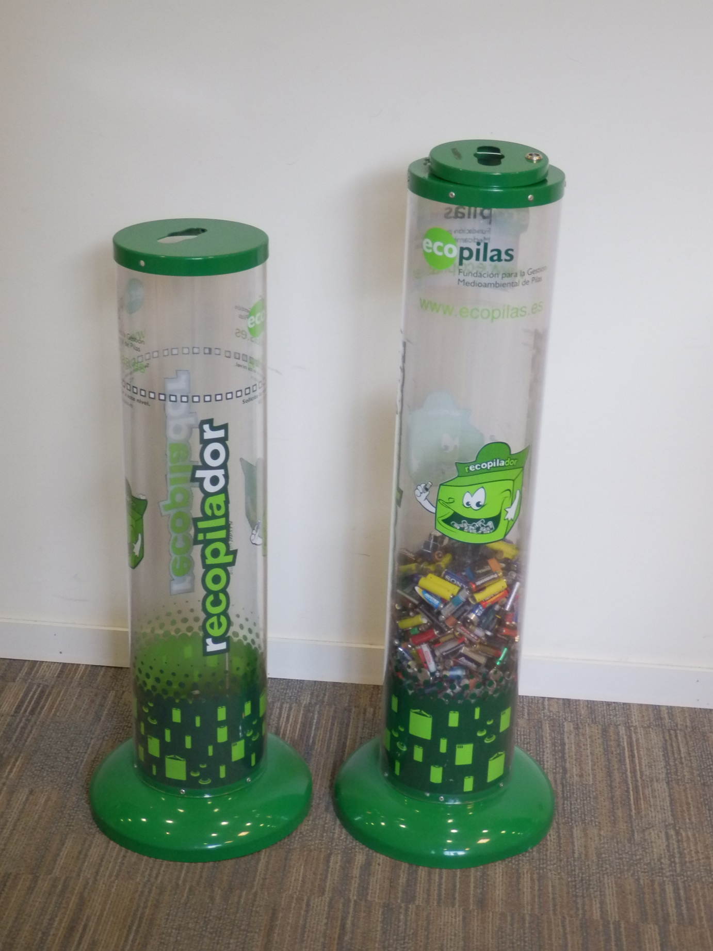
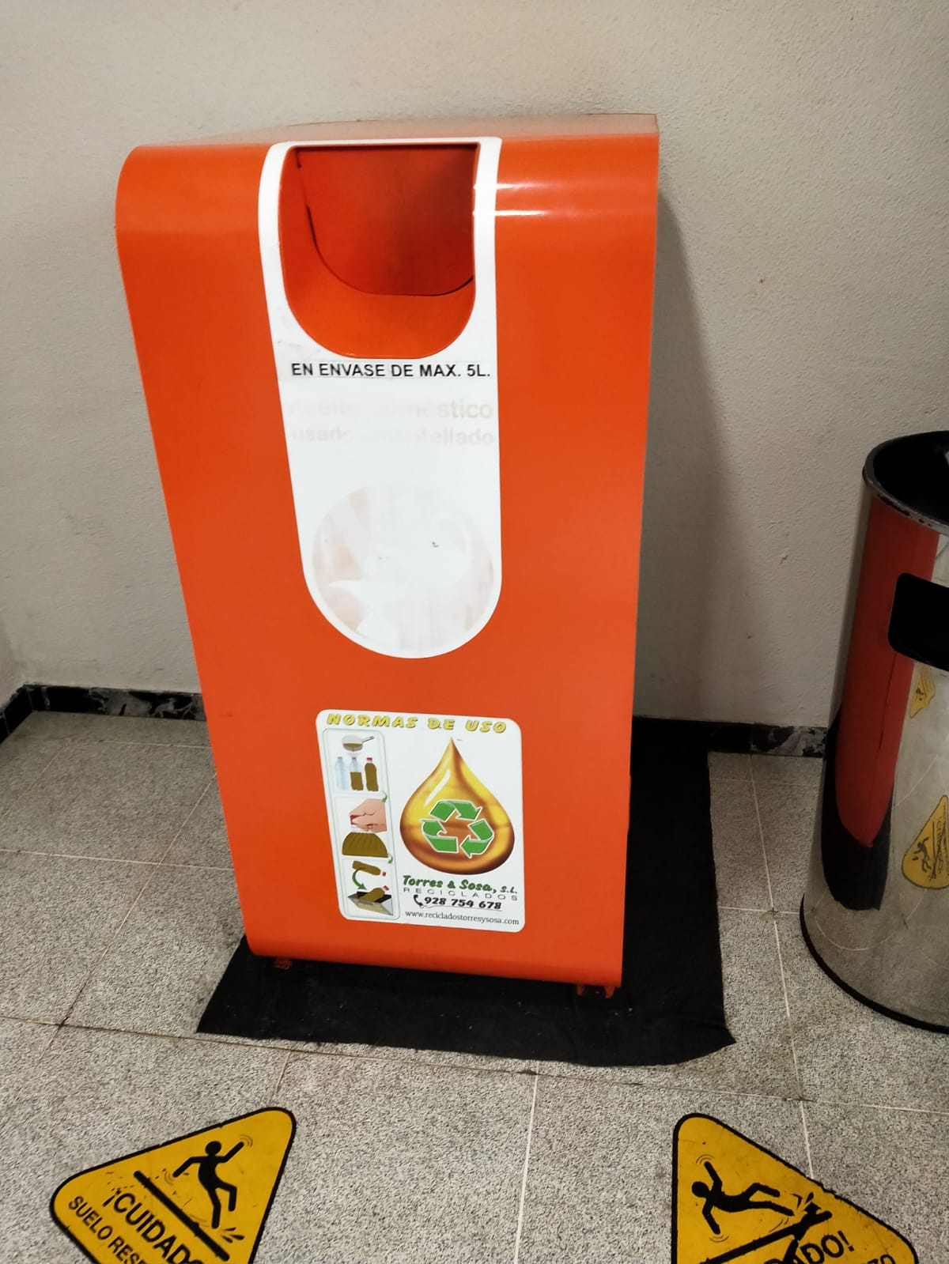
Other recycling bins
In addition to the Ecopark, we have other types of special containers for storing medicines, clothes, used cooking oils or batteries.
Normally, these containers are not on the street. They are usually found in stores.
Medicines
Batteries
Cooking oil
Clothes, shoes, ...

Slide 5
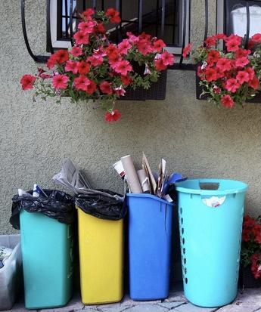
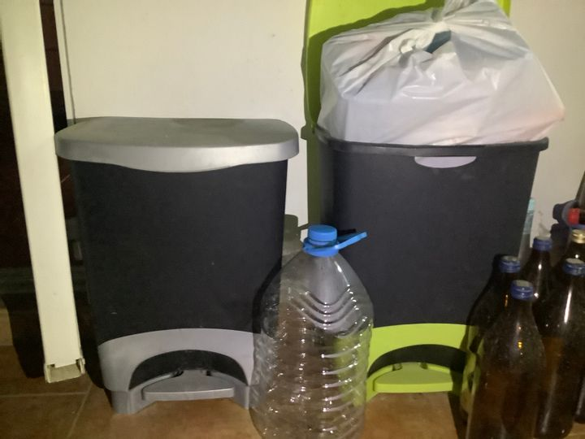
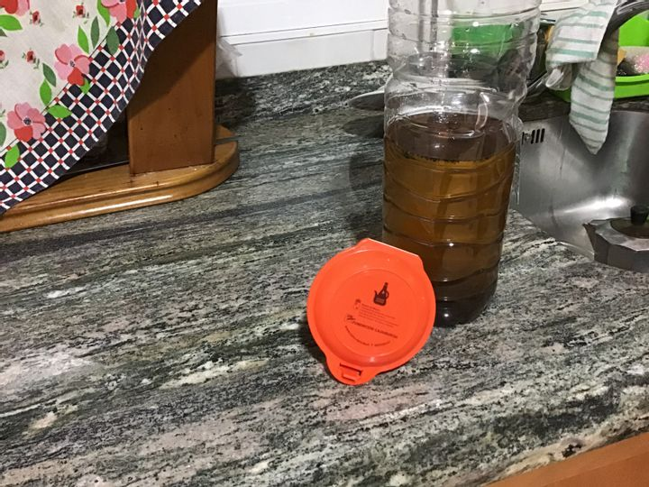
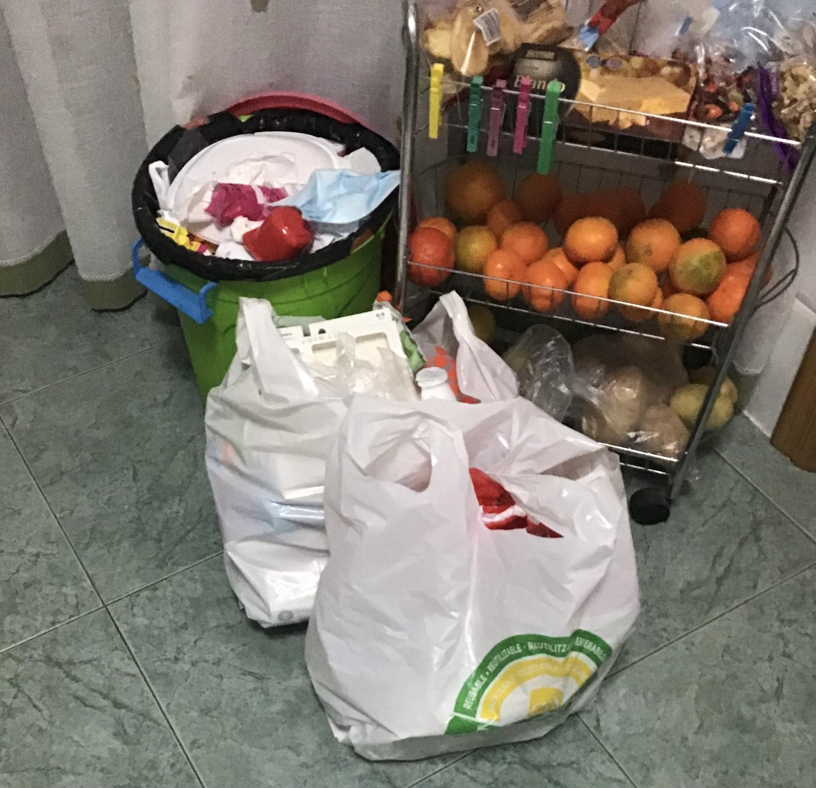
Recycling at home
The number of containers at home depends on the recycling commitment that each family has. That is why we find houses in which there can be up to 7 and 8 different containers or bags to separate.
Organic, glass, plastics, paper and cardboard are the most common.
But there exist more: medicines,batteries, oil and some objects for the Ecopark.

Slide 6
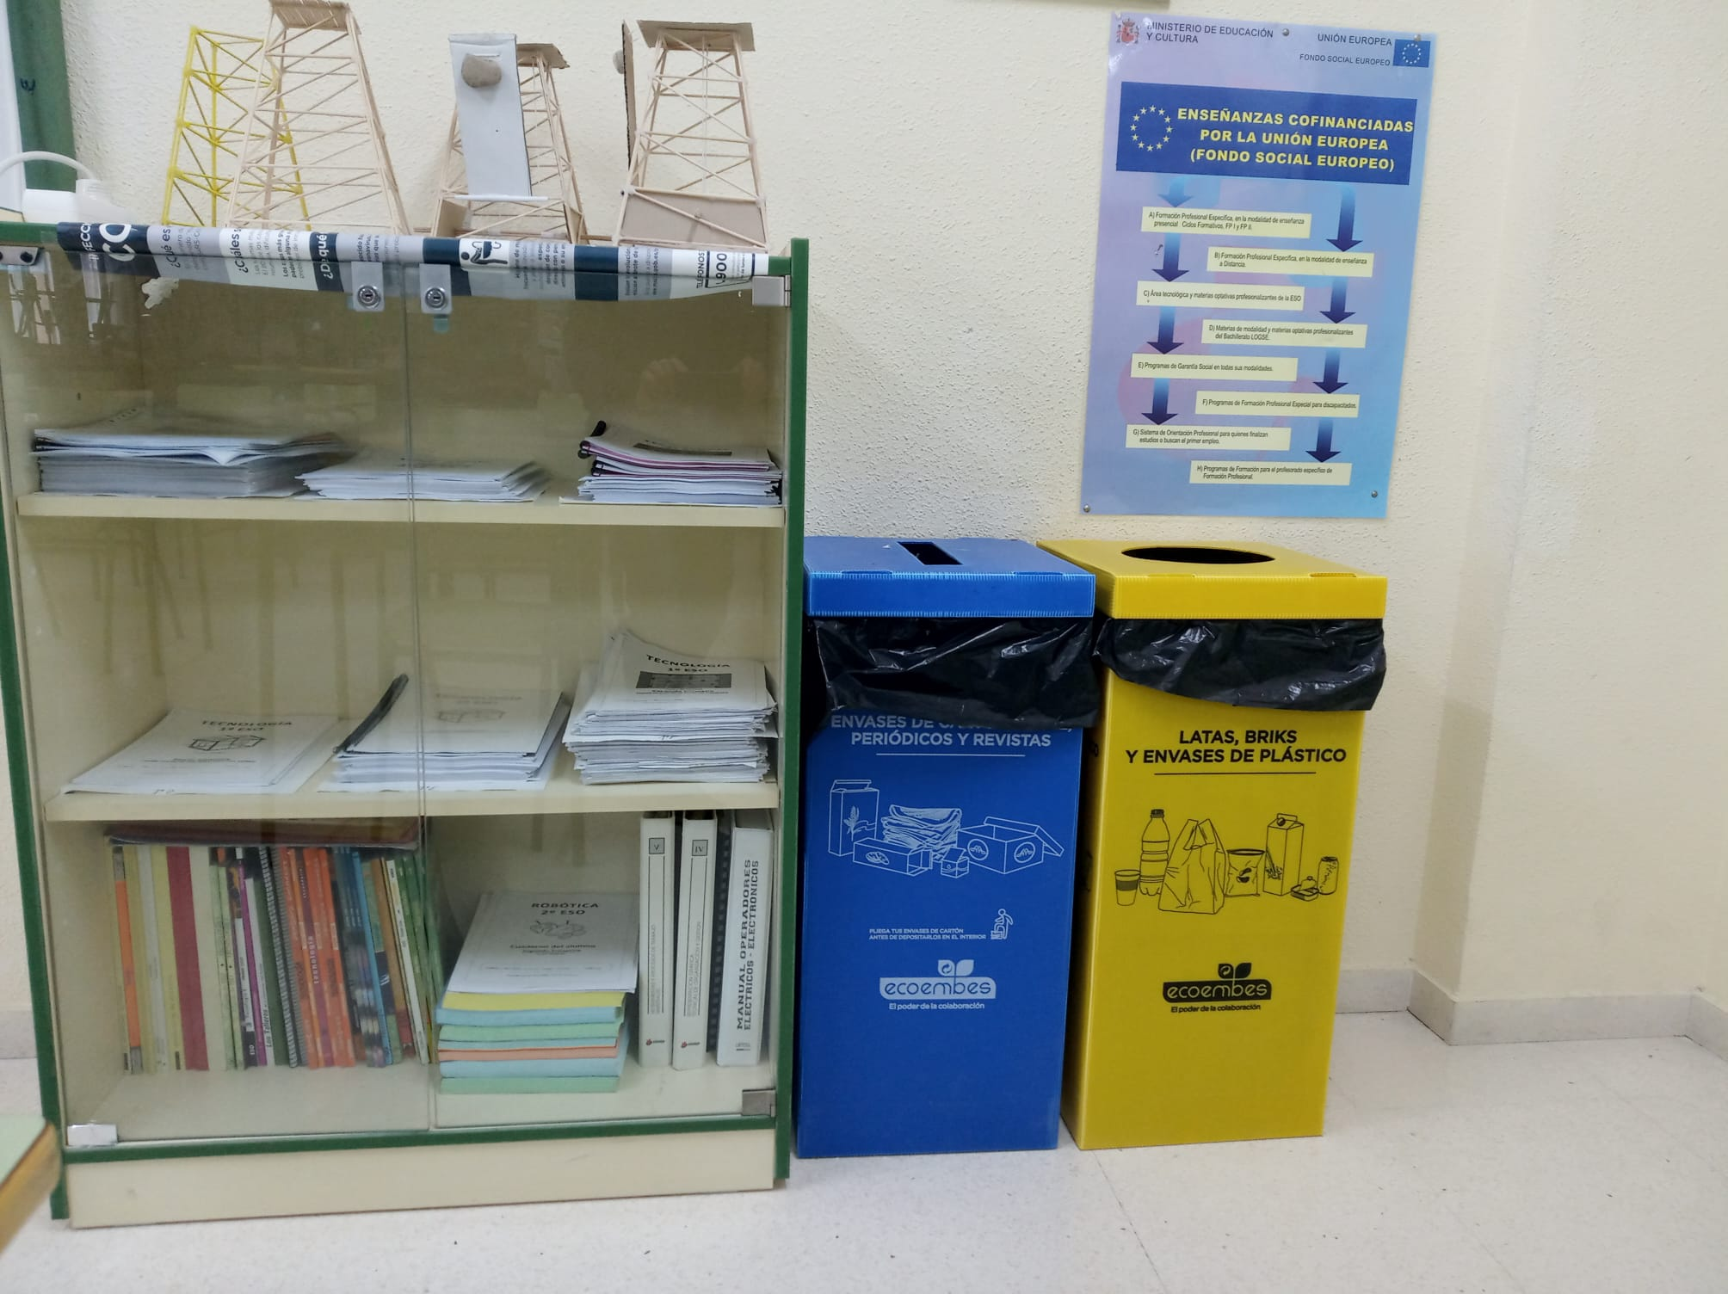
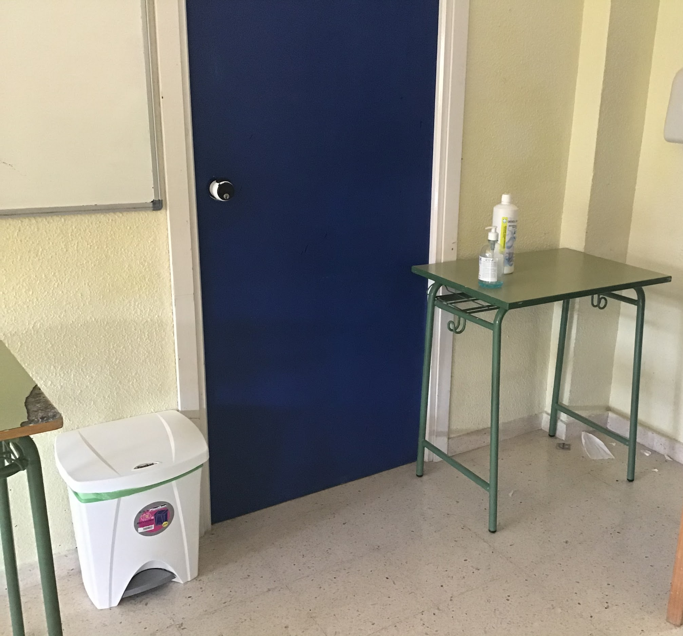
Recycling in IES
In our secondary school we don’t recycle a lot.
We only have 3 different containers and we don't have all of them in all classrooms. There are 3 containers: blue, yellow and a general bin.
It is for paper and cardboard and we have one of this in some the classes.
It is for plastic, bricks and tins. We have one of this in some classes too.
General bin: in this one we throw food, foil, soda cans…

Slide 7
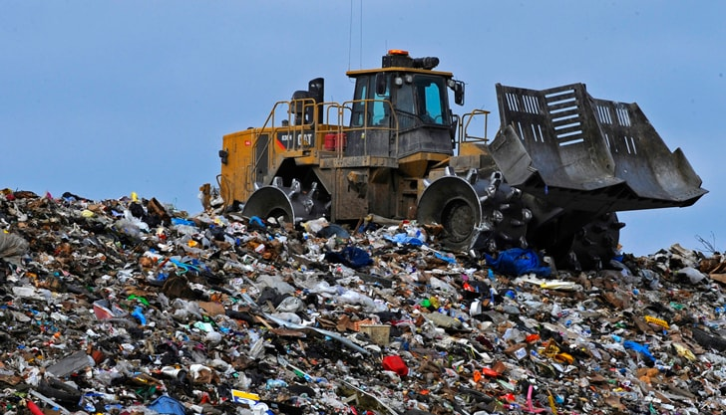
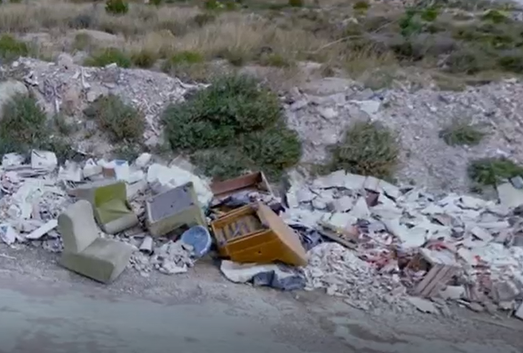
Some problems
The biggest problem of our recycling system is that it’s not very efficient. The result is that a large part of the waste is not recycled and ends up in large landfills. In our region there are several of these landfills
Other problems are:
Lack of information: incorrect use of recycling containers (waste mix, ...)
Lack of awareness: abandonment of waste outside containers (causing pollution problems)

Slide 8

Recycling Waste in Households in Spain Questionnaire
RESULTS

Slide 9
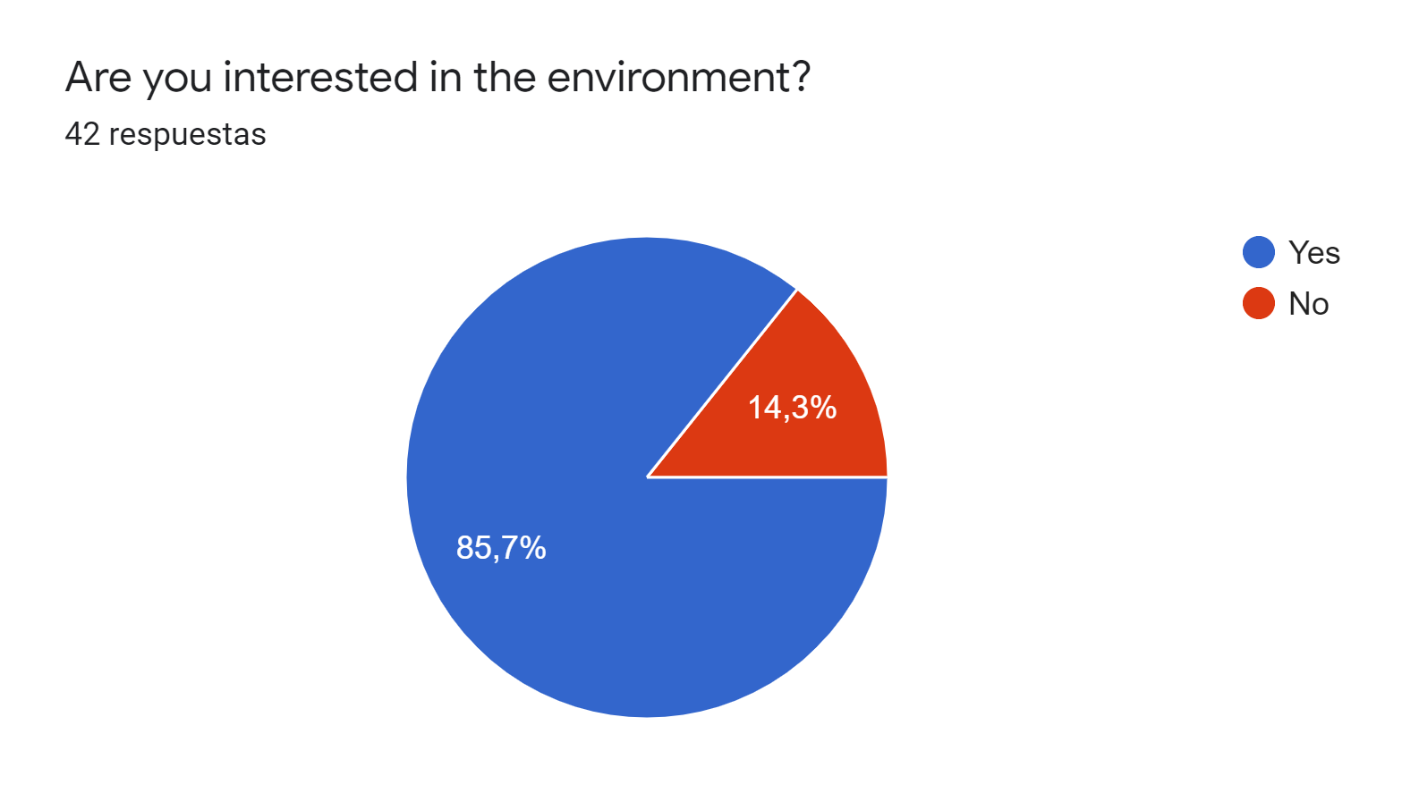
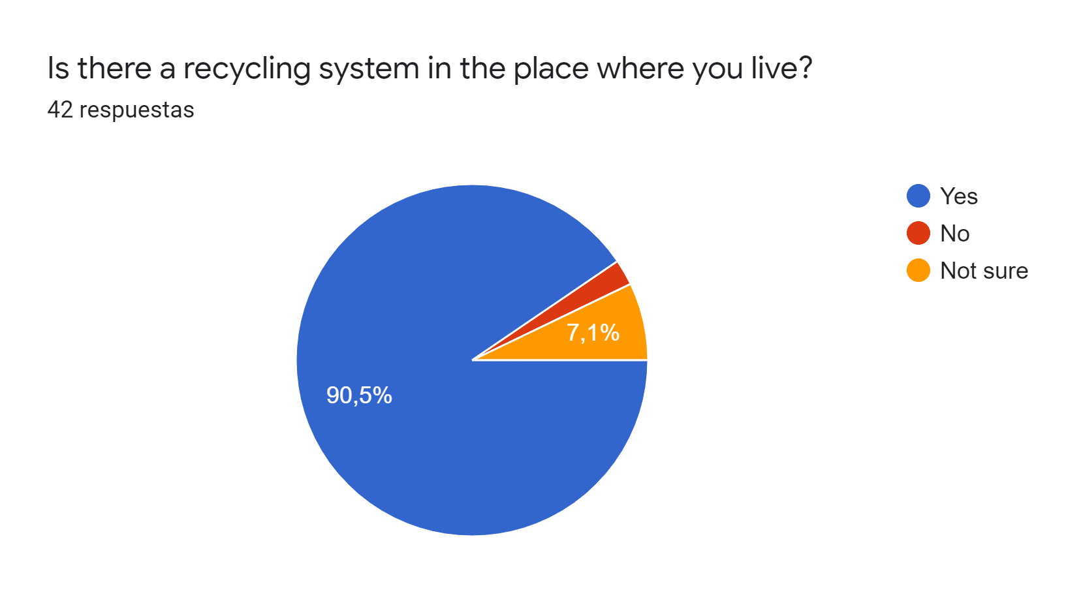

Slide 10
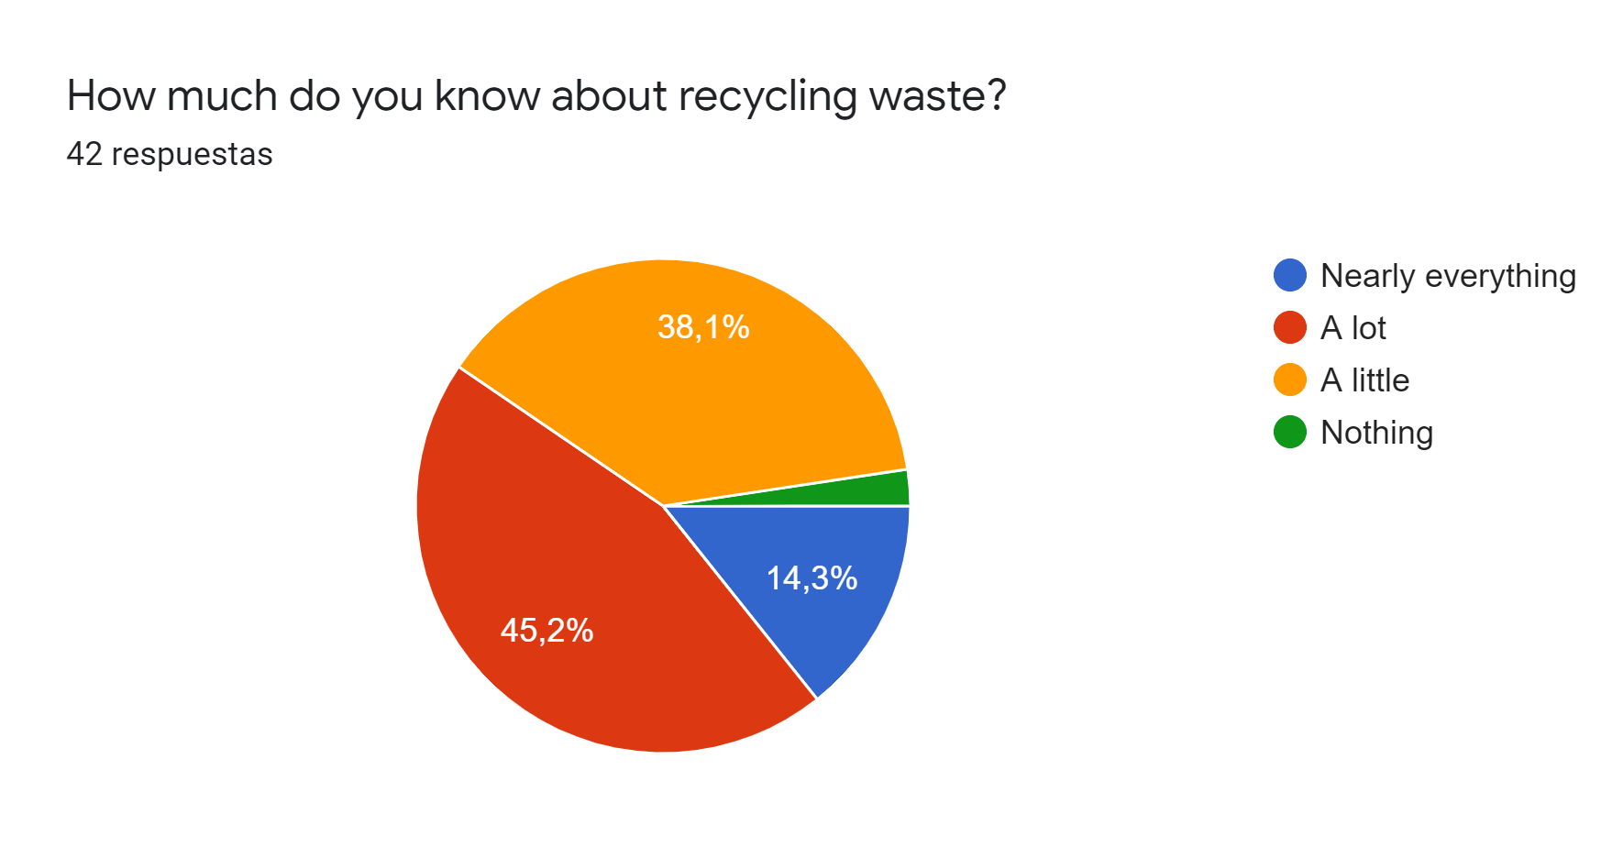
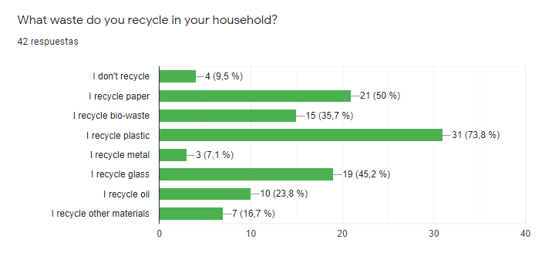
Other materials: batteries, clothes,..

Slide 11
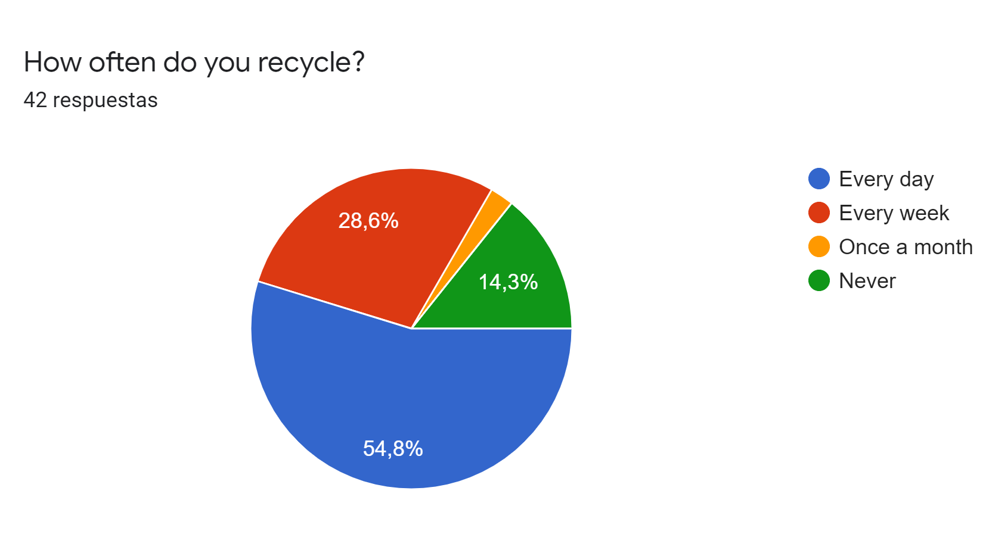
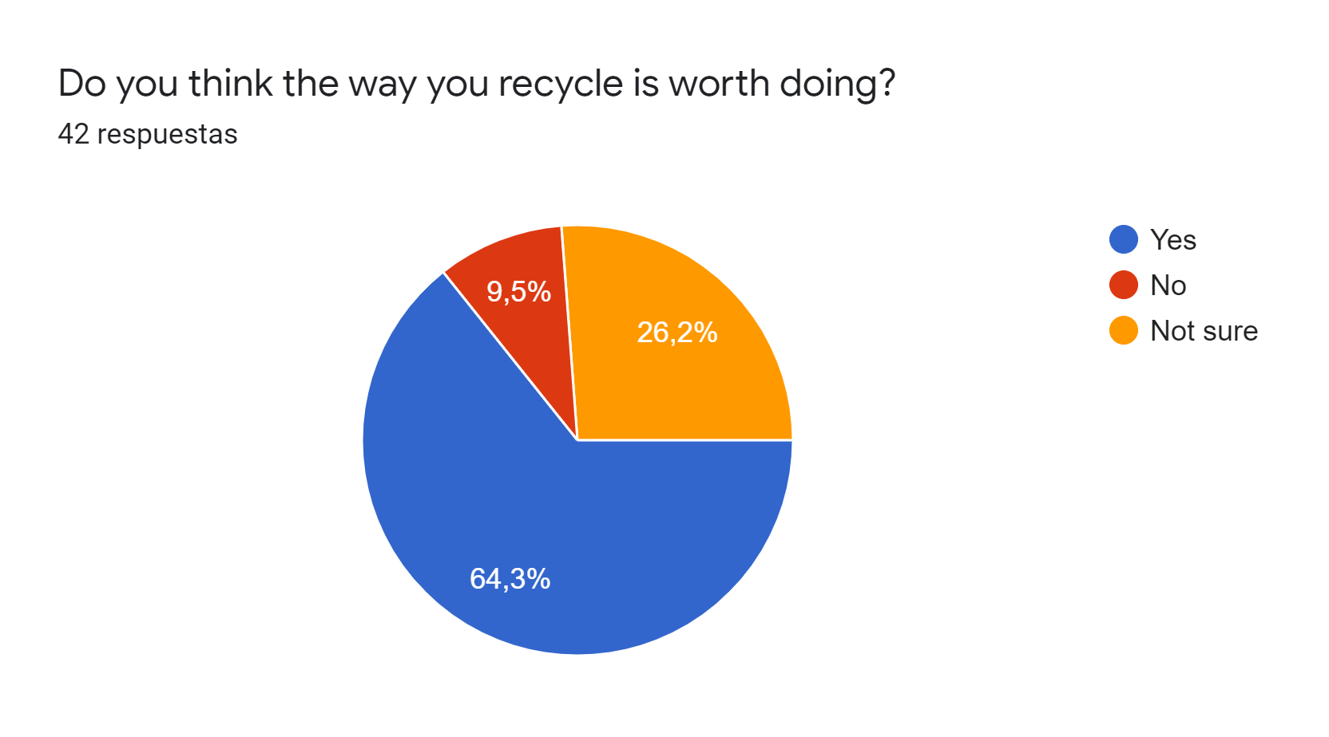
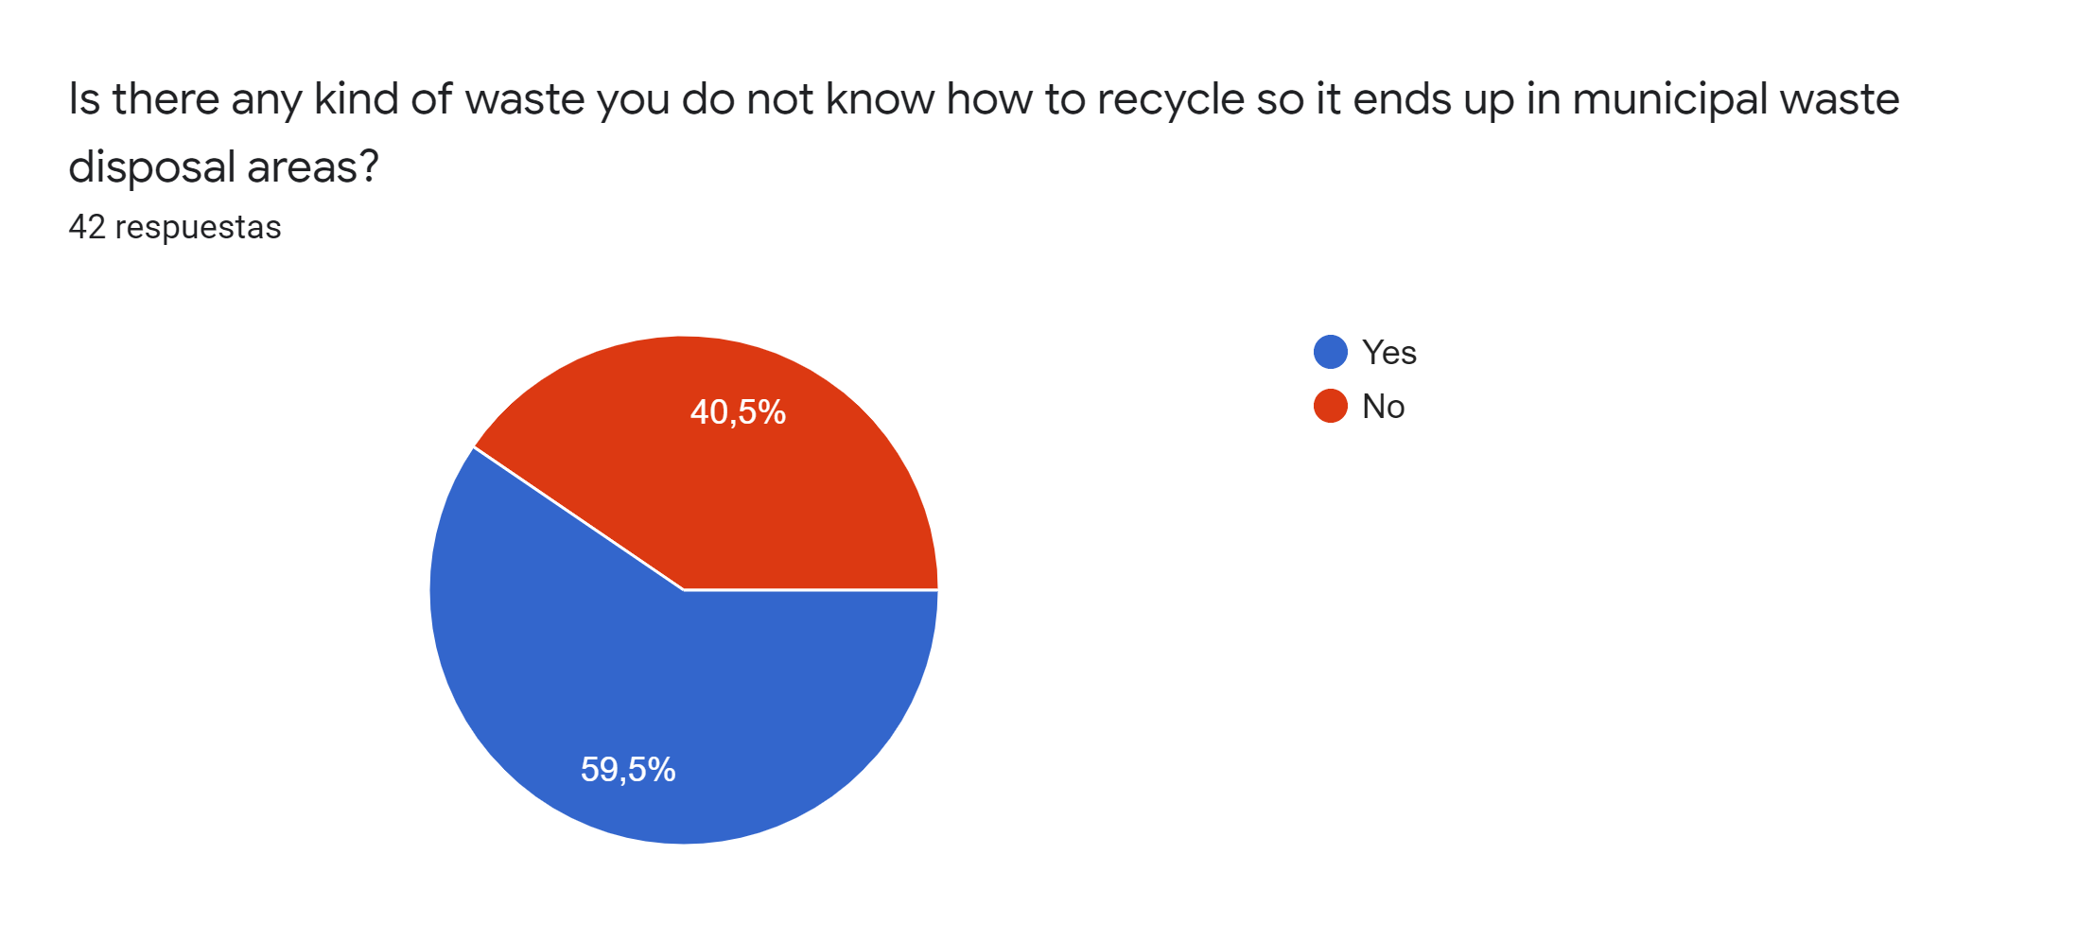
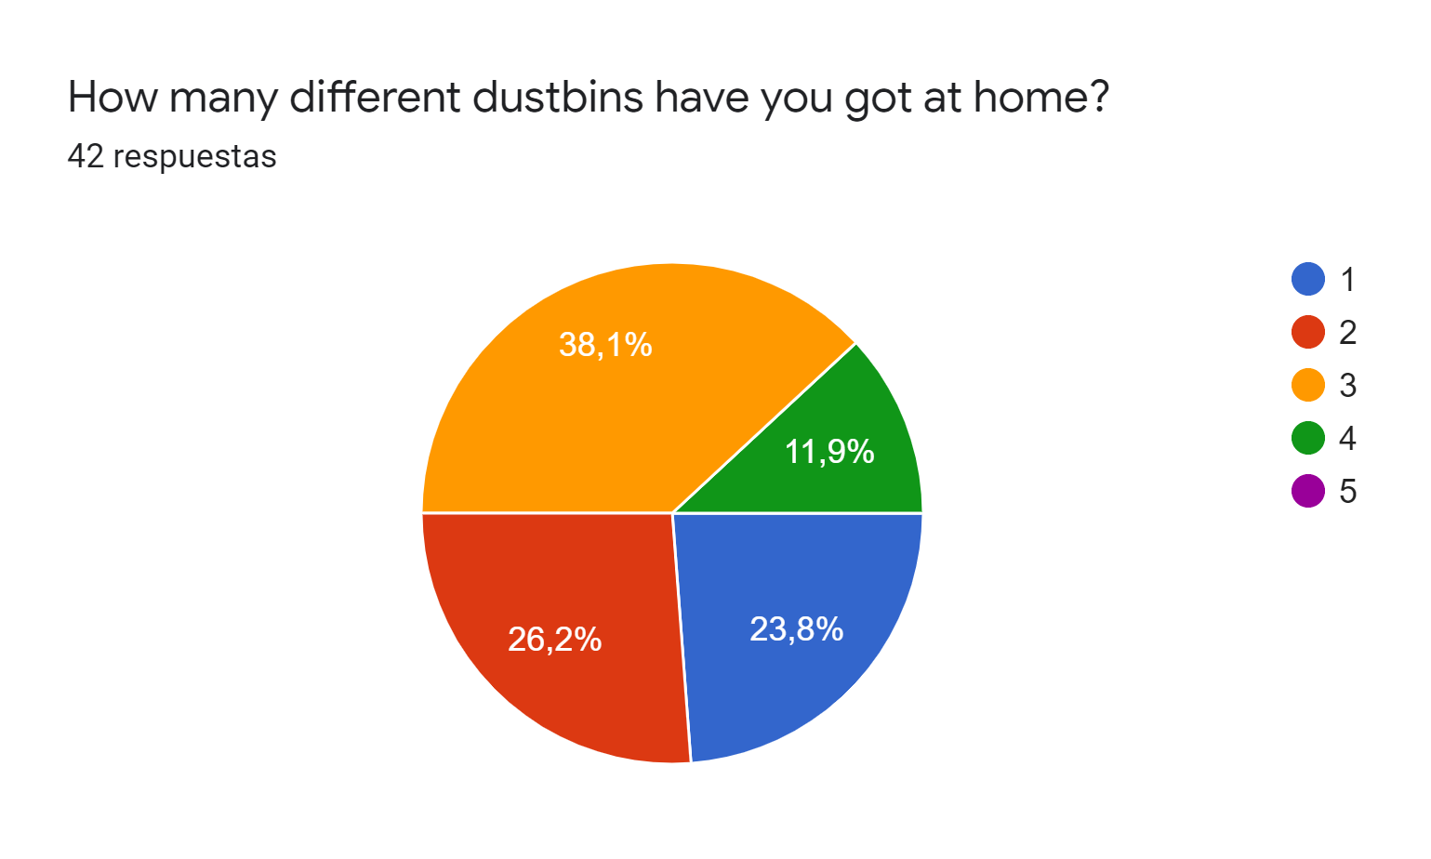

Slide 12
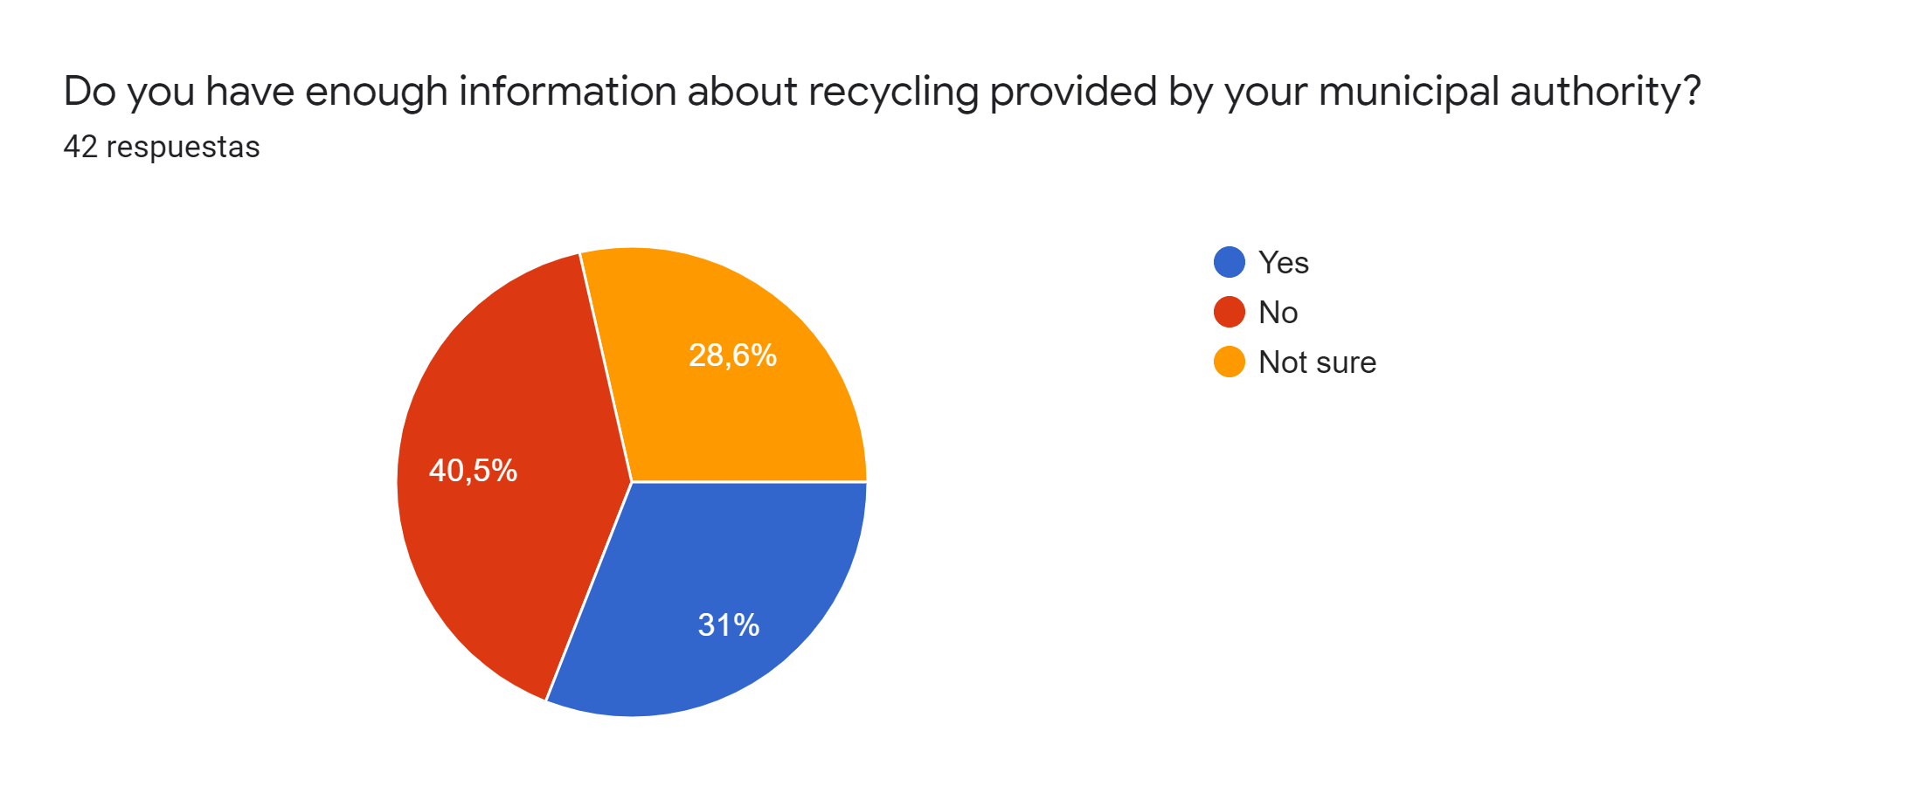
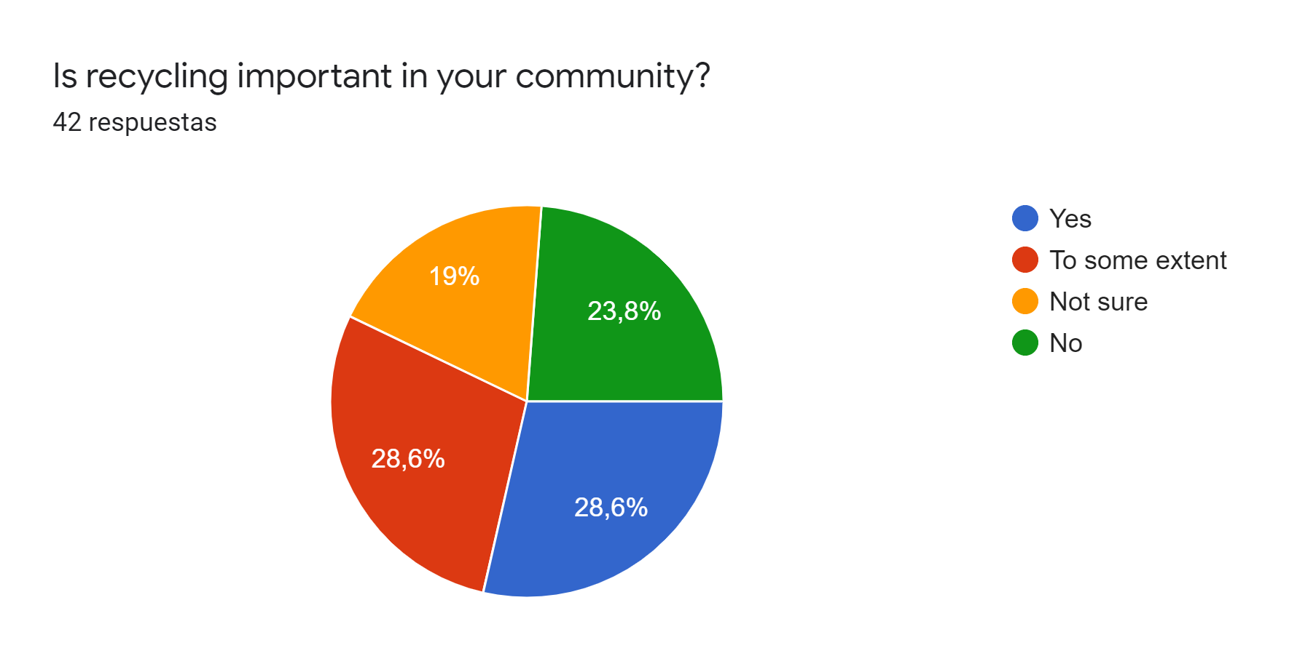
What prevents you from recycling the most?
Lack of containers
Have more information
Lack of space at home for cubes
What would help you to recycle more efficiently?
More bins or containers
More special containers (oil, batteries, ...)
More information and awareness campaigns

Slide 13

Thanks for your attention

