Slide 1
Food chain
peaches and apricots
ERASMUS+ “Happy, Healthy, Wise and Wealthy”
Pupils (Spain):
Salma Boukhart Boutayb
Pablo Gil Moreno
Javier Carrasco Gómez
Arturo Sánchez Juliá
Diego García Torres

Slide 2
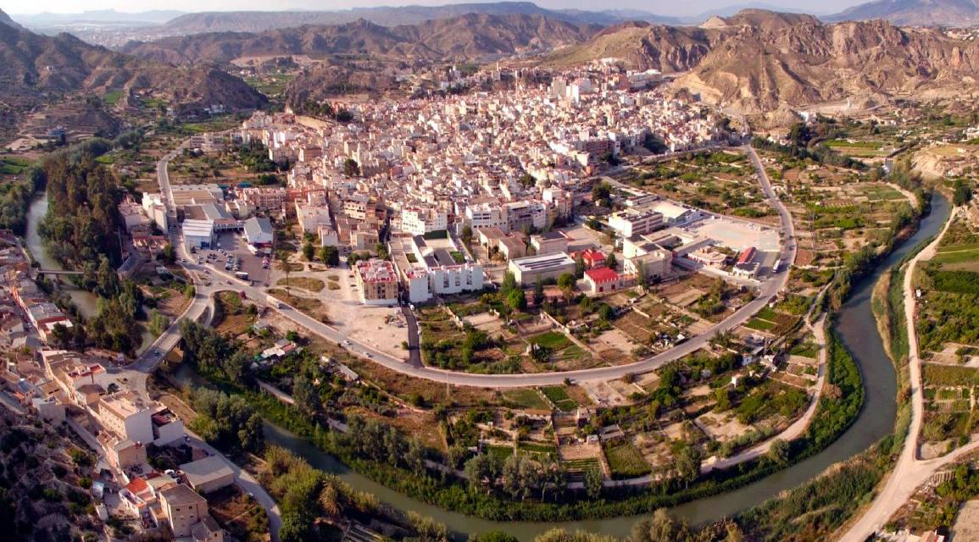
ORIGIN
Abaran is an agricultural town that meets great conditions to grow fruits.
We are known as the orchard of Europe. Apricots, peaches, grapes, lemons tomatoes, artichokes and so on can be found everywhere.
That’s why we have chosen for our presentation two of the most traditional products: peaches and apricots
A meander of river Segura bordering Abarán

Slide 3
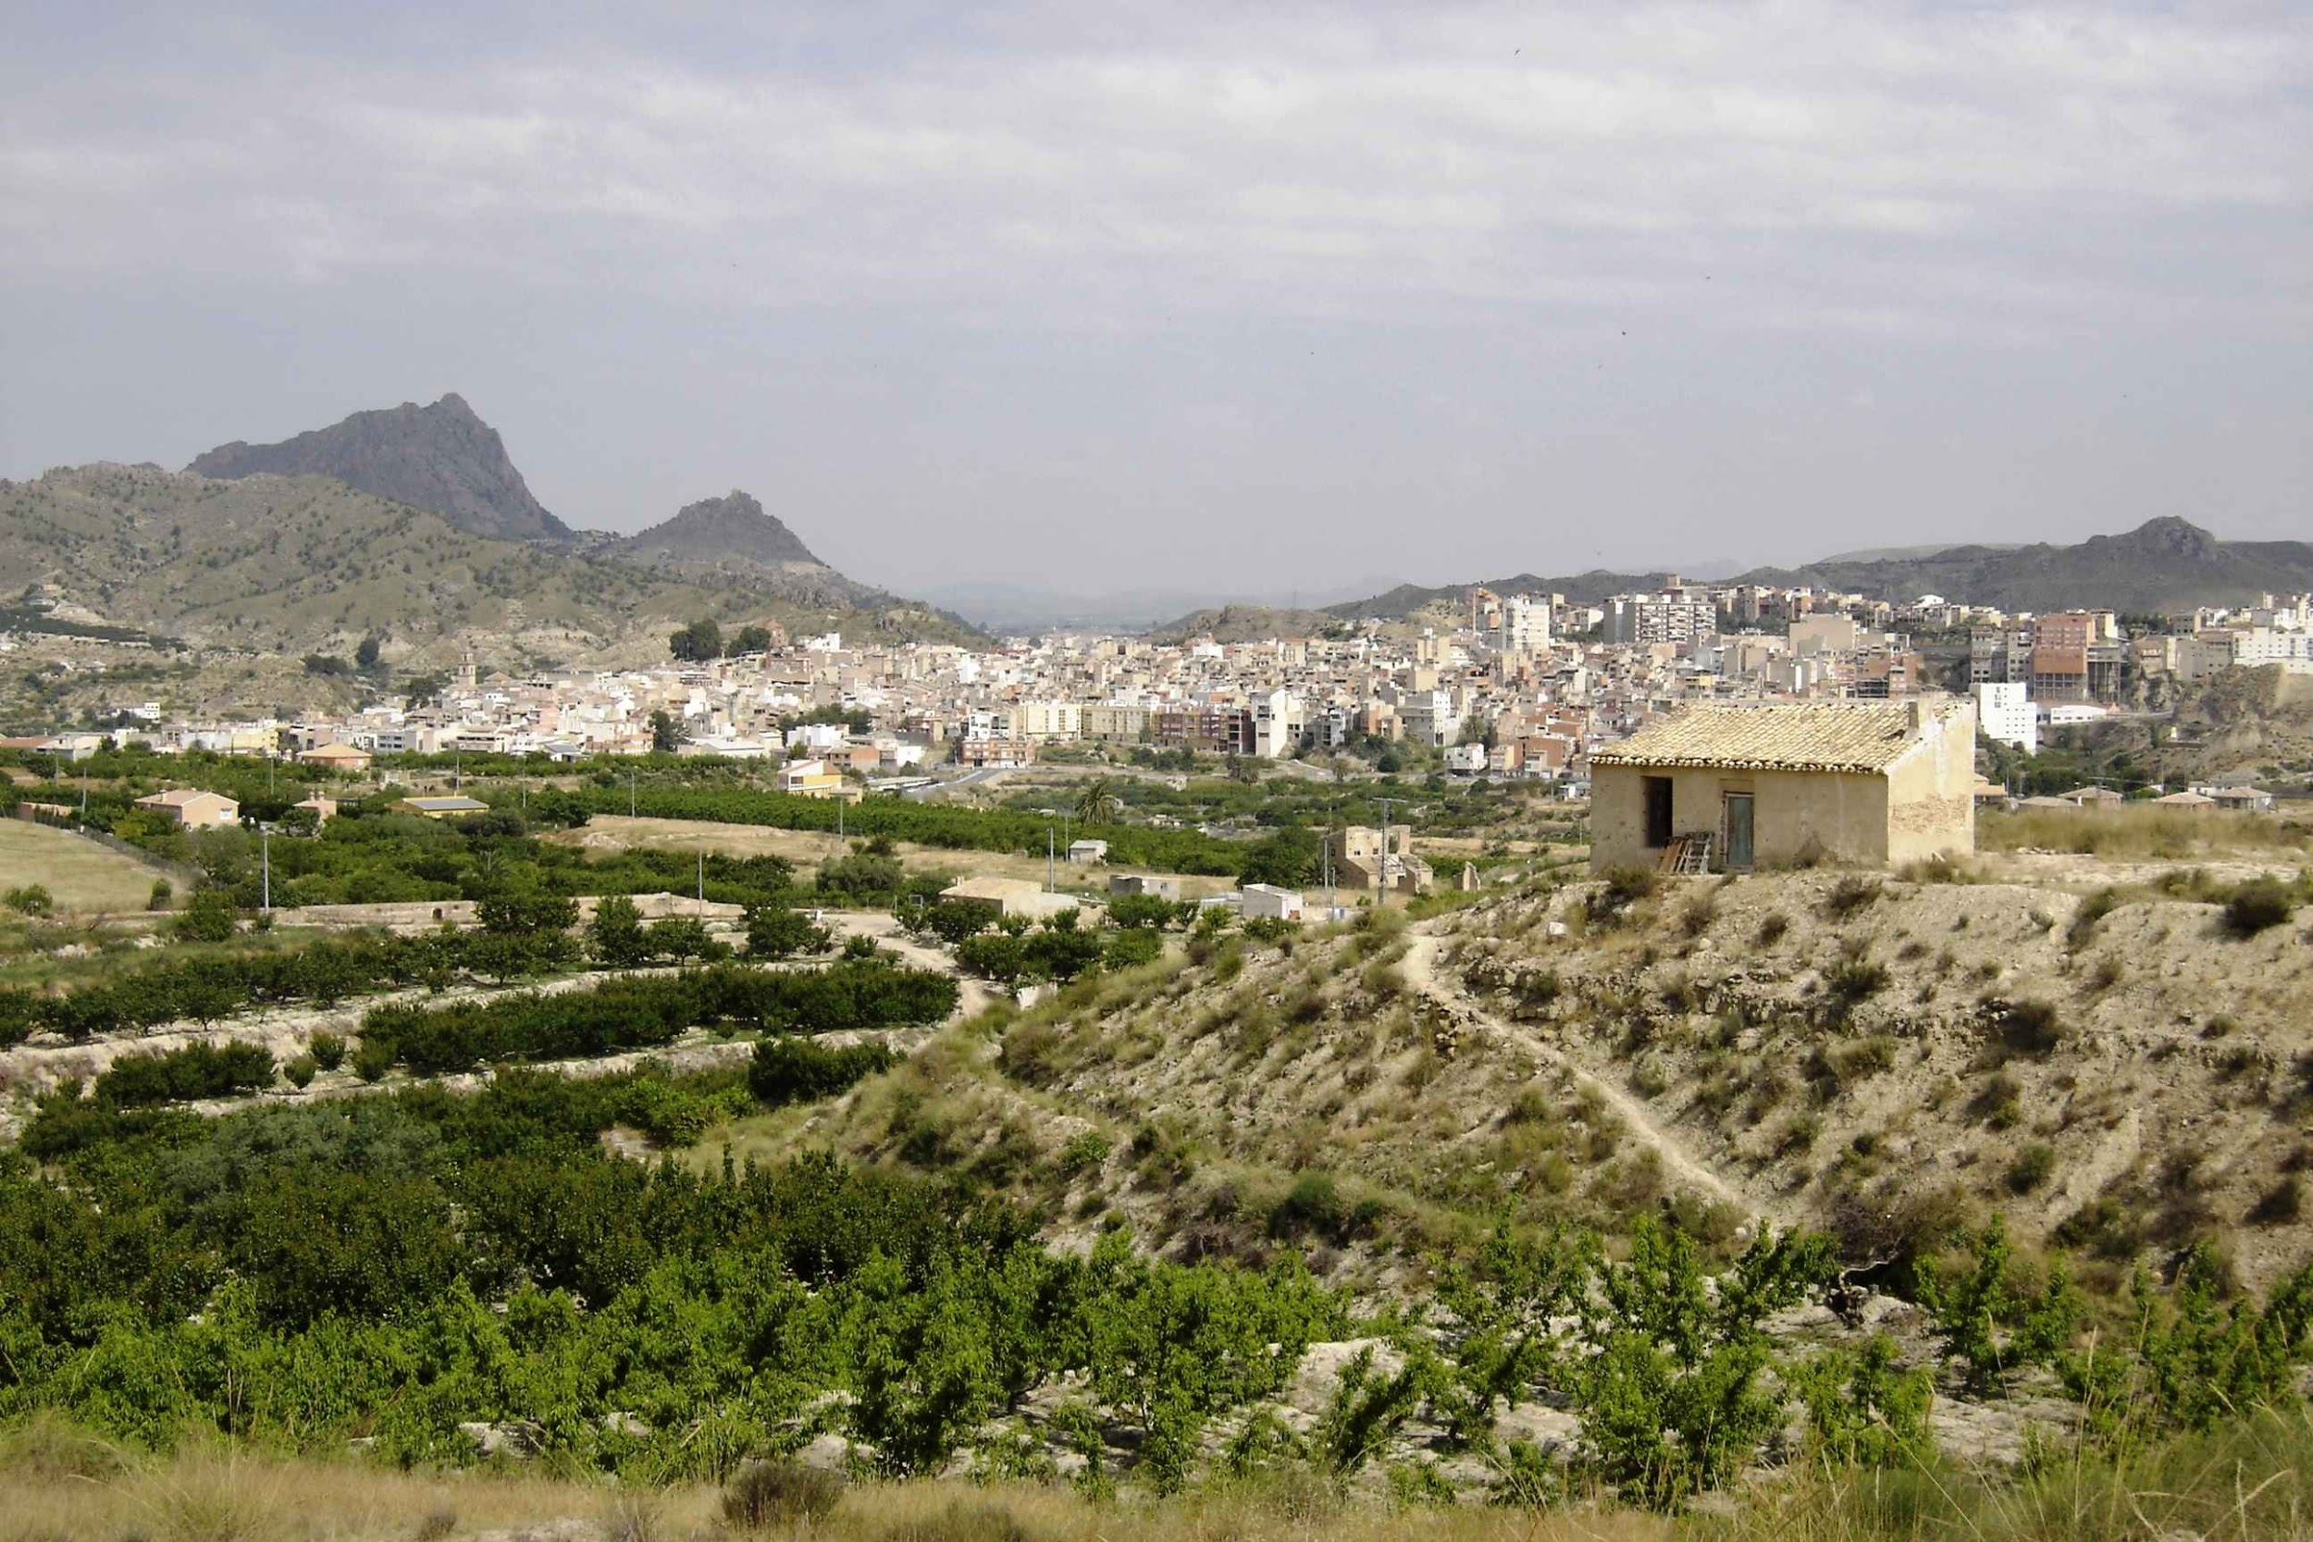
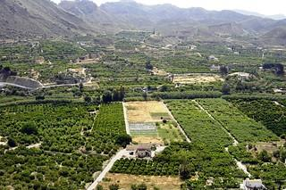
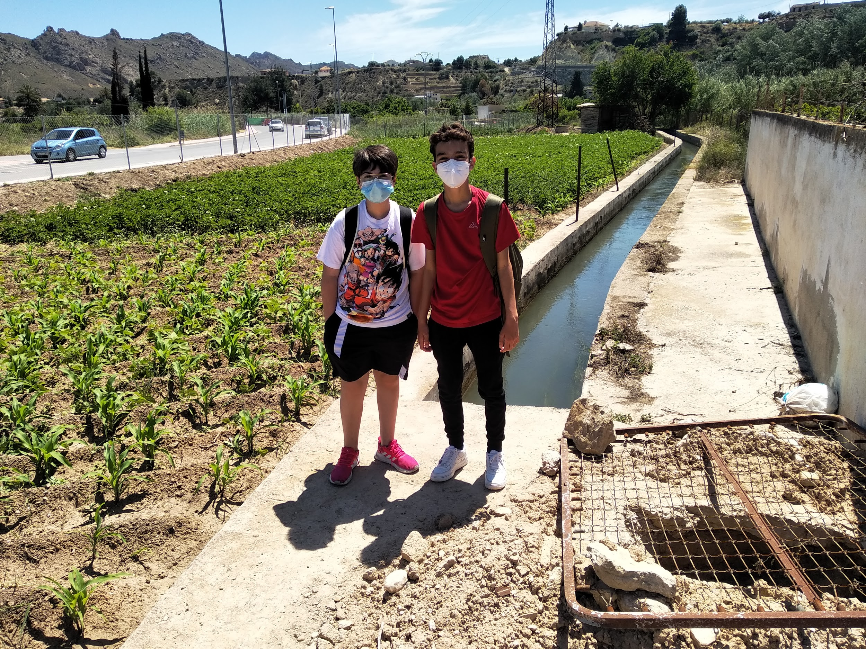
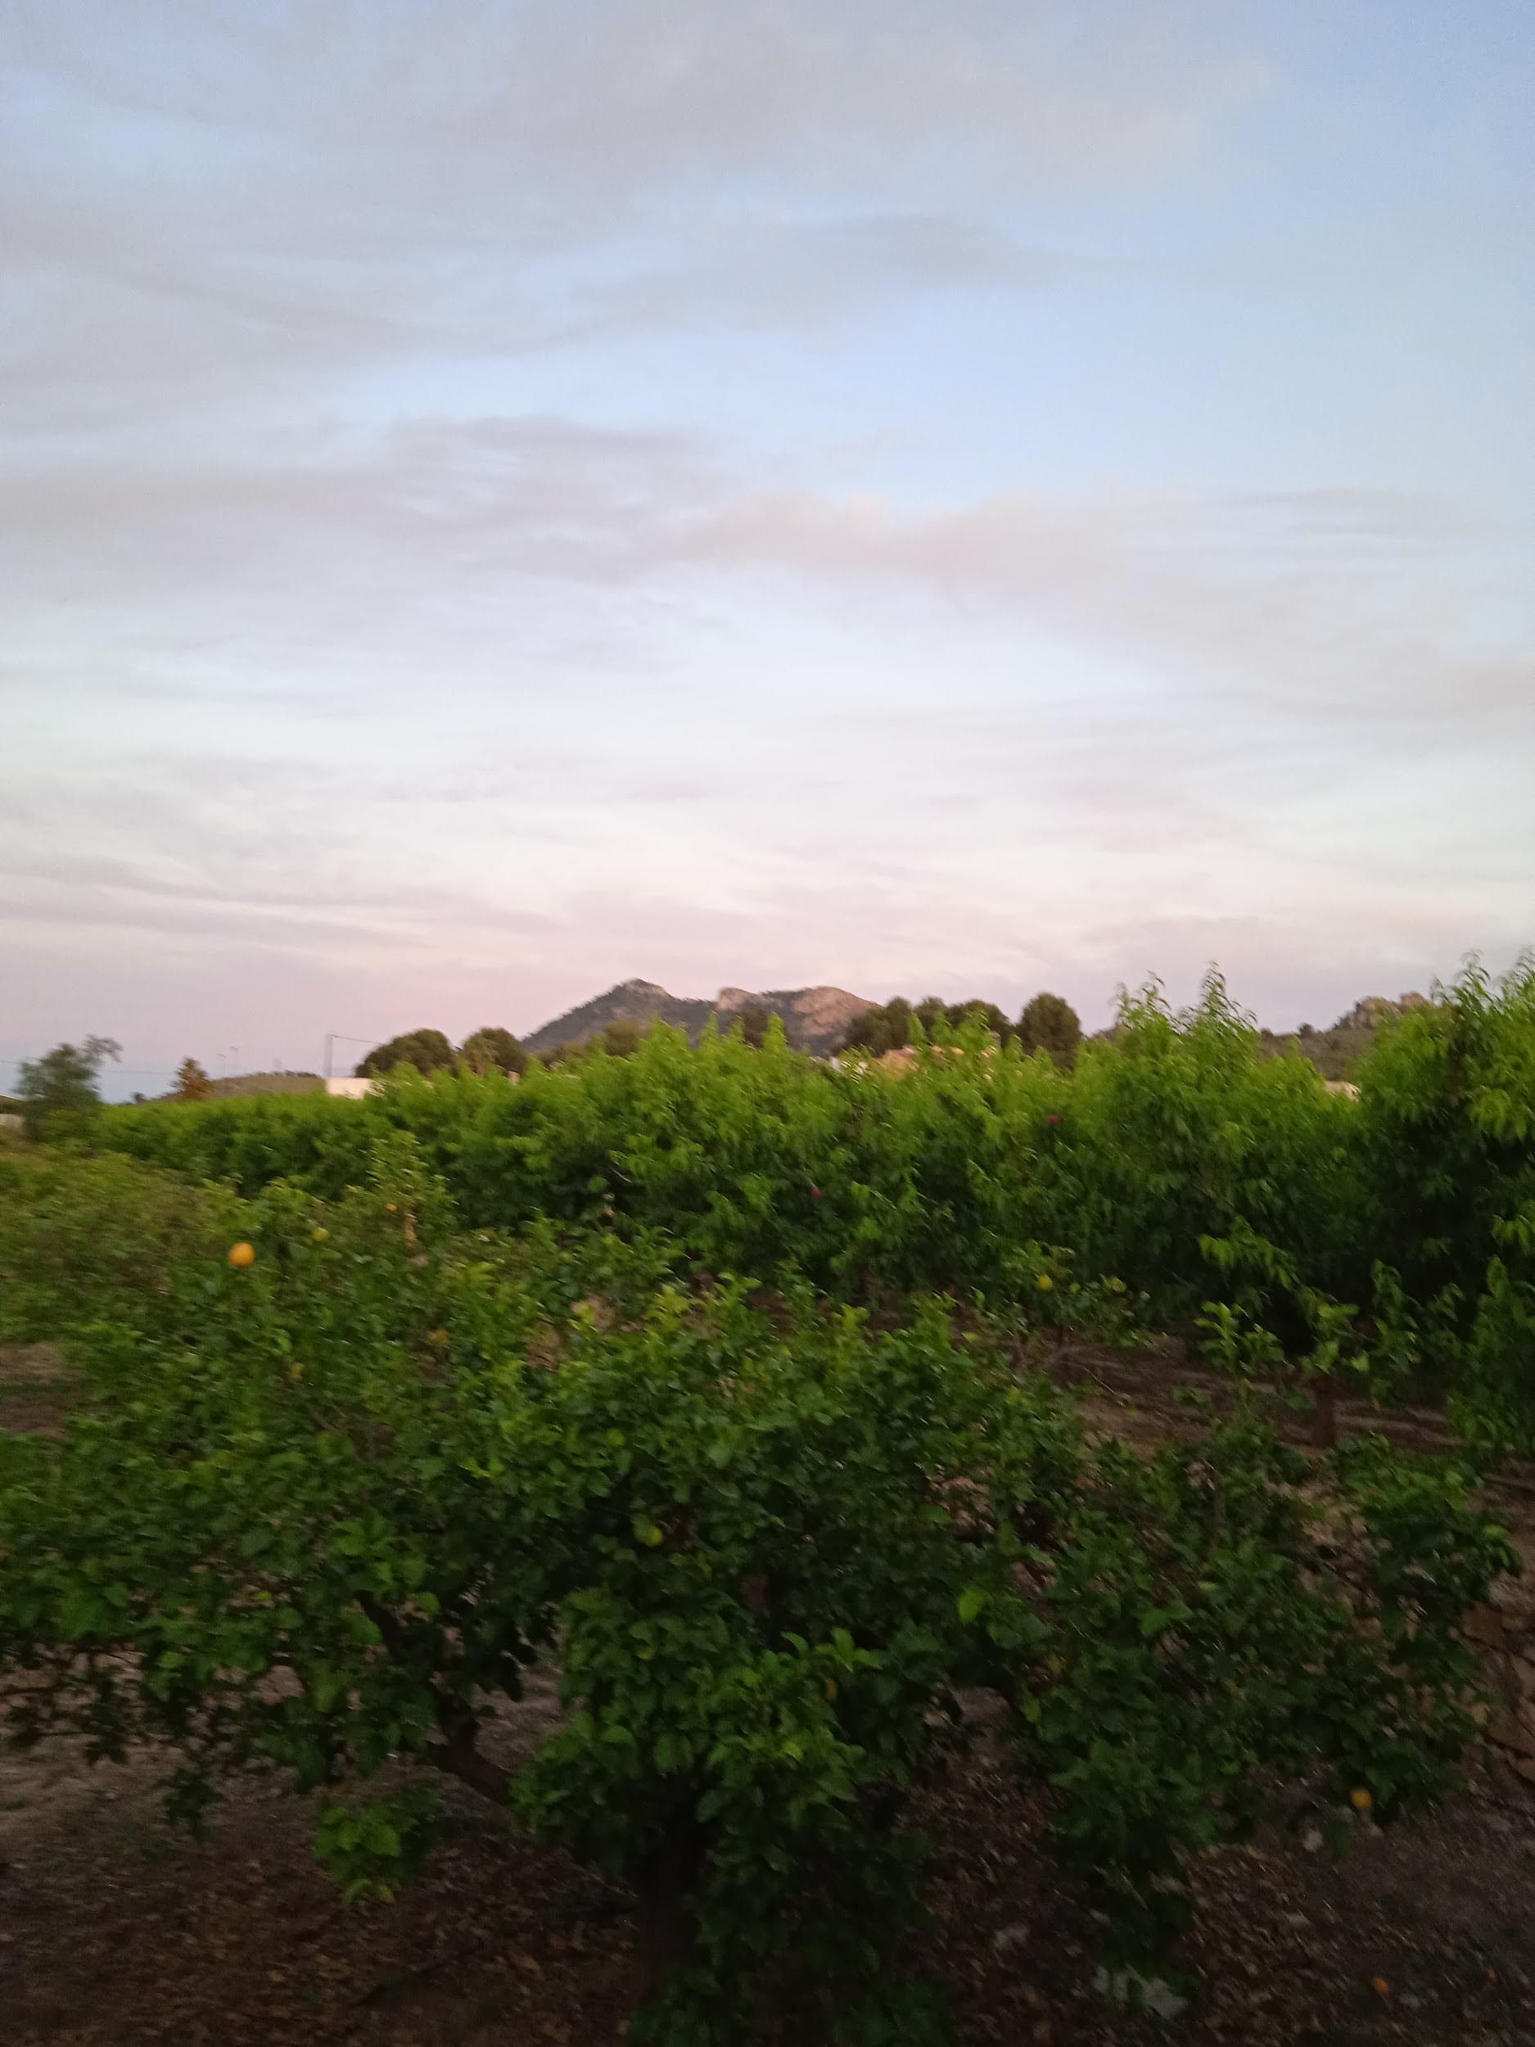

Slide 4
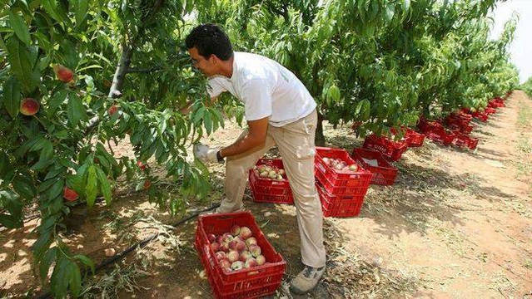
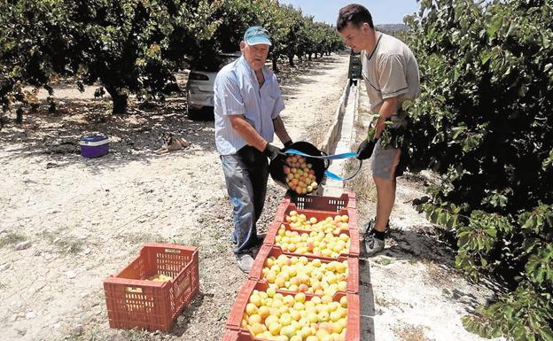
RECOLLECTION
The process begins with the recollection of the fruit in the orchard.This is the first step where the waste is generated.

Slide 5
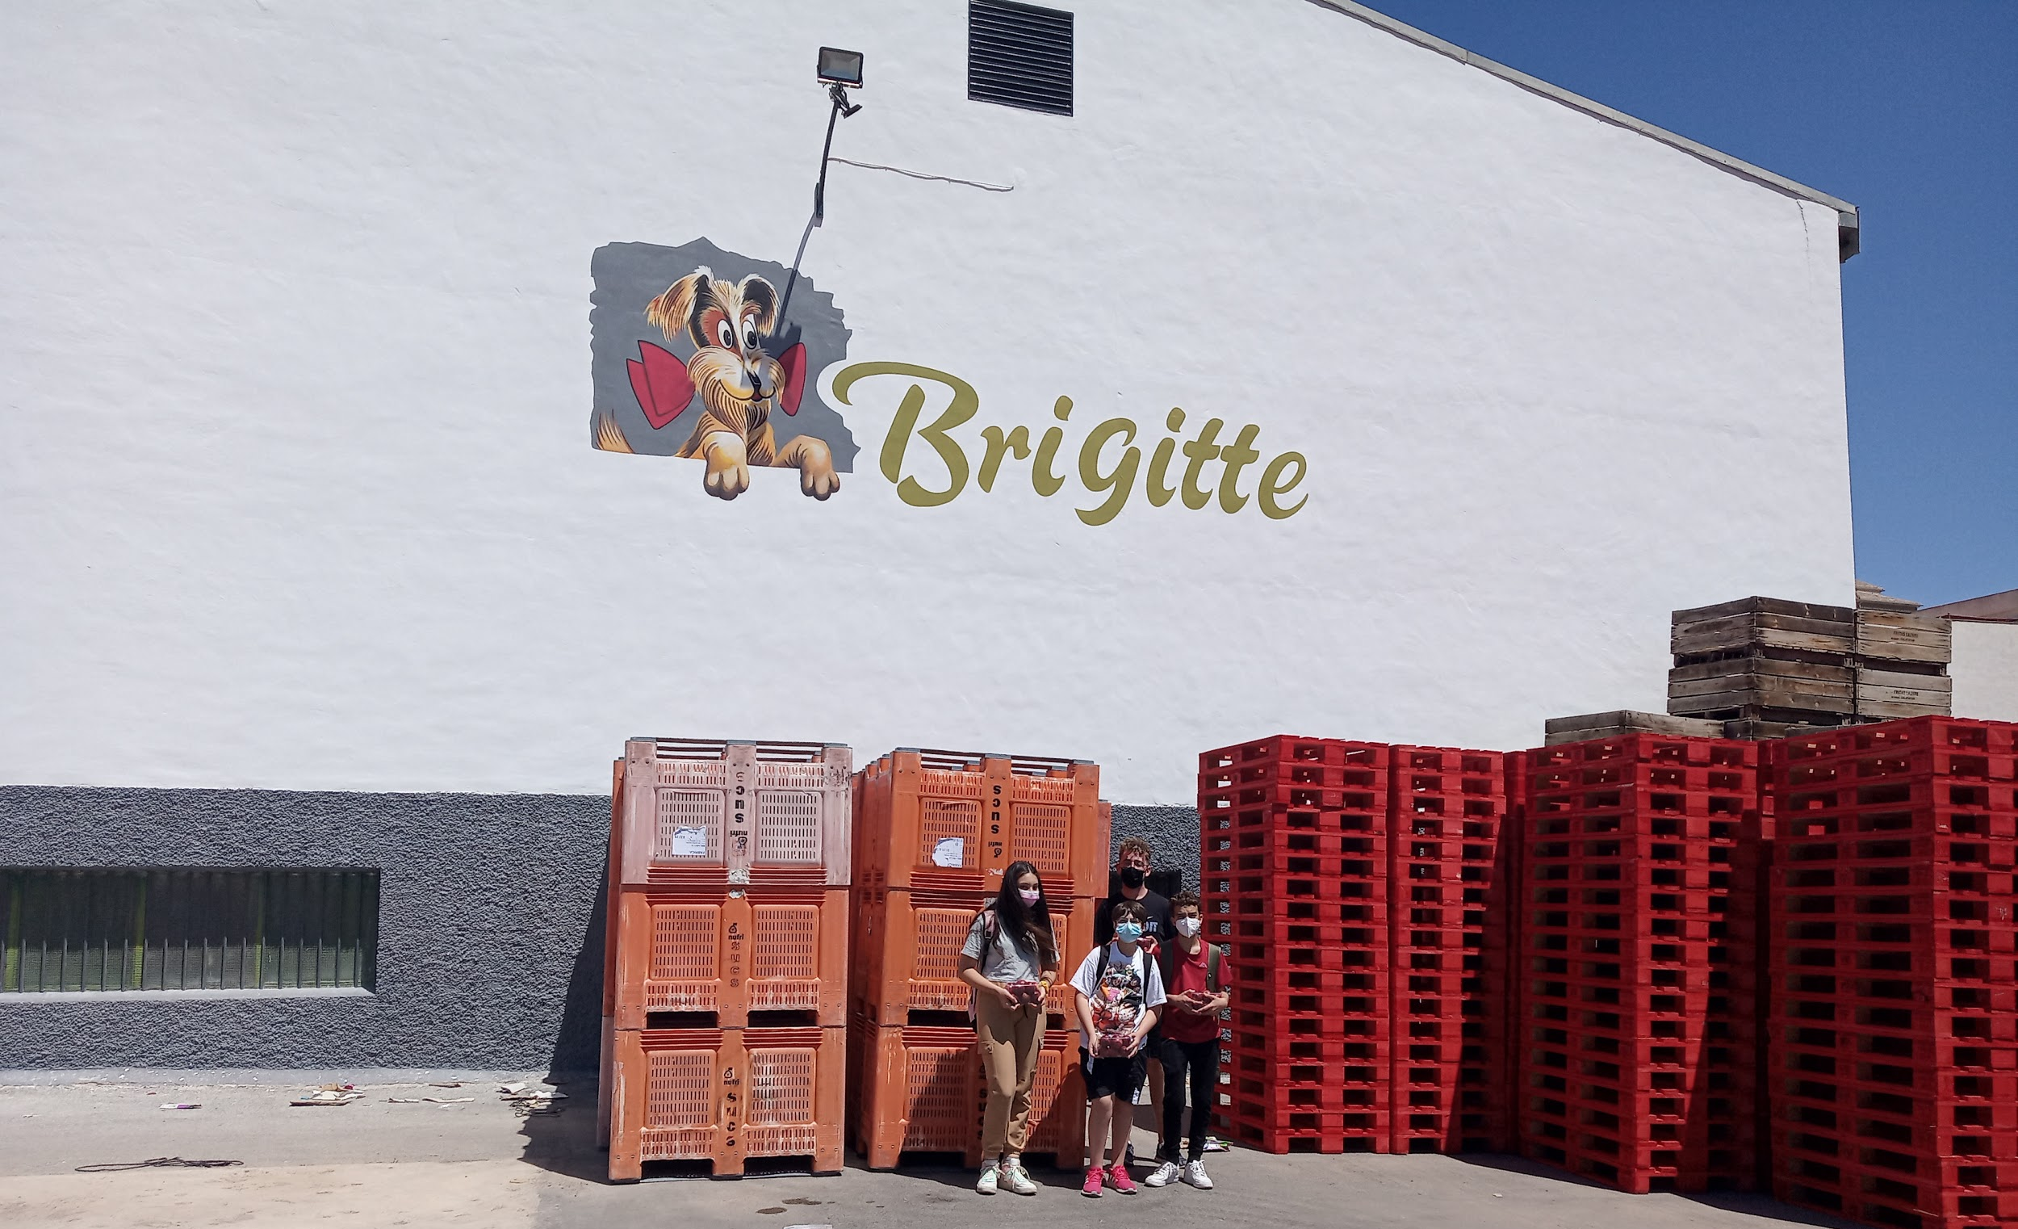
PROCESSING
Collected fruit arrives at the warehouse to be sort out, packed and prepared to be sold.
The major part of the fruit is sold as fresh products.
Fruit store located in our town
Notes:
Tuvimos la ocasión de visitar una almacén de frutas cercano a nuestro instituto. Allí nos explicaron todos los pasos que la fruta sigue desde que llega hasta que sale lista para su venta. Cuando visitamos el almacén estaban trabajando con melocotones que iban a enviar a Francia para su venta.

Slide 6
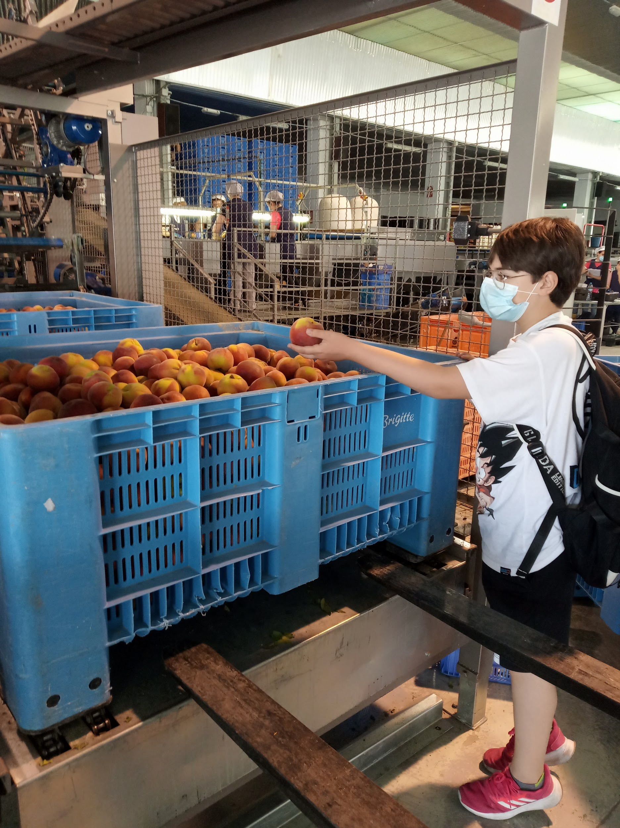
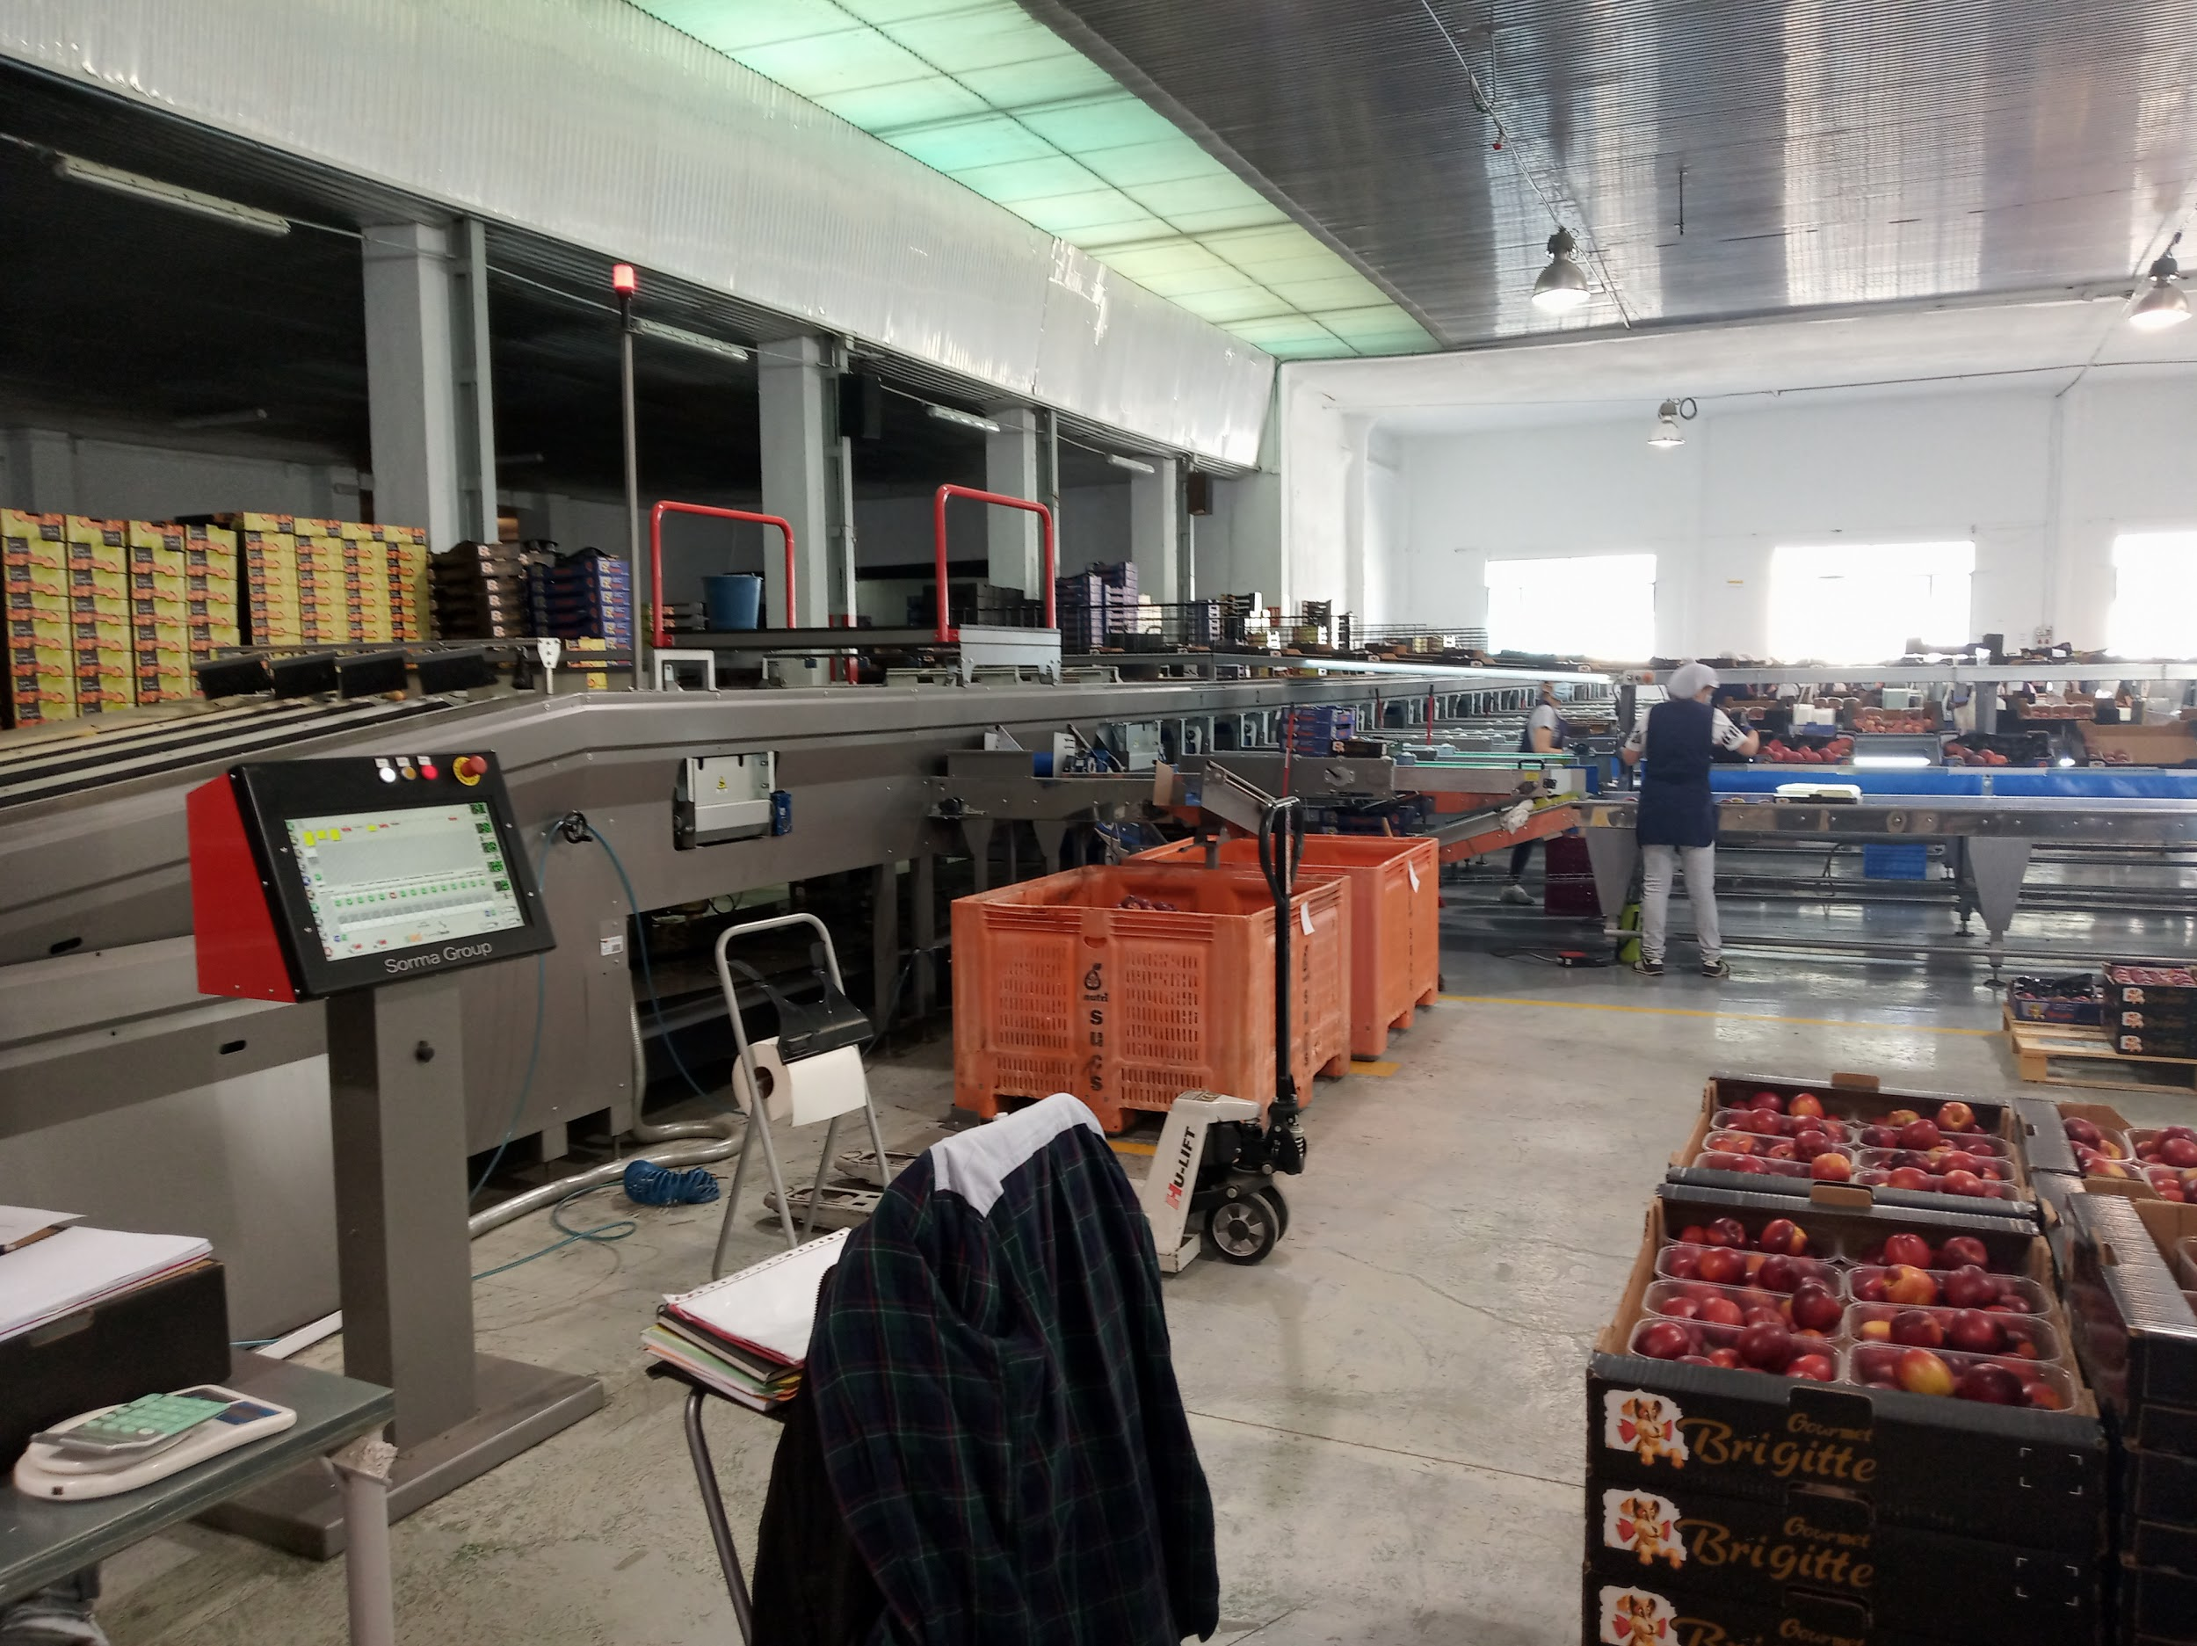
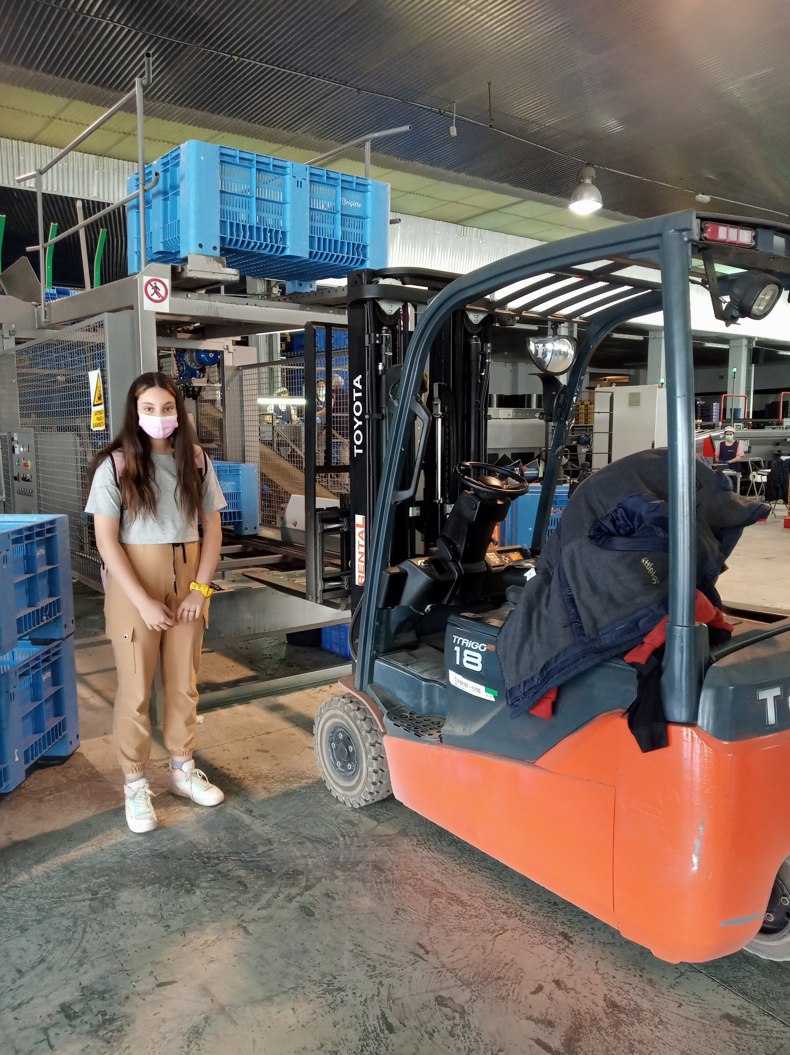
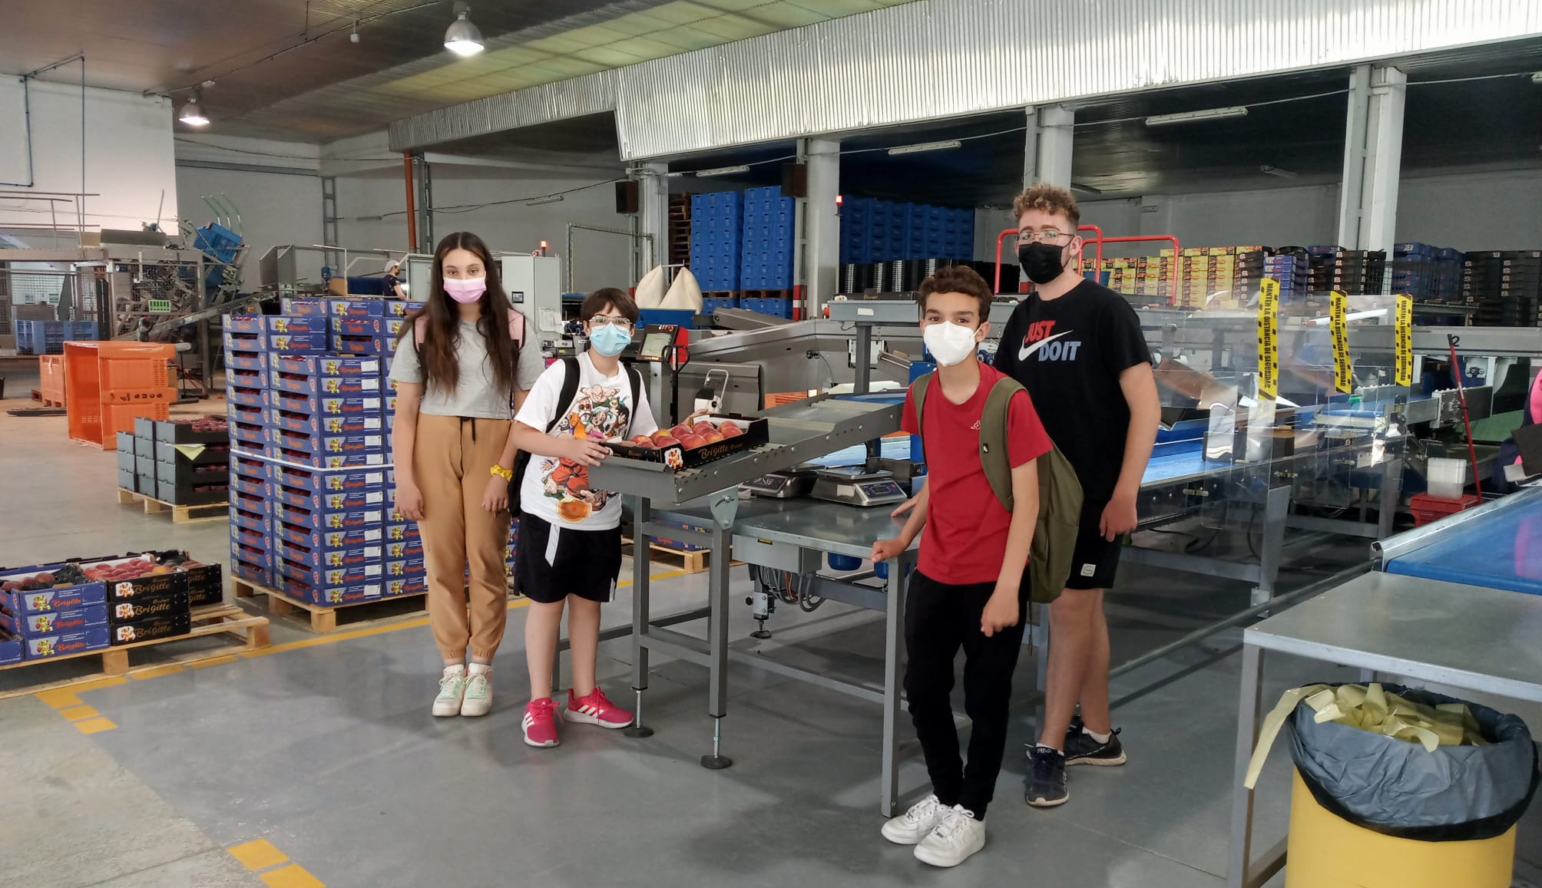

Slide 7
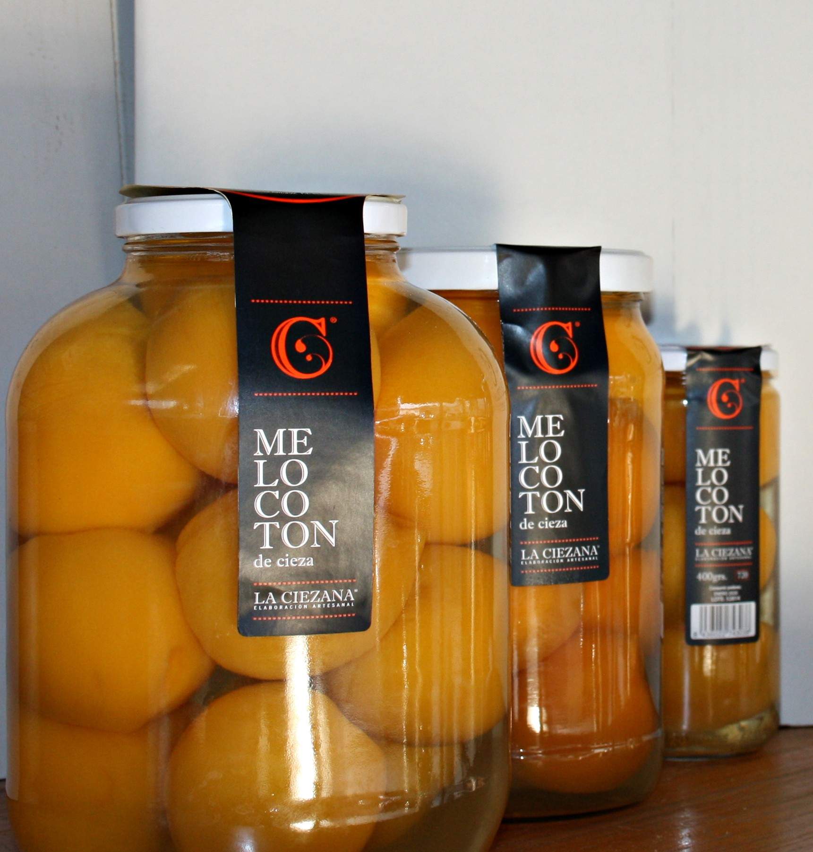
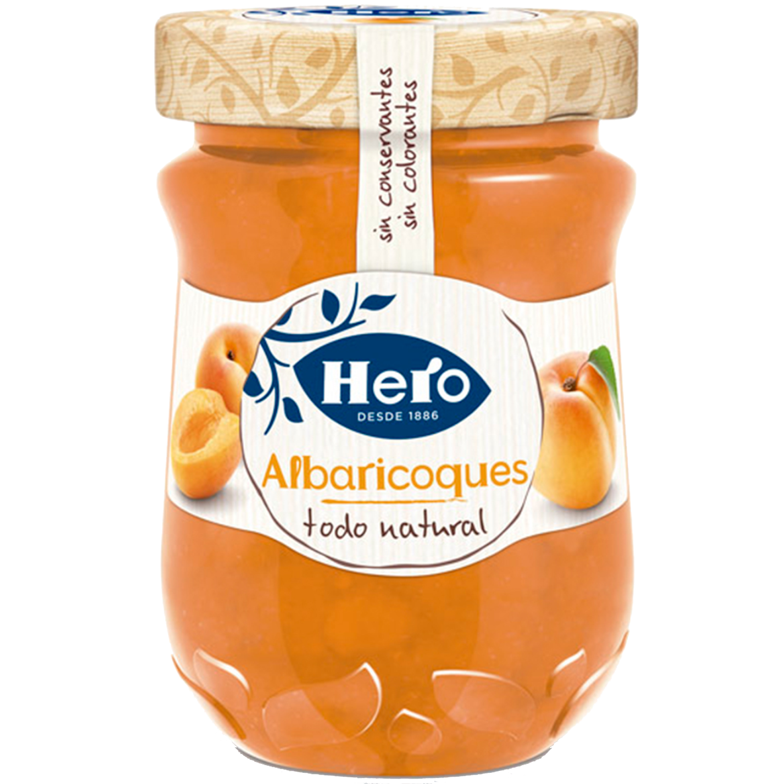
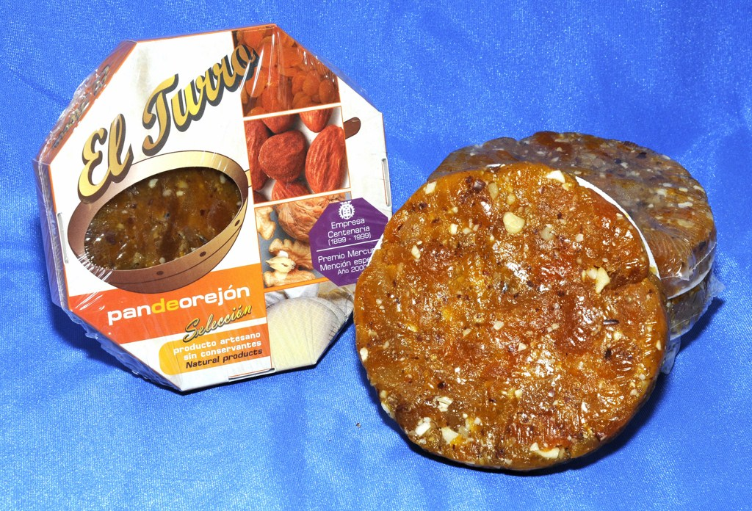
Another part will be turned into different products such as jam, juice, preserves or sweets.

Slide 8
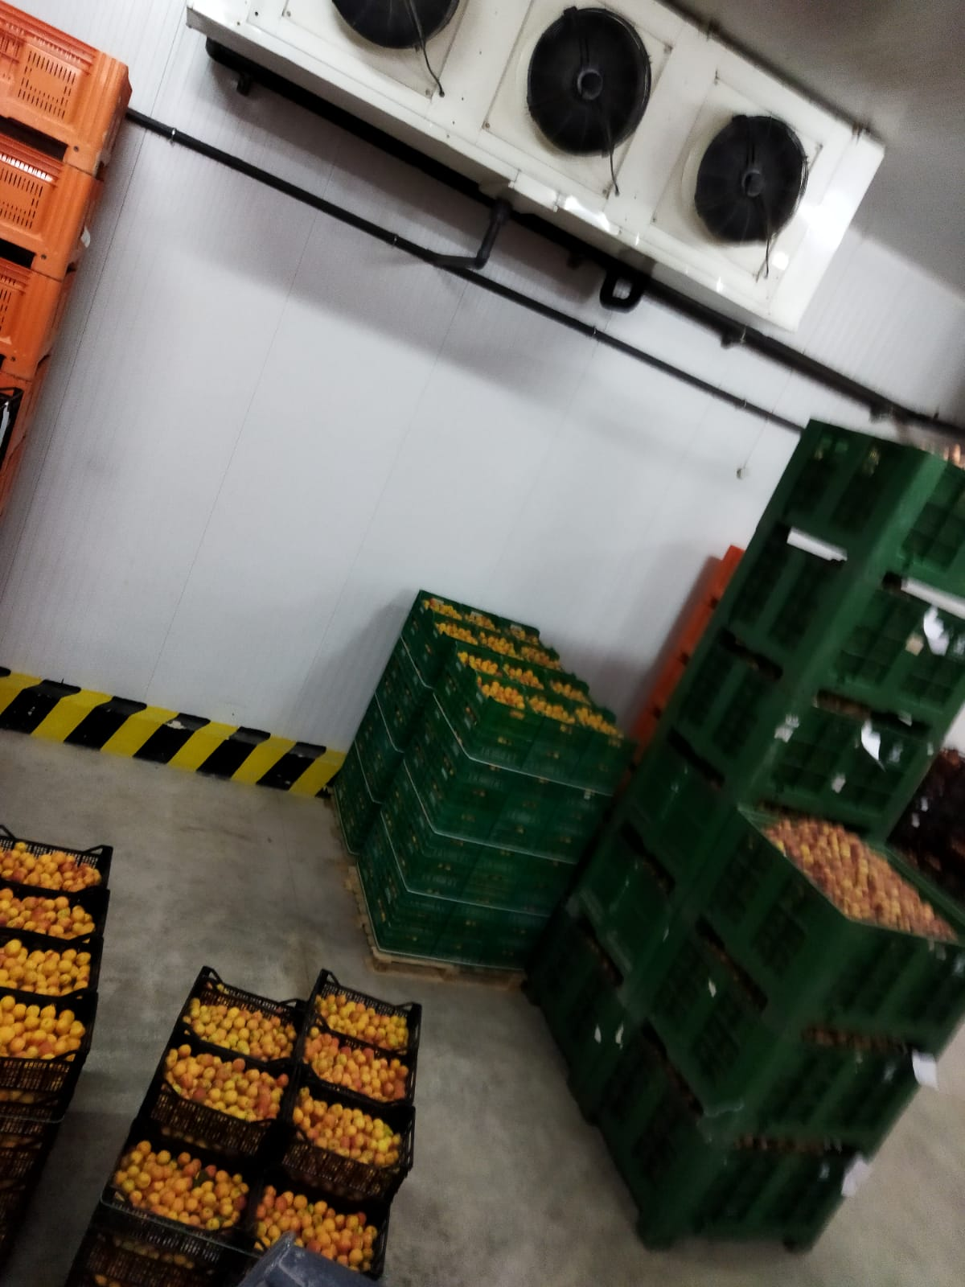
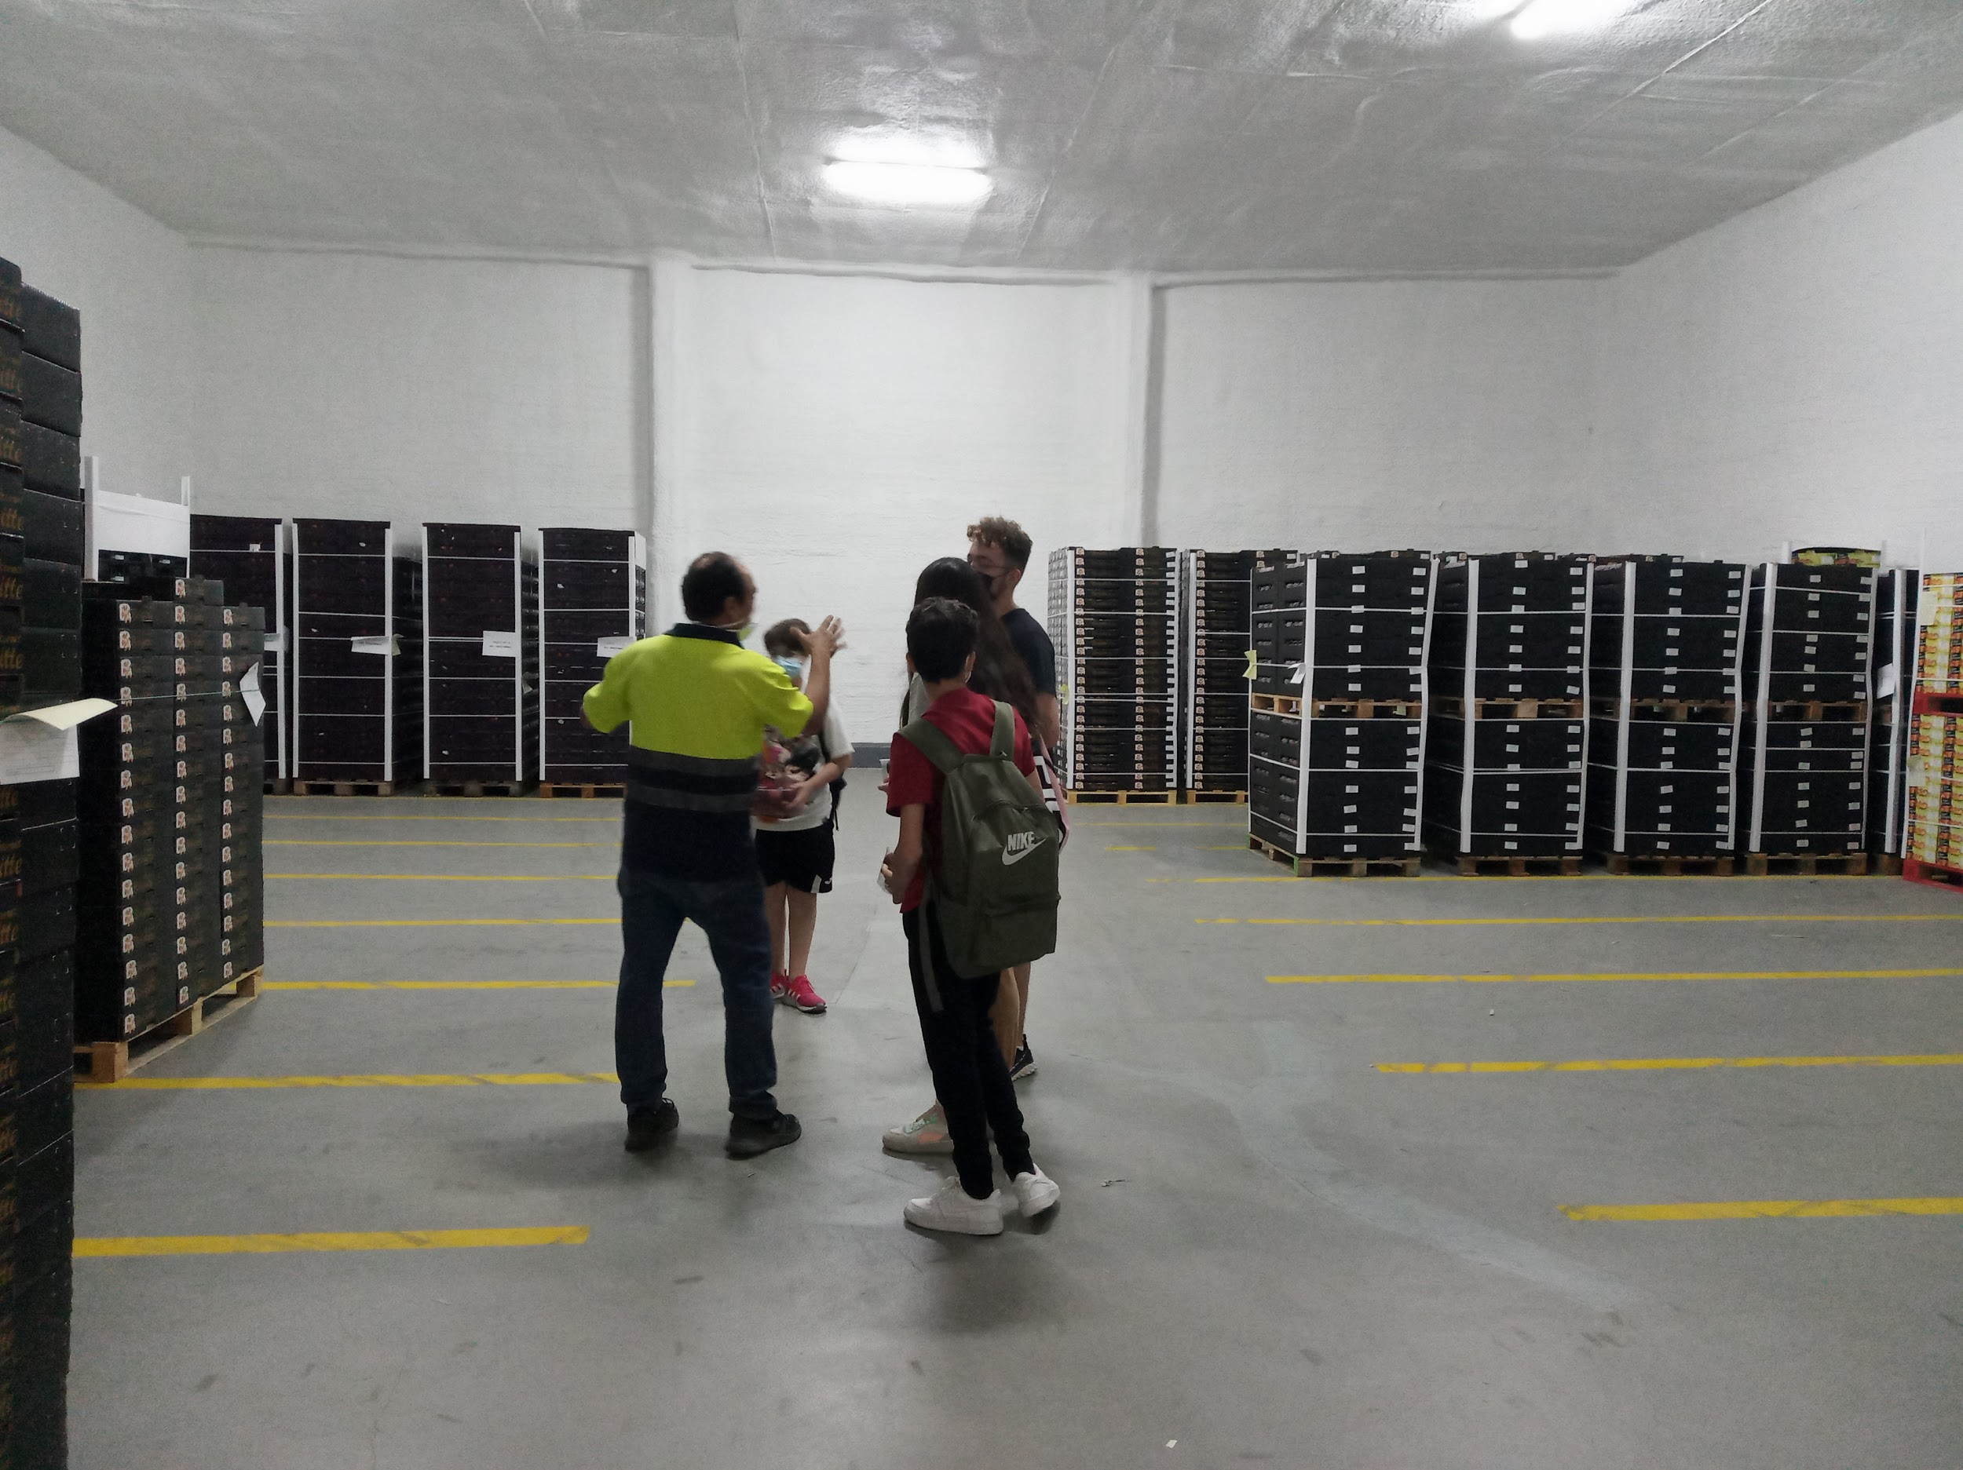
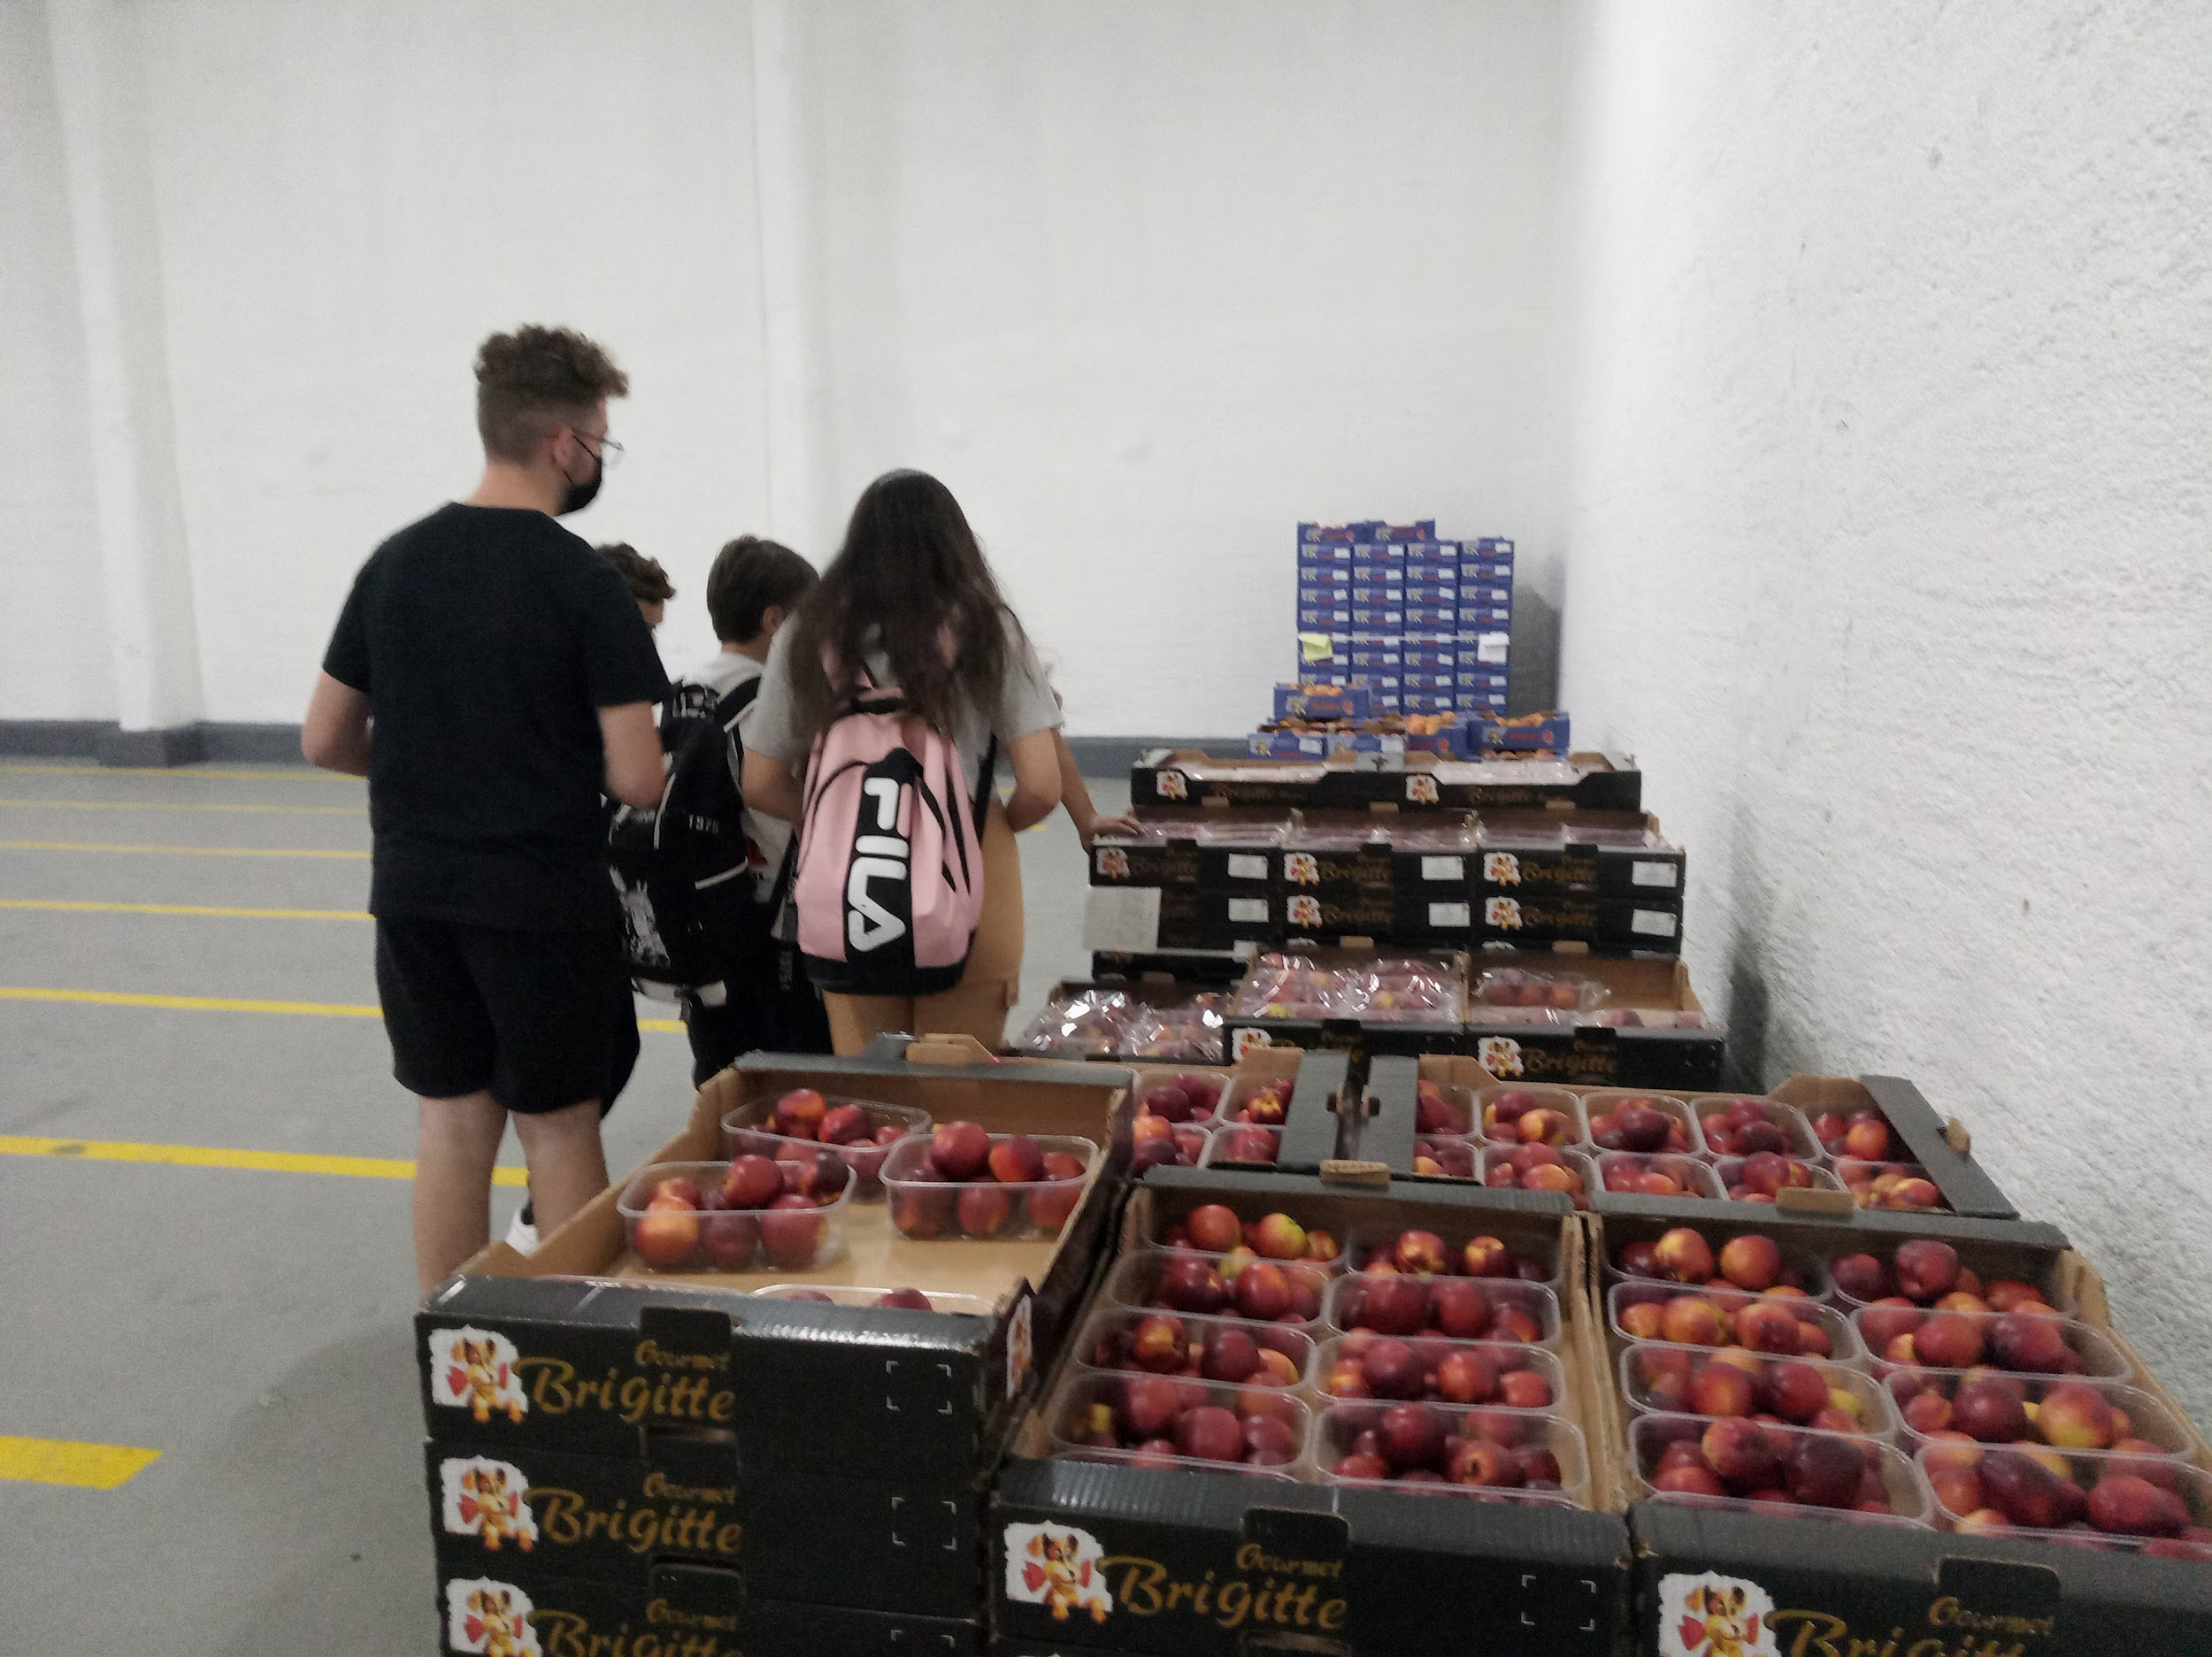
STORAGE
They should be stored paying attention to the producer’s advises which have been given.
Before being transported, these products are stored in warehouses and even in large cold rooms.. Conditions should be appropriate in order to ensure the products arrive in good conditions to their destination.
Notes:
Aquí estamos dentro de una de las grandes cámaras de refrigeración en las que la fruta, ya envasada en cajas, espera para ser cargada en camiones. La temperatura en el interior de estas cámaras de frío es de unos 3 grados

Slide 9
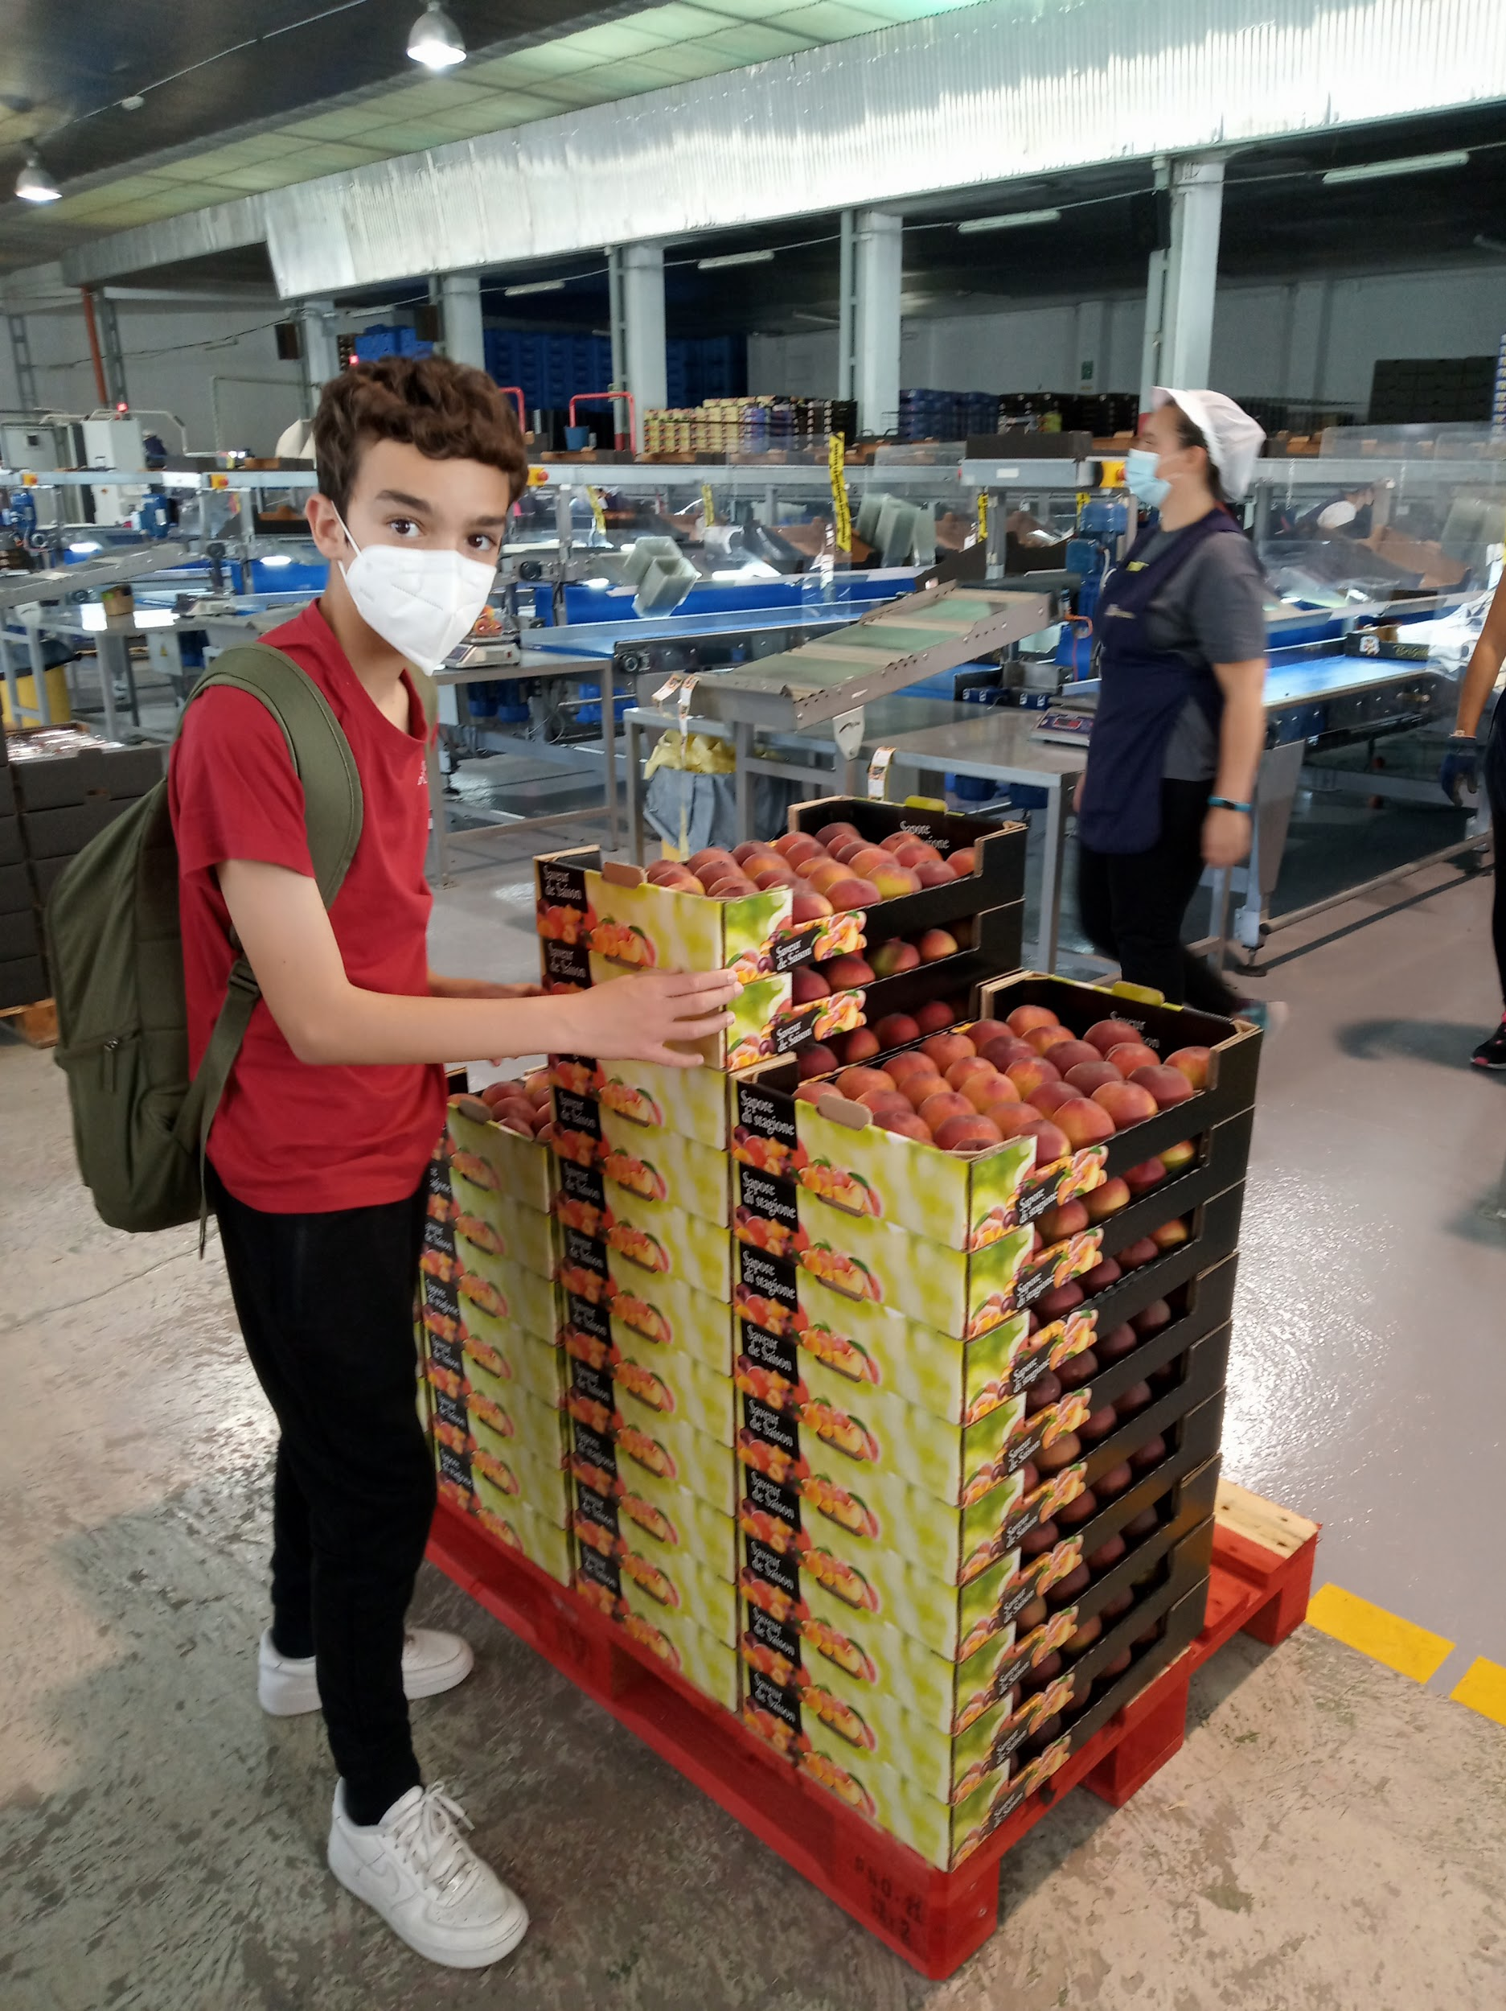
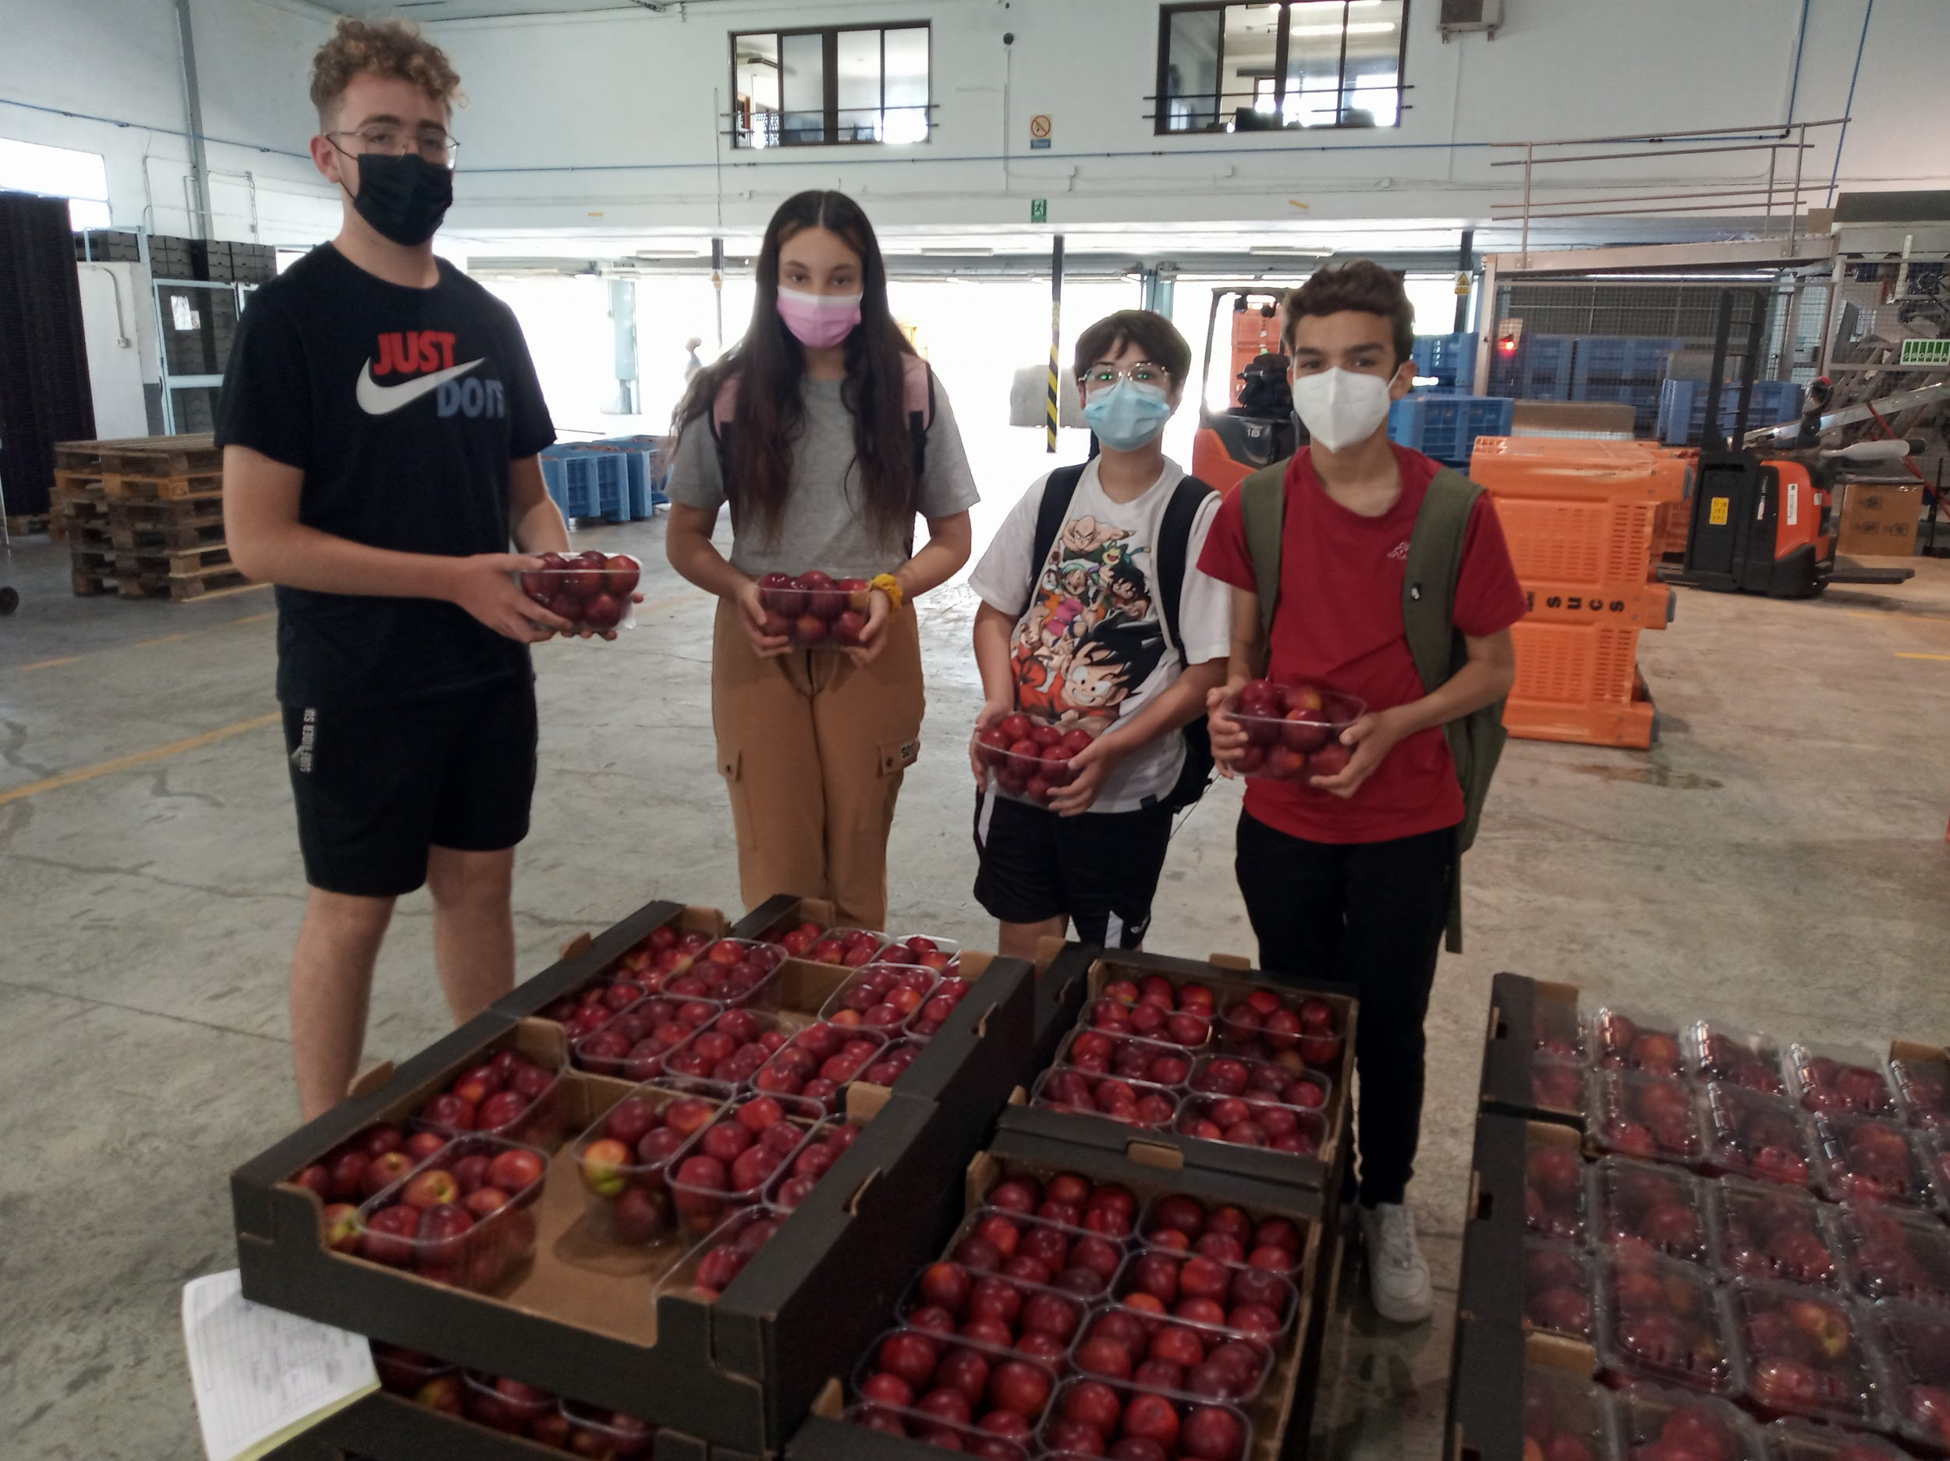
TRANSPORTATION
The fruit is packed in boxes of different sizes, and transported to the markets

Slide 10
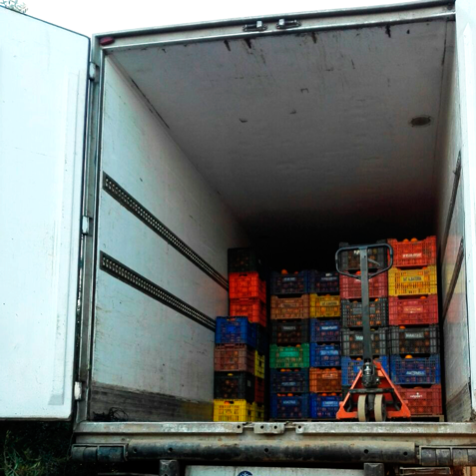
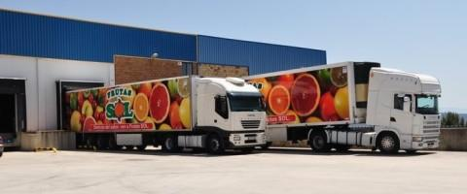
These products usually travel long distances in large refrigerated lorries to arrive in different countries of Europe

Slide 11
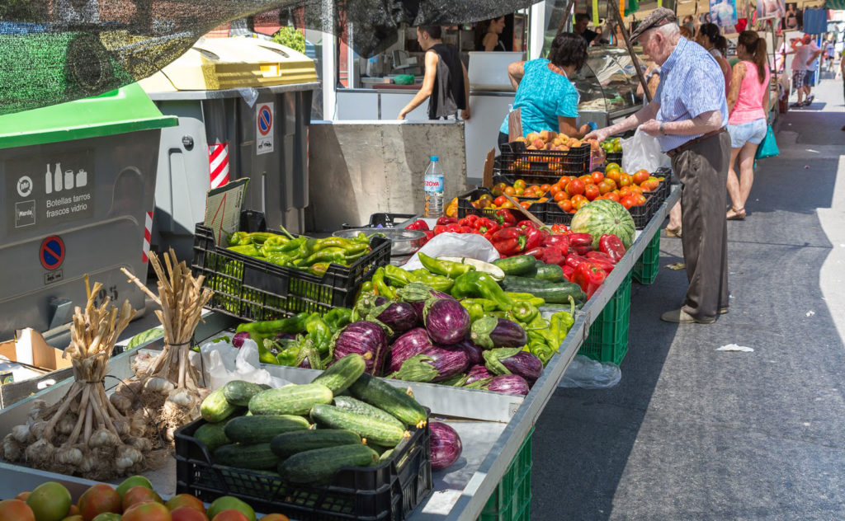
SALE
Fruits are perishable products, because of that, they must be saved in a properly way, mainly for not going bad quickly.

Slide 12
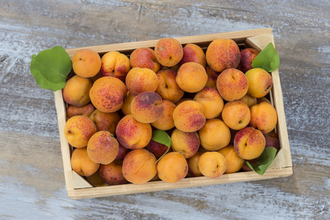
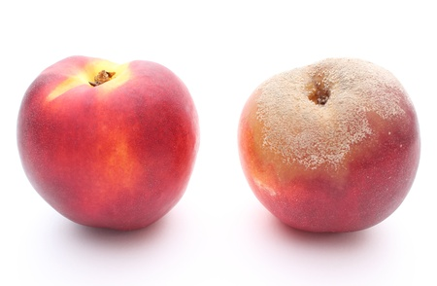
Fruit that isn't sold in a short period of time will probably become waste, because it will be too mature to eat it.

Slide 13
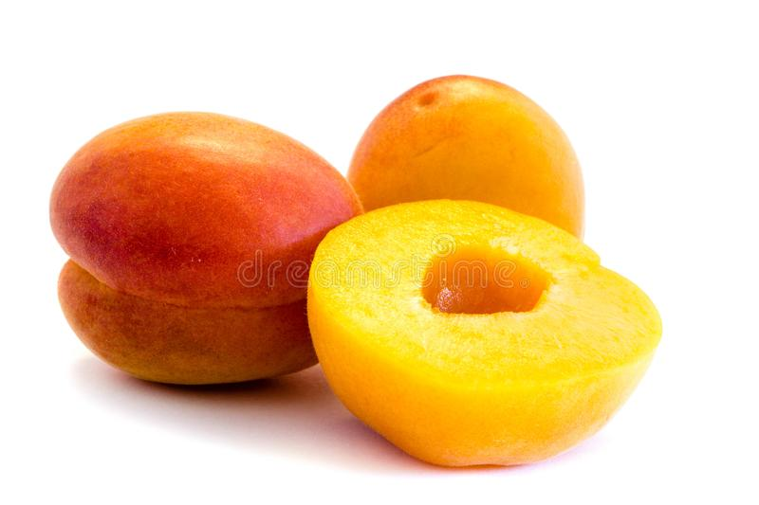
CONSUMPTION
It is the final arrival
These fruits, both fresh and processed, are consumed at home, bars or restaurants.
This part of the chain is essential to reduce food waste.

Slide 14
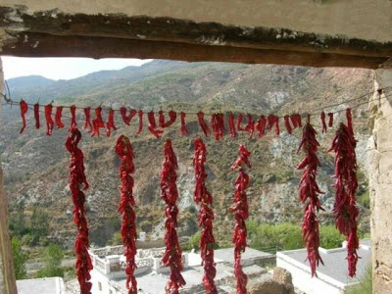
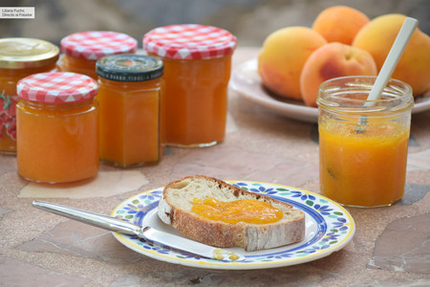
Traditional uses for reduction of food waste
Traditionally, in houses from our area, it exists the tradition of preparing conserves, jam or drying fruit so that nothing is wasted
Here’s an example of drying fruits and vegetables:

Slide 15
Thanks for your attention

