Slide 1
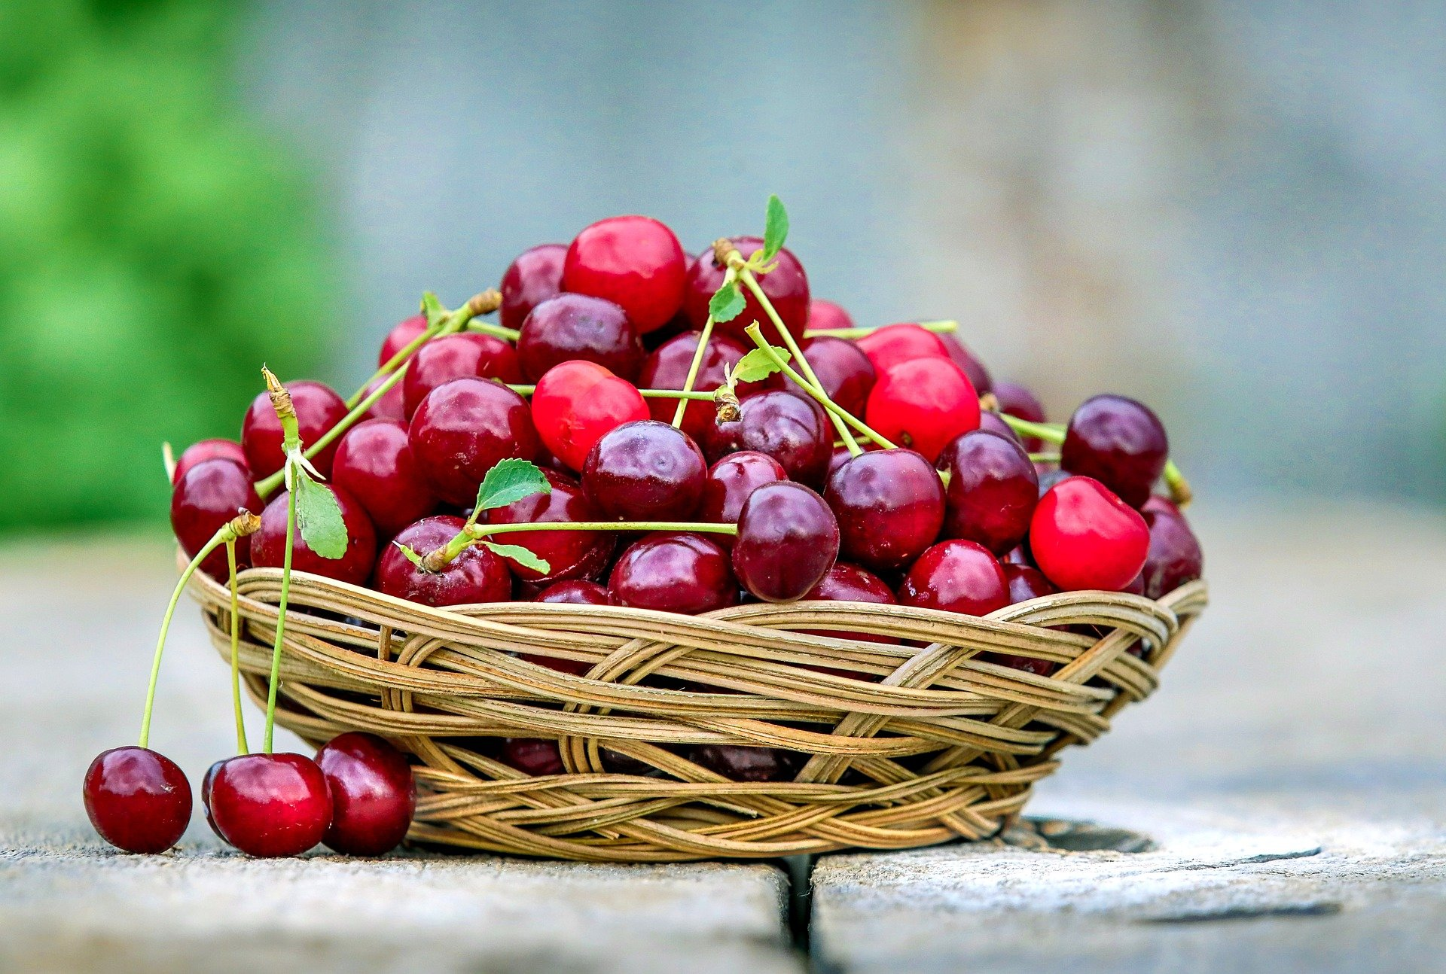


FOOD CHAIN

Slide 2
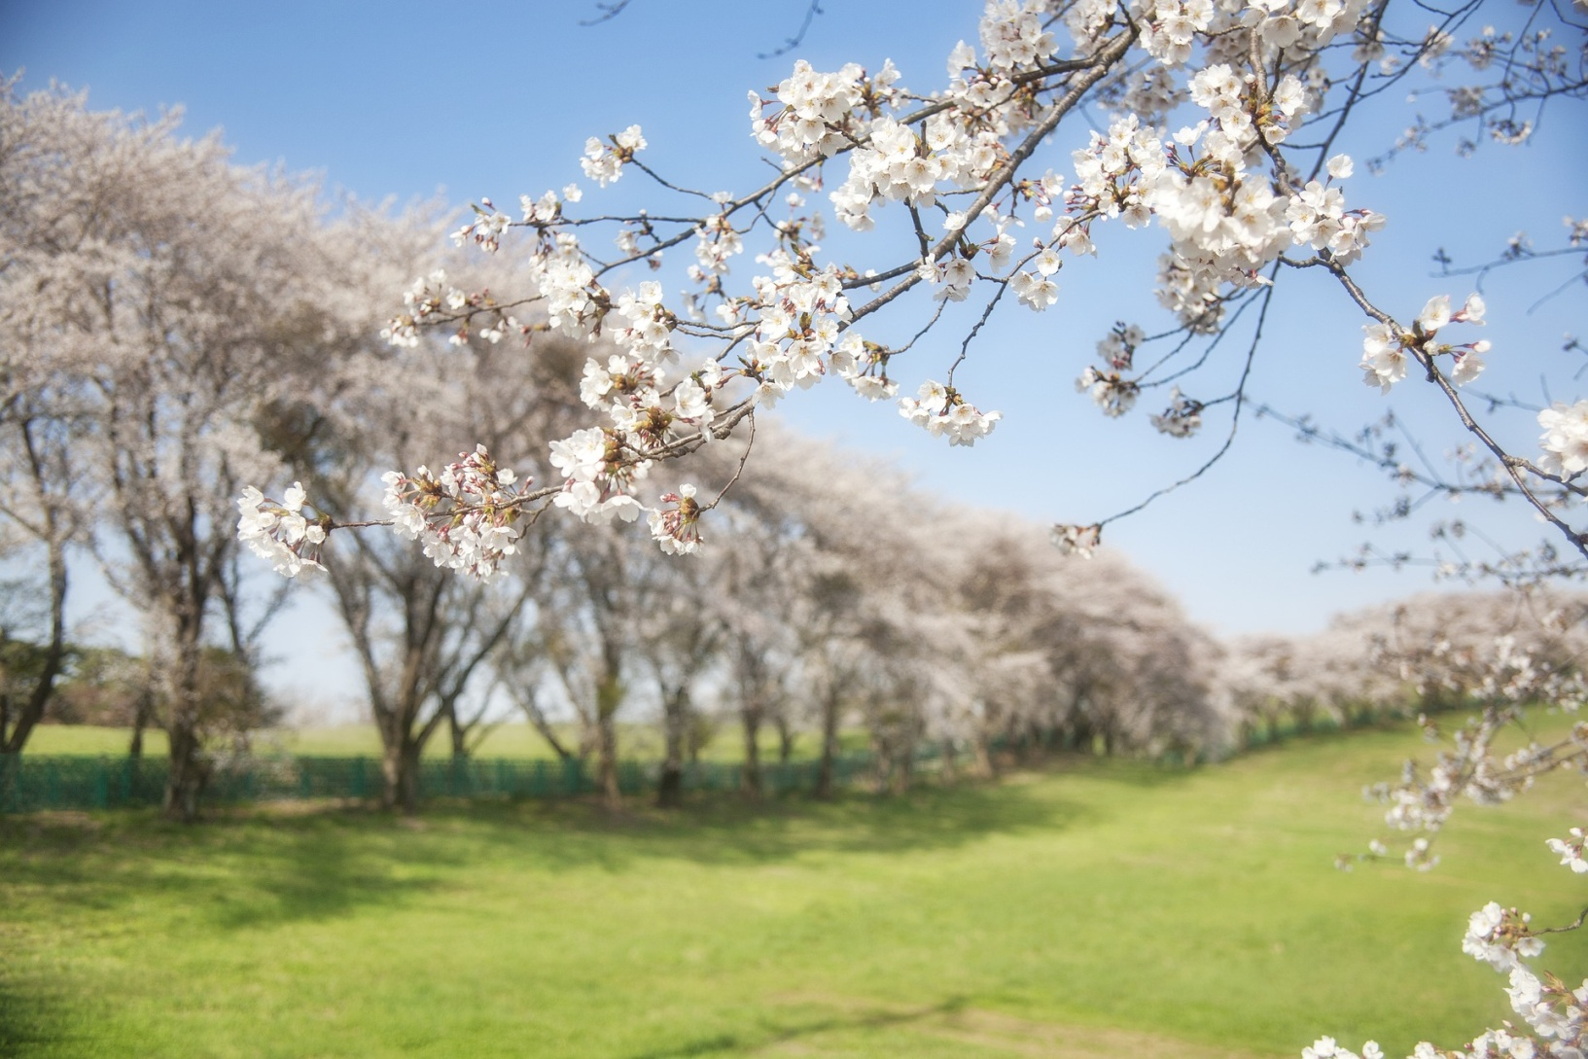
Cherry trees in blossom

Slide 3
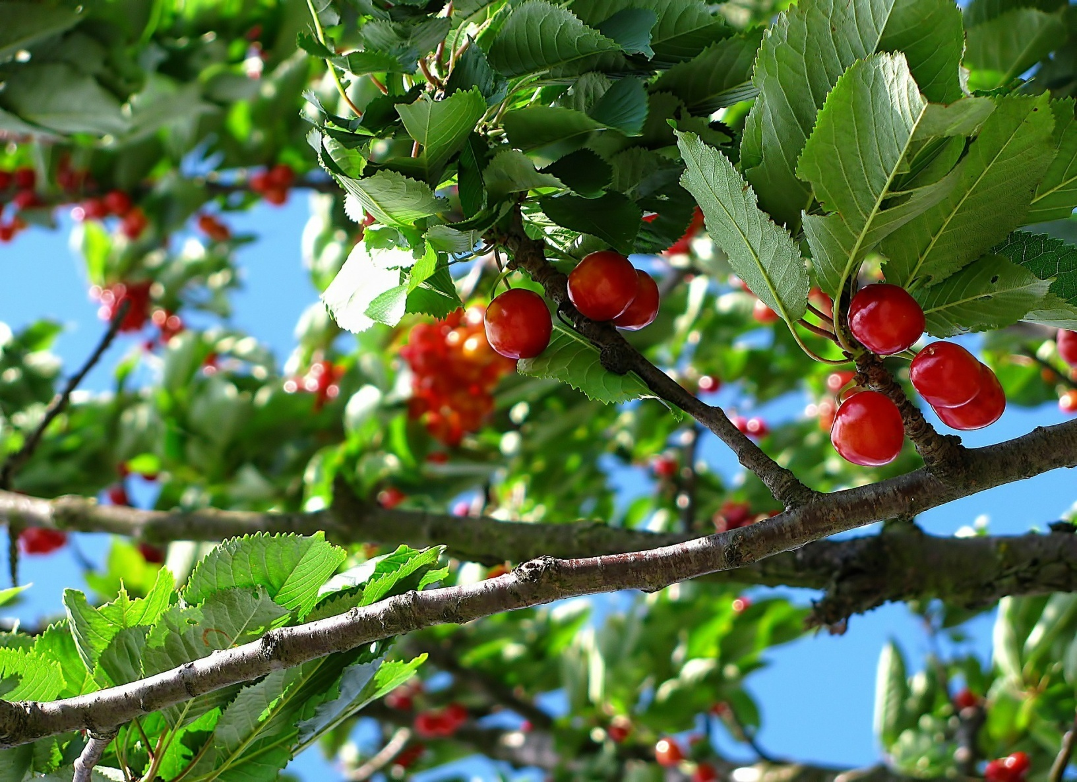
Cherry trees with fruits

Slide 4
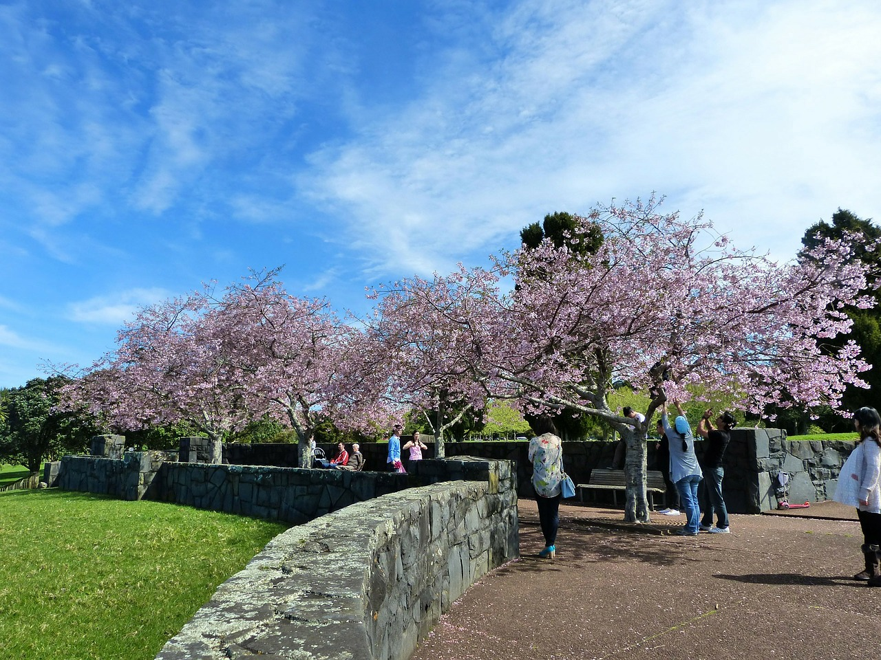
Picking up the cherries

Slide 5
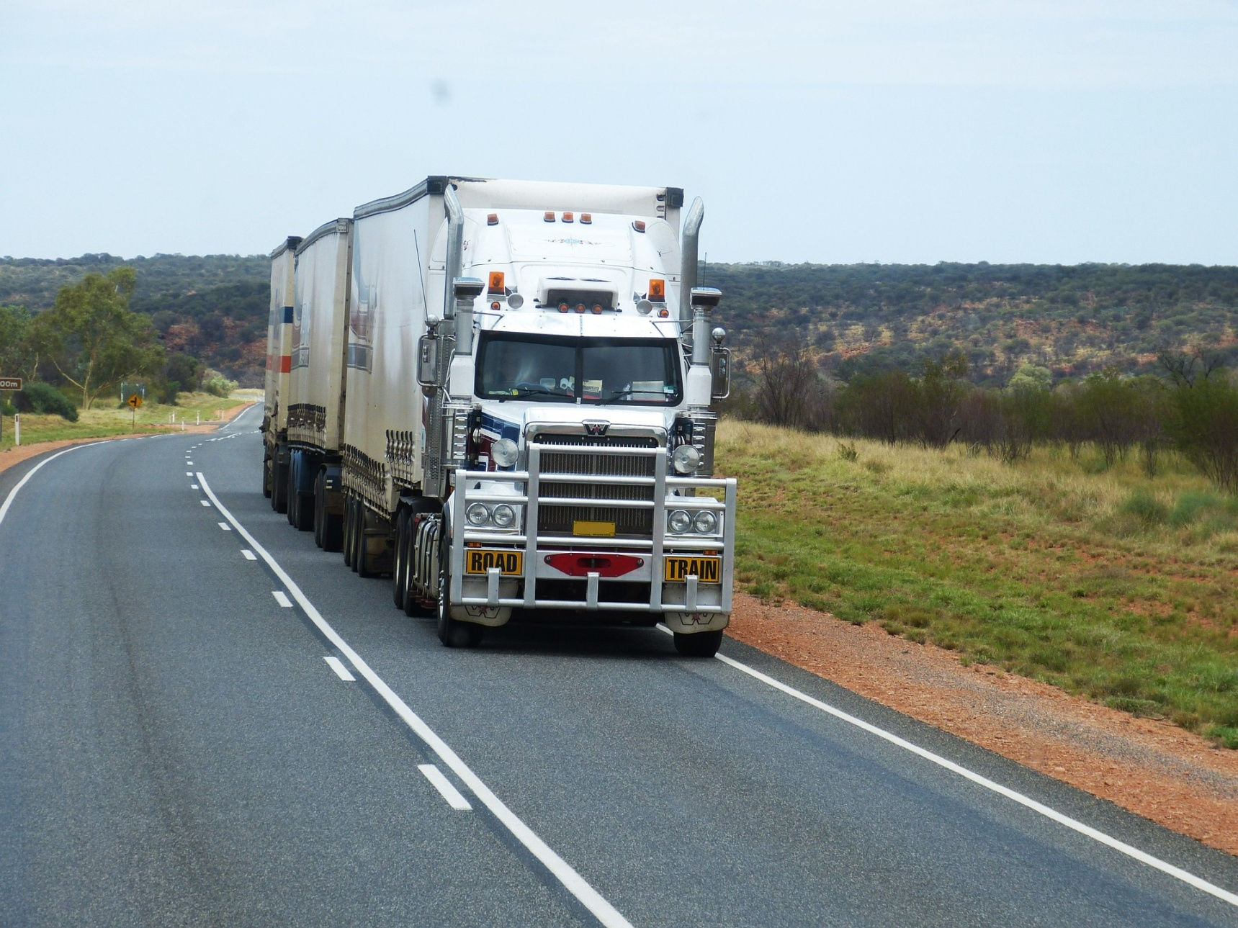
In transit to the market

Slide 6
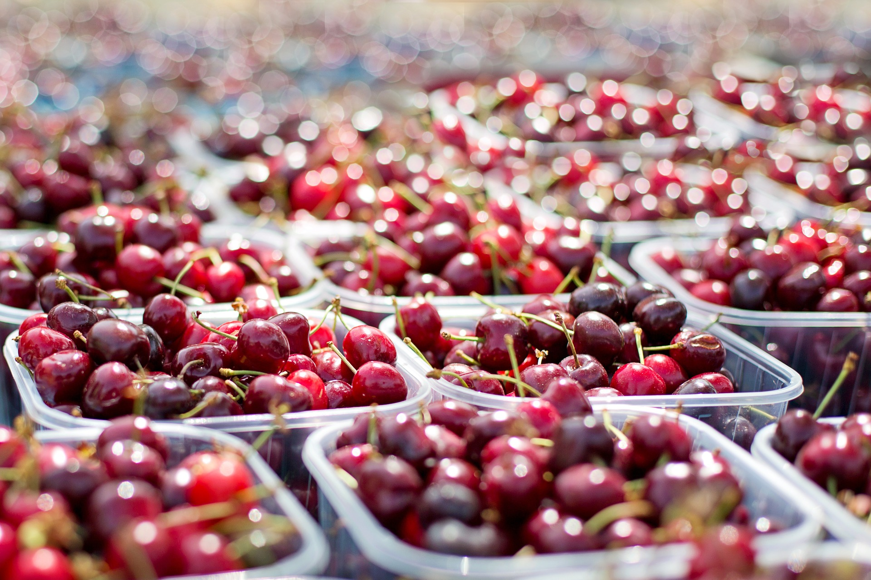
On display in the market

Slide 7
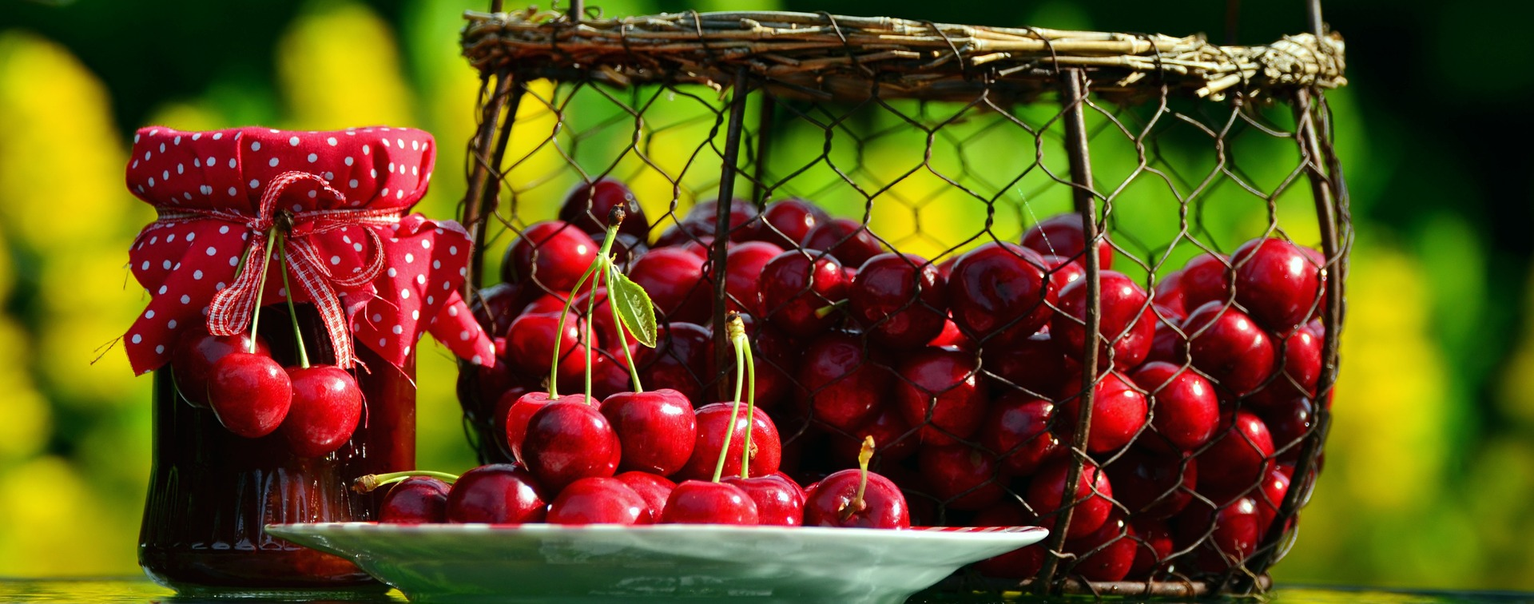
Webography:
Cherry food chain
All photos downloaded fromPixabay
Work done by: Artur, Francisco and Orlando

