Slide 1
Food chain
fish

Slide 3
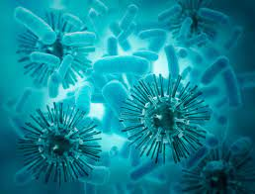
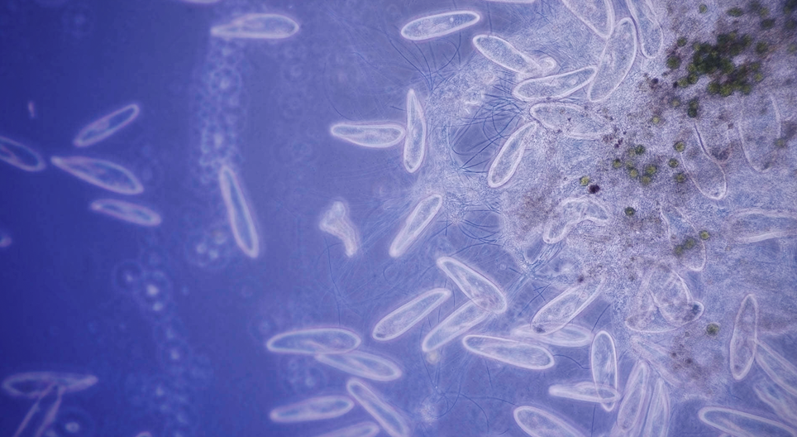
One celled organism
organism that consists of a single cell
Amoebas,Algae,Plankton, and Bacteria are single celled organism

Slide 4
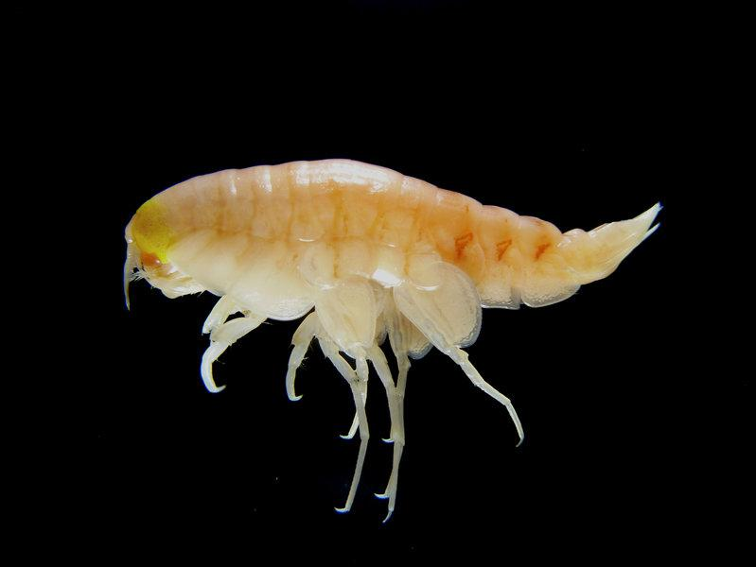
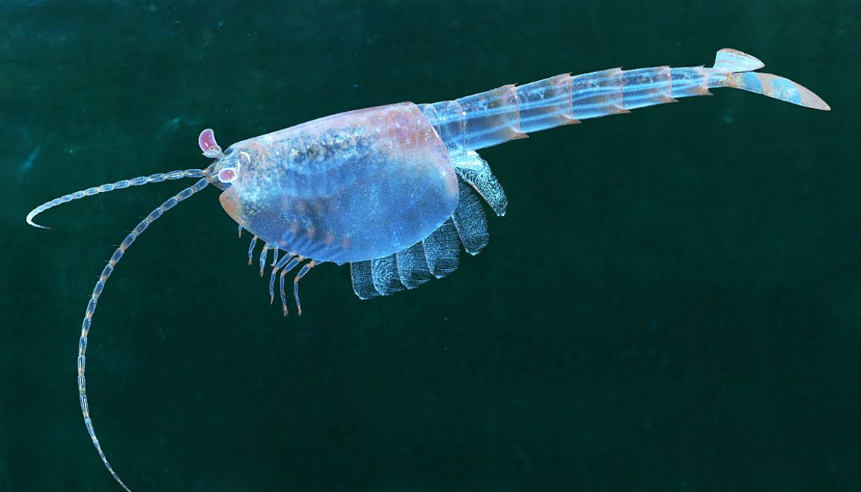
Shrimp-like creatures
shrimp-like creatures eat one celled organism
they are consumers

Slide 5
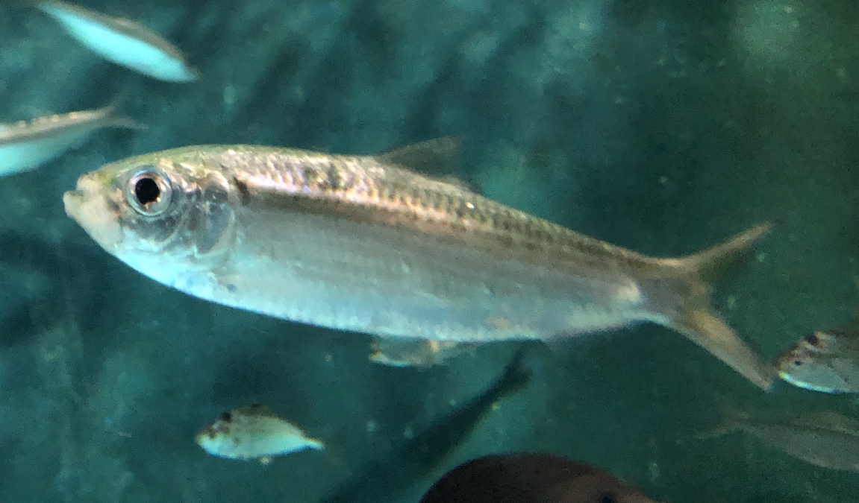
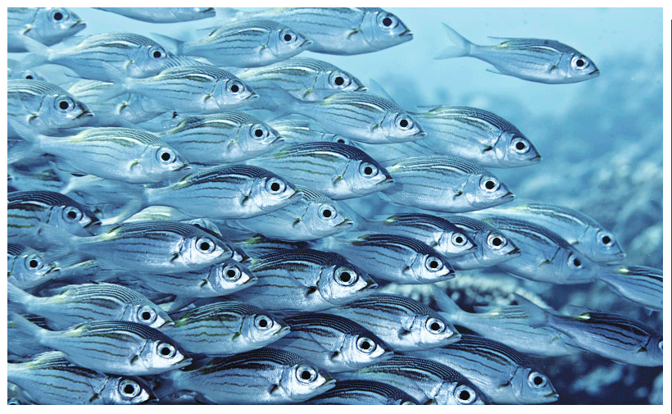
Small fish
they are used in fishing as a bait
for example sardines and herring

Slide 6
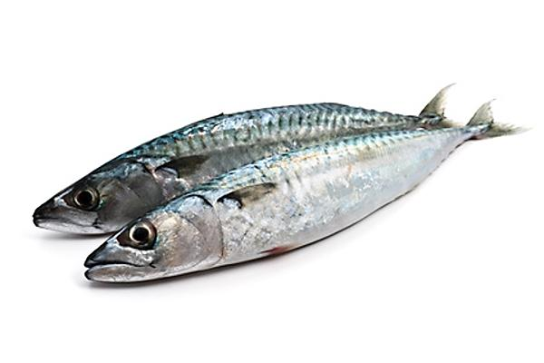
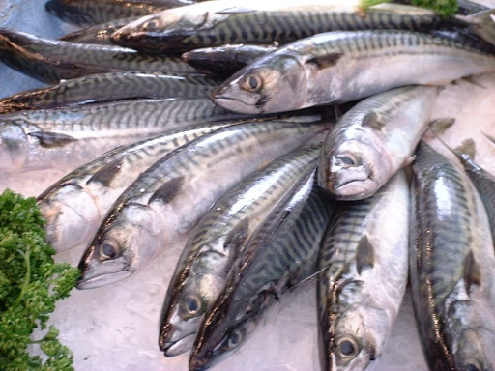
Large fish
you can eat them, you can find them easily in the shop
for example mackerela

Slide 7
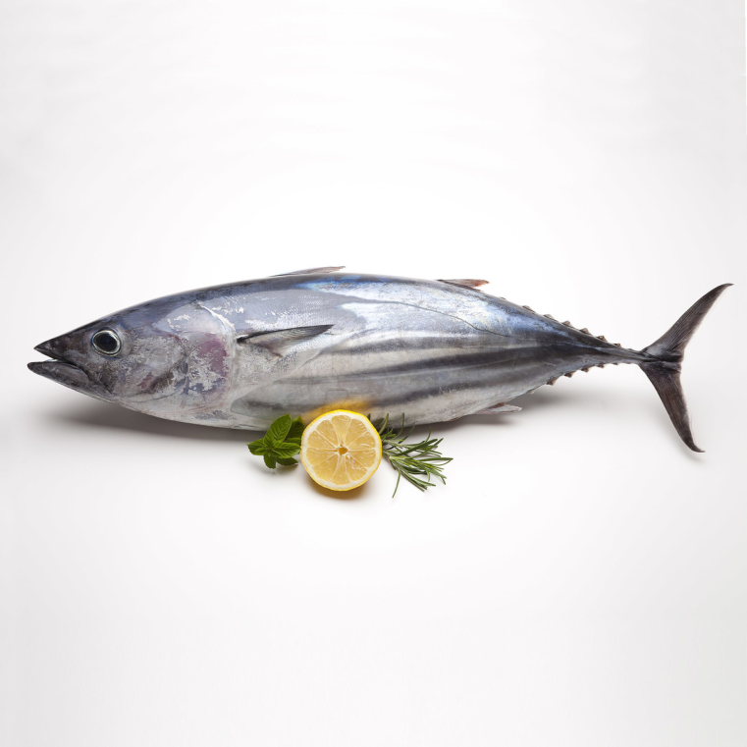
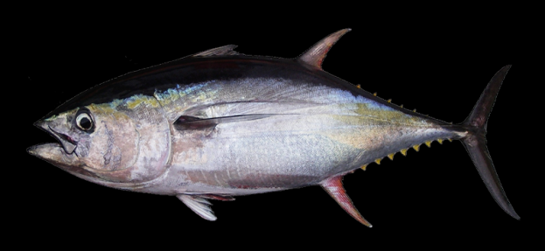
tuna
a saltwater fish
tuna eats mackerela

Slide 8
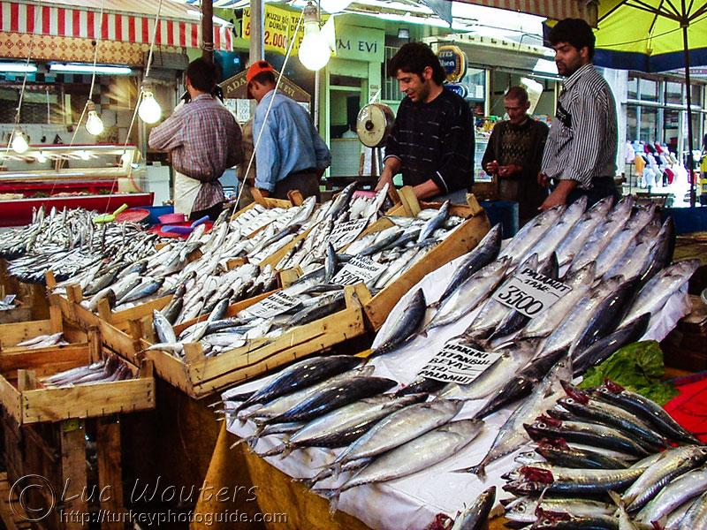
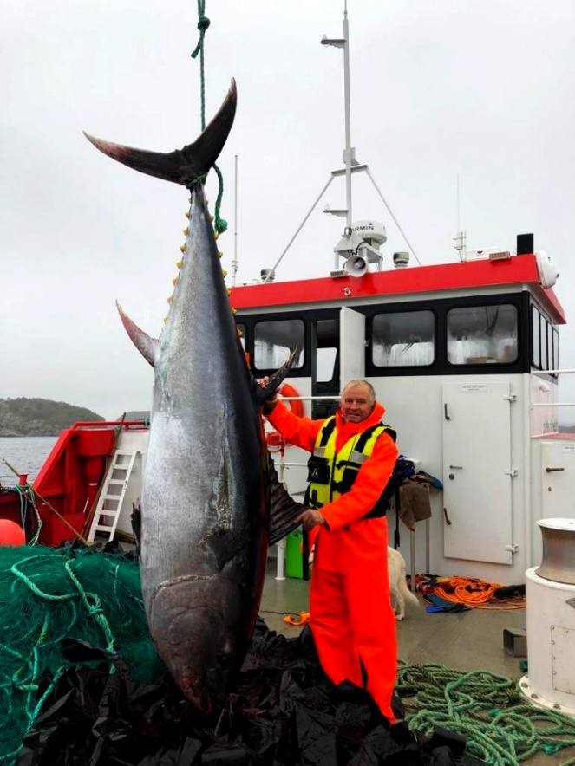
transportation
from ships transports them to restaurants

Slide 9
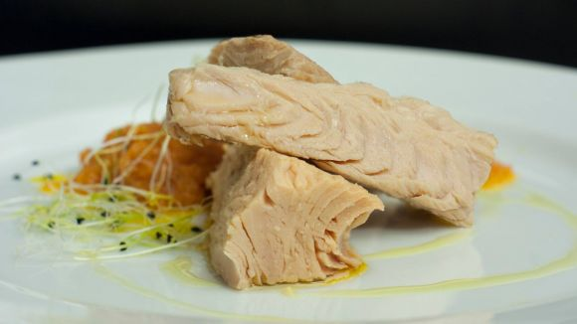
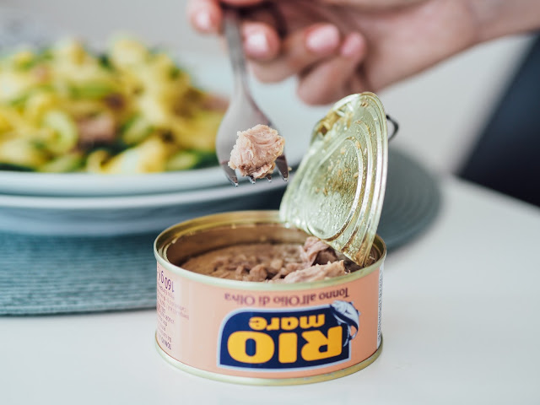
you can buy tuna in the shop, it's called tuna

Slide 10
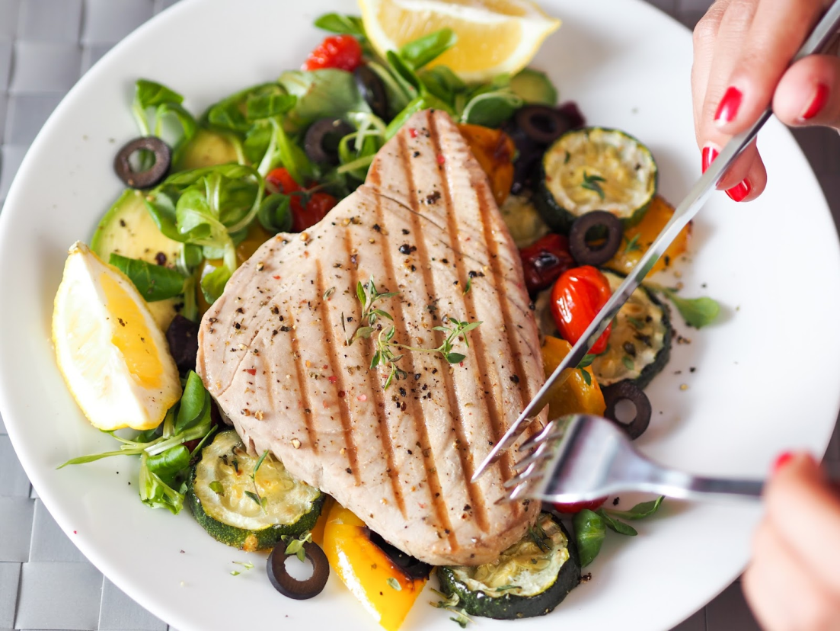
Tuna on the plate
in restaurants they make delicious meals like salads, wraps, char-grilled dishes and also sushi

Slide 11
https://www.google.com/url?sa=i&url=https%3A%2F%2Fwww.luluhypermarket.com%2Fen-om%2Ffresh-tuna-fish-small-1kg-approx-weight%2Fp%2F769547_EA&psig=AOvVaw04nfftu6OHcQt5SoxGdQQ_&ust=1617210007843000&source=images&cd=vfe&ved=0CAIQjRxqFwoTCIC4kfO-2O8CFQAAAAAdAAAAABAh
https://www.google.com/url?sa=i&url=http%3A%2F%2Fmojebarevnakuchyne.blogspot.com%2F2017%2F05%2Ftunak-s-grilovanou-zeleninou.html&psig=AOvVaw34wVu_wisaBmjKL1ogby9d&ust=1617210360949000&source=images&cd=vfe&ved=0CAIQjRxqFwoTCNCOoJvA2O8CFQAAAAAdAAAAABAD
https://www.google.com/url?sa=i&url=http%3A%2F%2Fmojebarevnakuchyne.blogspot.com%2F2017%2F06%2Ftunak-s-chrestem-testovinami.html&psig=AOvVaw34wVu_wisaBmjKL1ogby9d&ust=1617210360949000&source=images&cd=vfe&ved=0CAIQjRxqFwoTCNCOoJvA2O8CFQAAAAAdAAAAABAJ
https://www.google.com/url?sa=i&url=https%3A%2F%2Frybolovnorsko.cz%2F2018%2F10%2Ftunak-utoci-na-farmy%2F&psig=AOvVaw0tN9oFZsz3iJLCgDb51y8G&ust=1617210398393000&source=images&cd=vfe&ved=0CAIQjRxqFwoTCLDp66zA2O8CFQAAAAAdAAAAABAD
https://www.google.com/url?sa=i&url=http%3A%2F%2Fwww.fao.org%2Fin-action%2Fglobefish%2Fmarket-reports%2Fresource-detail%2Fen%2Fc%2F1268643%2F&psig=AOvVaw0VWG_Ann7ErMCEr9qMoHjr&ust=1617210433712000&source=images&cd=vfe&ved=0CAIQjRxqFwoTCOiu-r7A2O8CFQAAAAAdAAAAABAD
https://www.google.com/url?sa=i&url=https%3A%2F%2Fwww.fishfiles.com.au%2Fconsuming%2Fbuying%2Fchoosing-species%2FBlue-Mackerel-118&psig=AOvVaw0VWG_Ann7ErMCEr9qMoHjr&ust=1617210433712000&source=images&cd=vfe&ved=0CAIQjRxqFwoTCOiu-r7A2O8CFQAAAAAdAAAAABAJ
https://www.google.com/url?sa=i&url=http%3A%2F%2Fwww.seaaroundus.org%2Fchinas-bohai-sea-left-with-only-tiny-fish%2F&psig=AOvVaw1SK80Nku4TbZawDeMSq1CF&ust=1617210477258000&source=images&cd=vfe&ved=0CAIQjRxqFwoTCNjdvtLA2O8CFQAAAAAdAAAAABAD
https://www.google.com/url?sa=i&url=https%3A%2F%2Fwww.pinterest.com%2Fpin%2F487796203370089606%2F&psig=AOvVaw3EPEA6jcr-TQC3DyHJCZ4k&ust=1617210516344000&source=images&cd=vfe&ved=0CAIQjRxqFwoTCKCikeXA2O8CFQAAAAAdAAAAABAJ
https://www.google.com/url?sa=i&url=https%3A%2F%2Fwww.pinterest.es%2Fpin%2F433753007856581495%2F&psig=AOvVaw1SK80Nku4TbZawDeMSq1C
F&ust=1617210477258000&source=images&cd=vfe&ved=0CAIQjRxqFwoTCNjdvtLA2O8CFQAAAAAdAAAAABAI
https://www.google.com/url?sa=i&url=https%3A%2F%2Fwww.nationalgeographic.com%2Ftravel%2Farticle%2F120828-amphipods-oceans-mariana-trench-wood-science-animals&psig=AOvVaw3EPEA6jcr-TQC3DyHJCZ4k&ust=1617210516344000&source=images&cd=vfe&ved=0CAIQjRxqFwoTCKCikeXA2O8CFQAAAAAdAAAAABAO
https://www.google.com/url?sa=i&url=https%3A%2F%2Fsciencing.com%2Flist-singlecell-organisms-8543654.html&
psig=AOvVaw05ZzR38vUwkVCo1UaQyjcH&ust=1617210558636000&source=images&cd=vfe&ved=0CAIQjRxqFwoTCPDNn_nA2O8CFQAAAAAdAAAAABAD
https://www.google.com/url?sa=i&url=https%3A%2F%2Fwww.sciencenews.org%2Farticle%2Fone-celled-life-possessed-tools-going-multicellular&psig=AOvVaw05ZzR38vUwkVCo1UaQyjcH&ust=1617210558636000&source=images&cd=vfe&ved=0CAIQjRxqFwoTCPDNn_nA2O8CFQAAAAAdAAAAABAI

