Slide 1
FOOD CHAIN
By: Anna Balaštíková, Adéla Forstová, Johana Mráčková, Jaroslav Vojáček, Filip Vysloužil

Slide 2
Plantation preparation

Slide 3
Planting pineapples

Slide 4
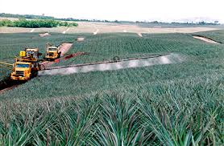
Spraying treatment at the time

Slide 5
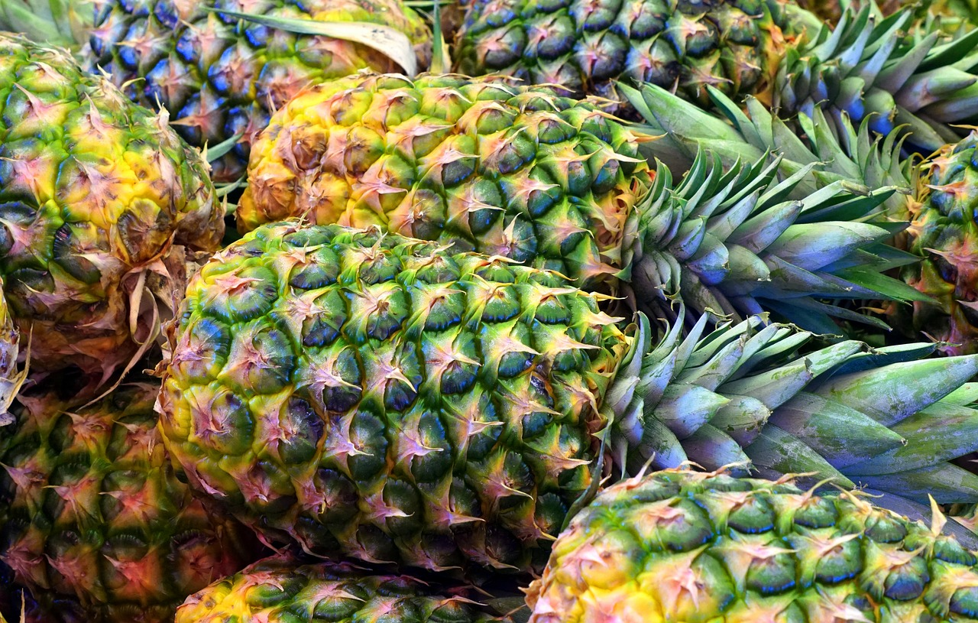
Ripening pineapples

Slide 6
Hand harvest

Slide 7
Sorting pineapples according to quality, size or ripeness

Slide 8
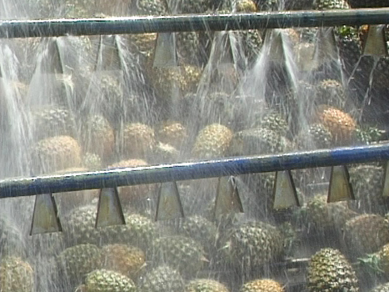
Washing and processing of pineapples

Slide 9
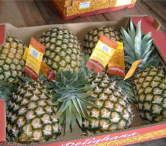
Burning into shopping boxes

Slide 10
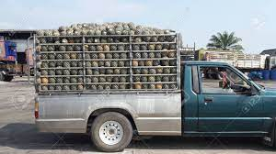
Transport to shop

Slide 11
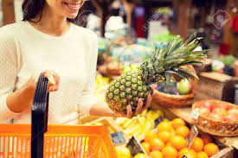
For sale in the shop

Slide 12
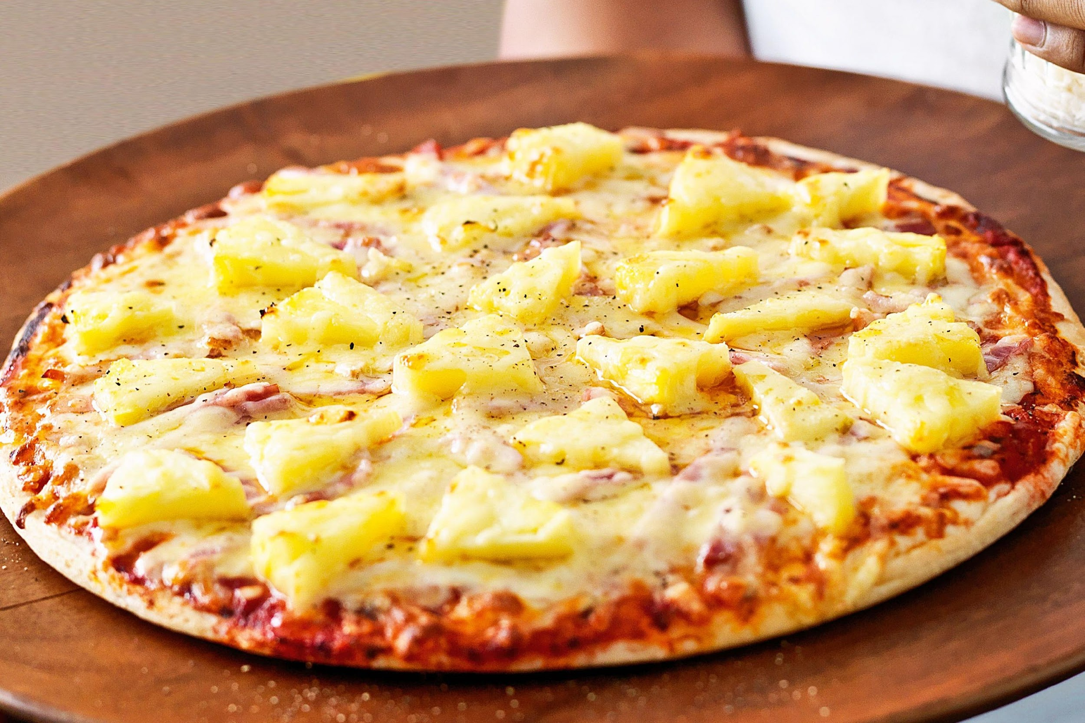
Pineapple in food

Slide 13
SOURCES:
https://www.ireceptar.cz/galerie/ananas-pestovani-20200718.html?photo=1
https://www.apsnet.org/edcenter/apsnetfeatures/Pages/Pineapple.aspx
https://our-dog.ru/cs/pitanie/kak-vyglyadit-tavolga-labaznik-ili-tavolga-posadka-i-uhod-v-otkrytom-grunte-vidy/
https://www.taste.com.au/recipes/bacon-cheddar-pineapple-pizza/d512a8cc-16b5-410e-9279-c53b3a742620
https://www.123rf.com/photo_49524749_sale-shopping-consumerism-and-people-concept-close-up-of-young-woman-with-food-basket-and-pineapple-.html
https://www.123rf.com/photo_95167089_pineapple-fruit-truck.html
https://www.123rf.com/photo_95167089_pineapple-fruit-truck.html
https://www.bananalink.org.uk/why-pineapples-matter
https://www.nasezahrada.com/poznate-zraly-ananas-mame-pro-vas-nekolik-tipu
http://www.ticomachine.com/faq/pineapple-juice-extraction-machine.html
https://www.itfnet.org/v1/2016/05/pineapple-post-harvest-processing/
https://www.ireceptar.cz/galerie/ananas-pestovani-20200718.html?photo=1
https://www.veselebydleni.cz/magazin/jak-vypestovat-ananas-z-odrezku

