Slide 1
Food chain presentation
SUGAR BEETS

Slide 2
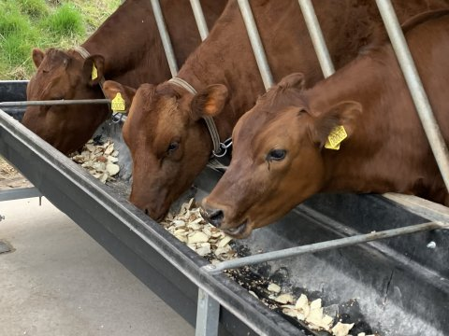
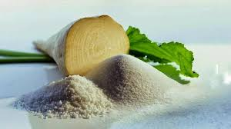
Sugar beets are used to make sugar. Only a small portion is used for animal feed

Slide 3
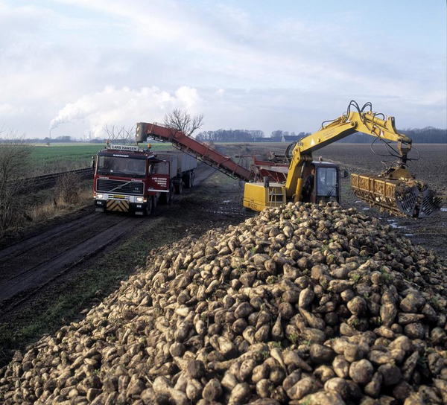
Harvest in the field with the factory in the background

Slide 4
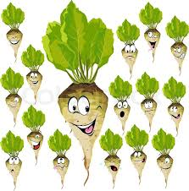
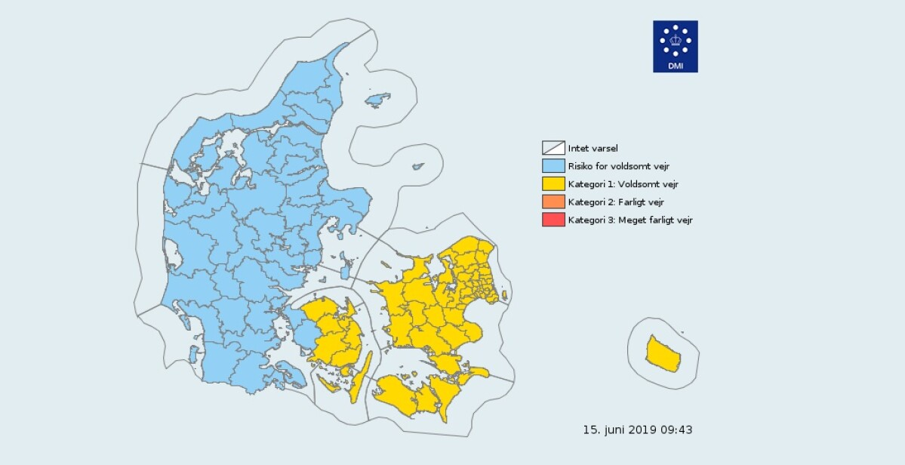
In Denmark beets grow especially on Lolland, Falster and Sjælland where the soil is extra good (yellow map)

Slide 5
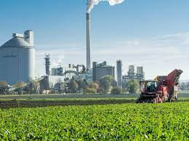
Sugar beets on the factory
20% of the beet is sugar, and you want to get hold of it.
First, the beets are washed and cleaned of soil and stones. Then they are driven through a machine,
which cuts them into thin pieces. Then rinse the beets in 70 ° C hot water.
Precisely with that temperature, the water can draw almost all the sugar out of the beets.

Slide 6
More production
Now the sugar water continues, to the next step in production.
The juice still contains some impurities from the beets. It must be cleaned away before the sugar can form.
This is done by adding lime. When you subsequently blow CO² through the raw juice,
lime and impurities fall to the bottom. Various filters now clean the juice of the precipitate.

Slide 7
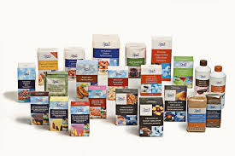
Last step
To get sugar crystals, add a little icing sugar and heat the thin juice until the water evaporates.
The heating is repeated several times until you have a sugar mass.
The sugar mass is divided into two products: liquid molasses and the pure white sugar.
Only now can it be dried and packed for sale.

Slide 8
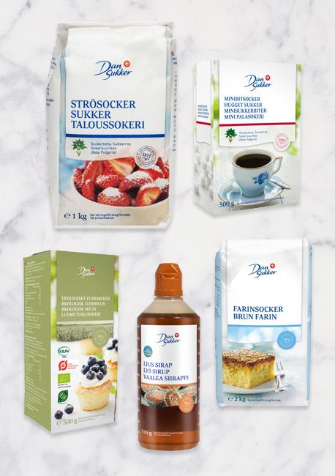
Sugar facts
Did you know that ... it only takes approx. 12 hours from the crops comes to the factory until the sugar is ready for packing?
A single sugar beet gives approx. 100 grams of sugar
In 2011/2012, Danisco produced 464.000 tonnes of sugar in Denmark

