Slide 1
Egg bread

Slide 2
ingredients
5-day old bread ( half ) ( not moudly)
7-8 eggs
200 grams lard or frying oil
Cucumbear
Ketchup

Slide 3
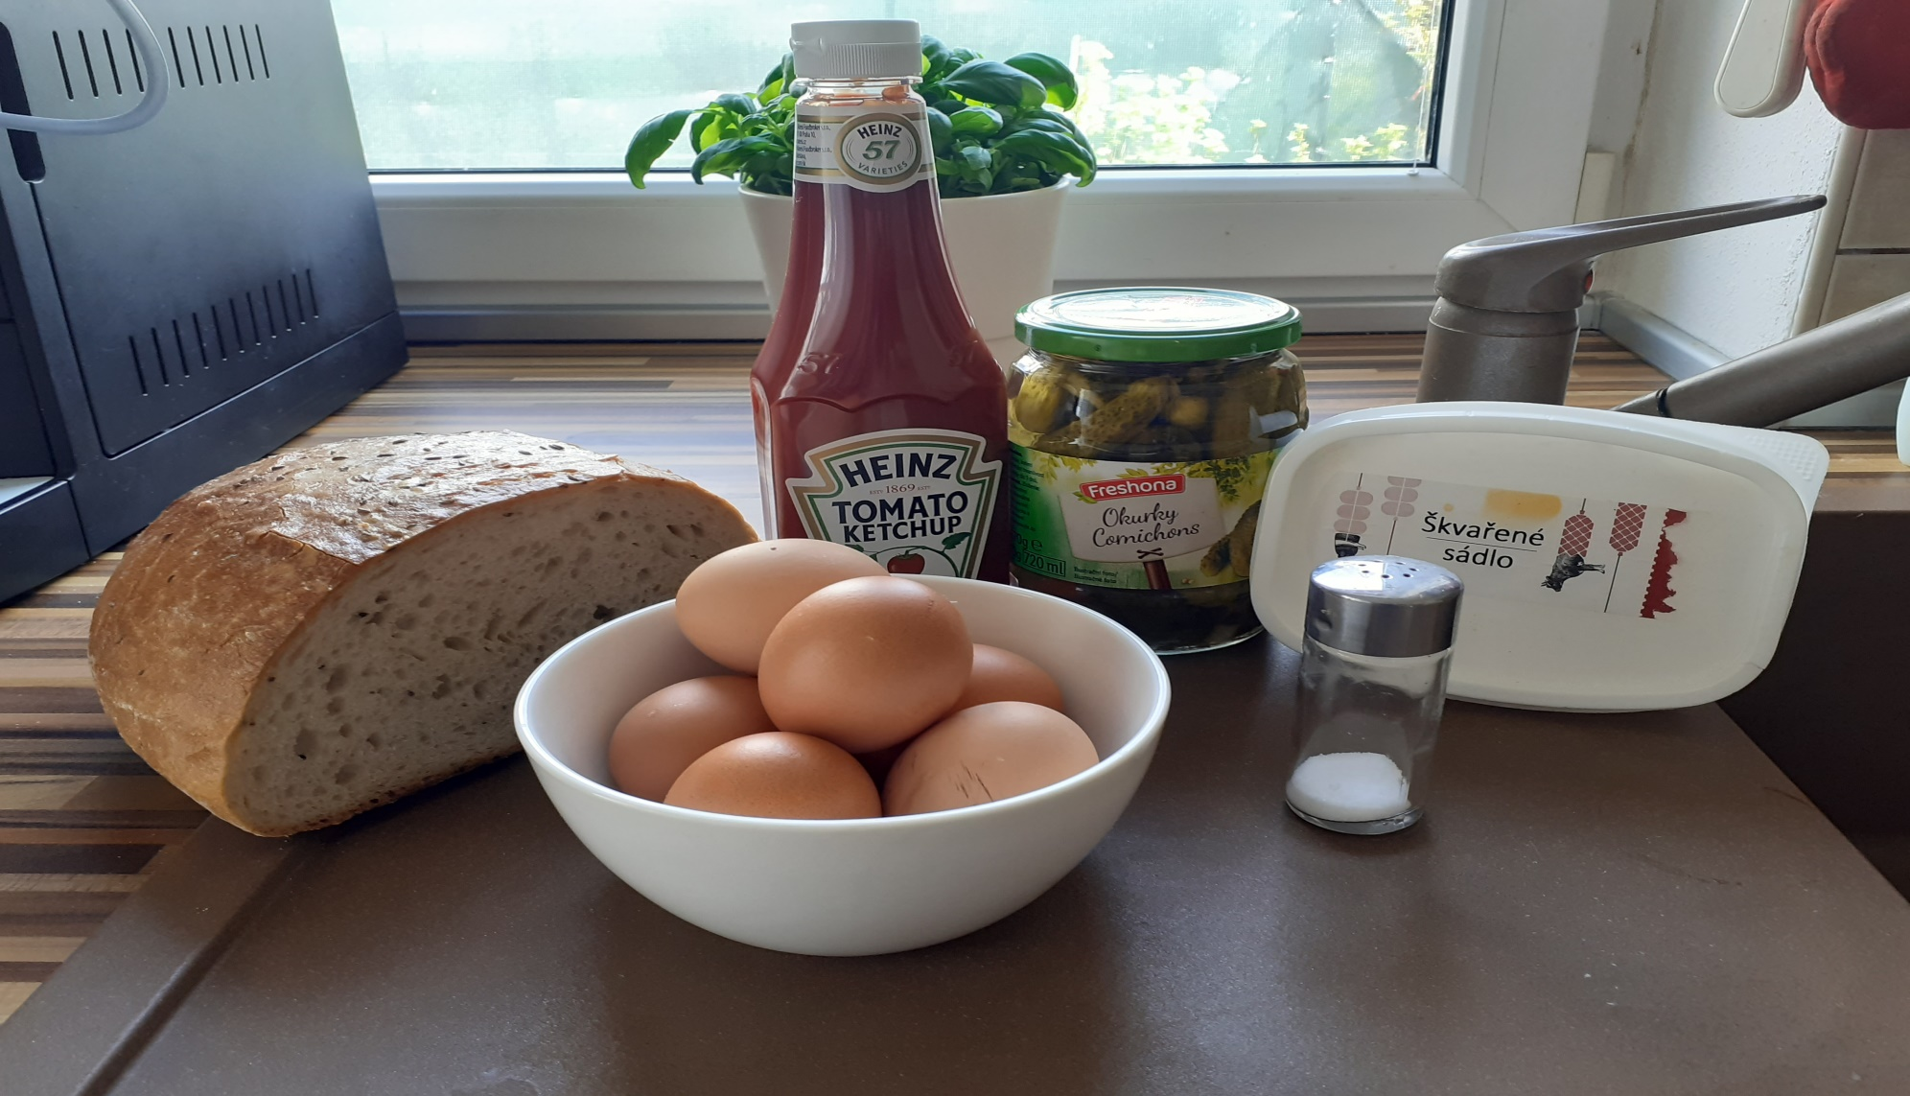
ingredients

Slide 4
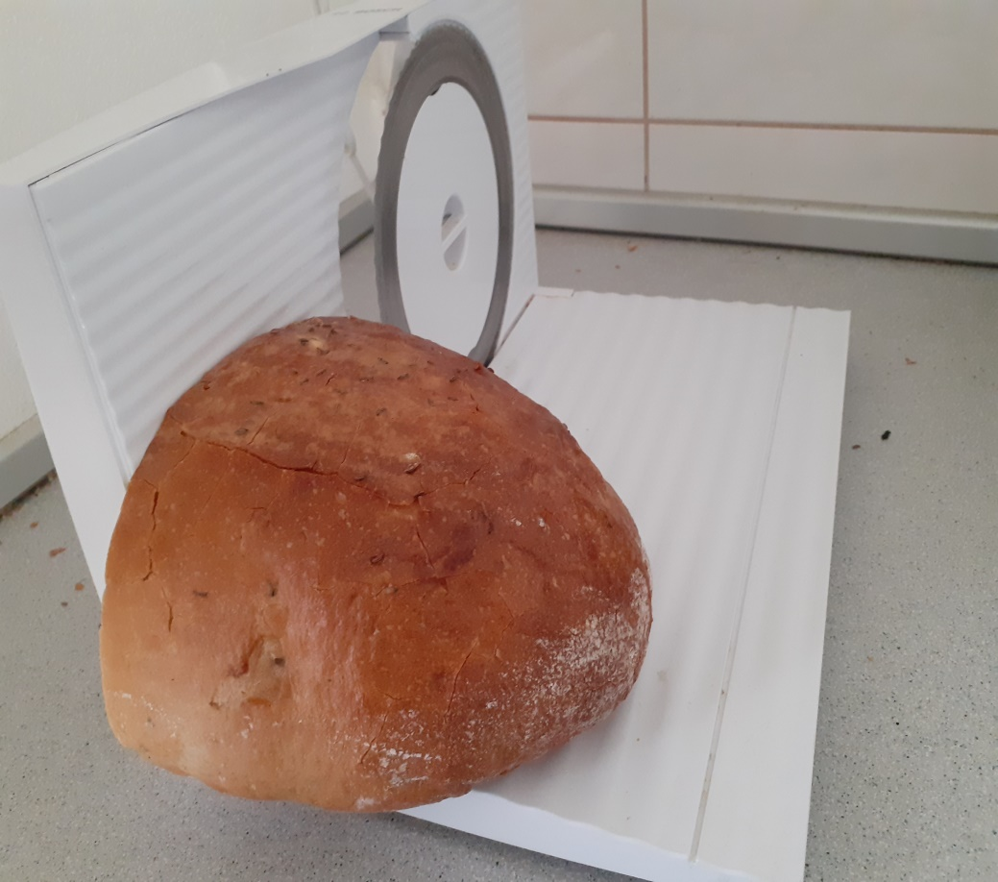
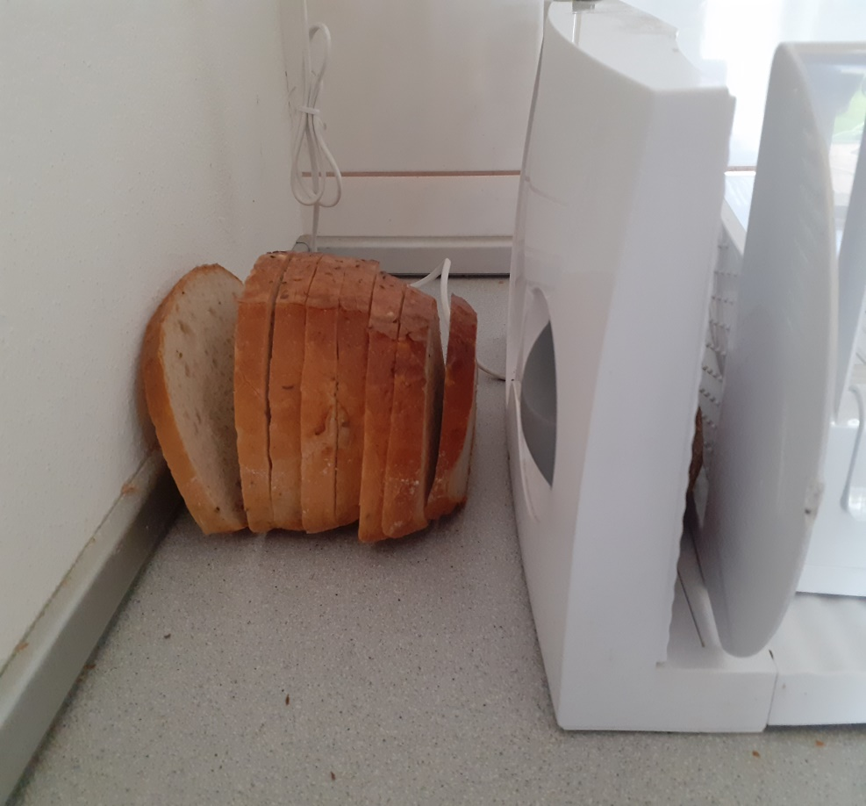
Cut the bread into slices

Slide 5
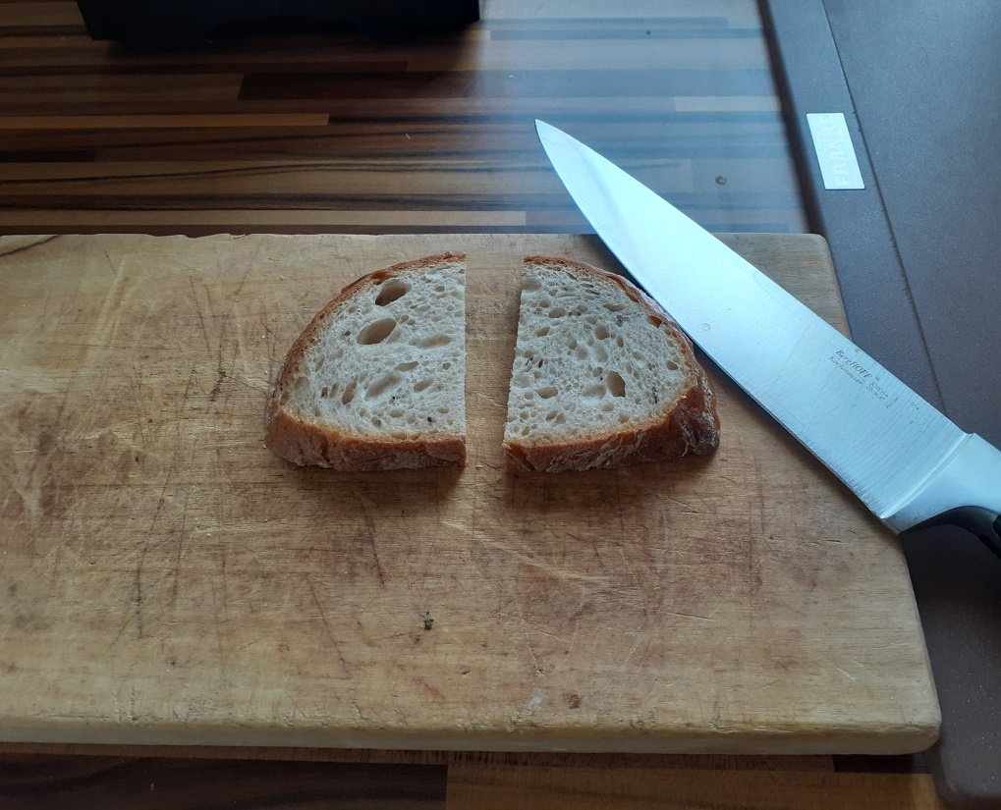
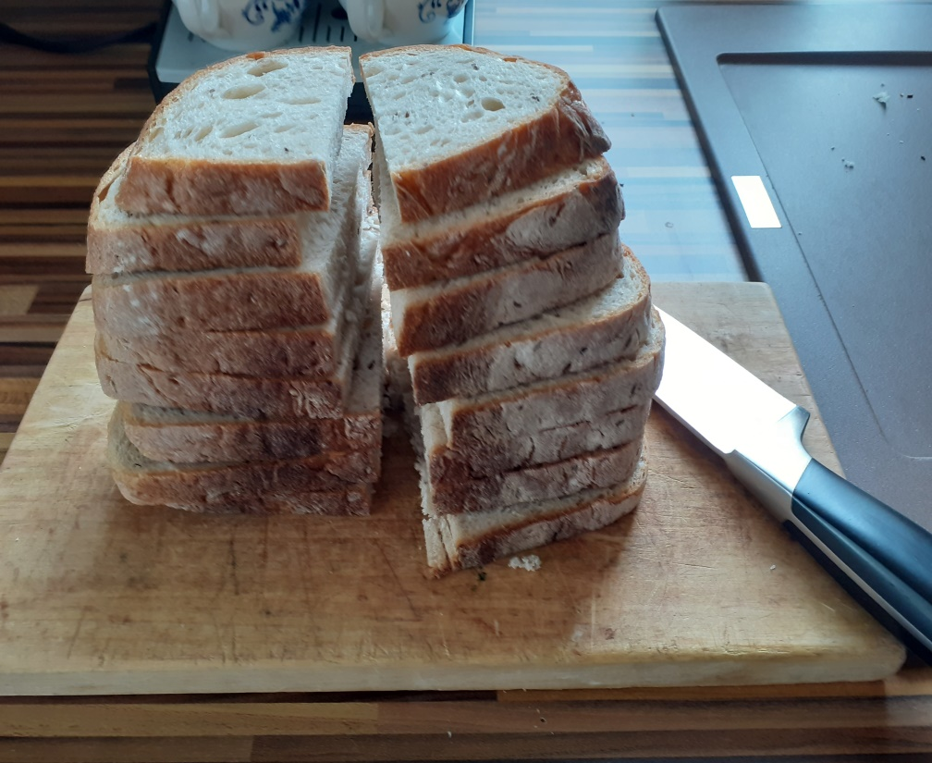
Cut bread

Slide 6
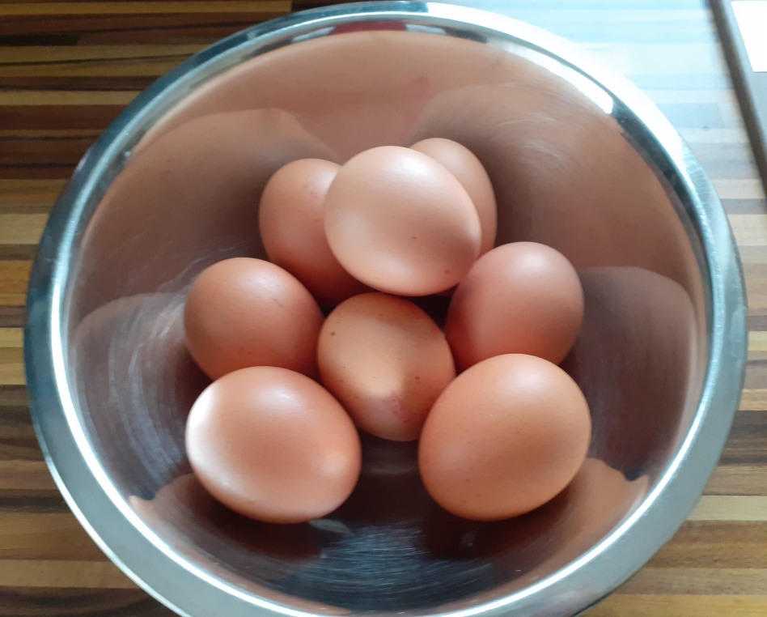
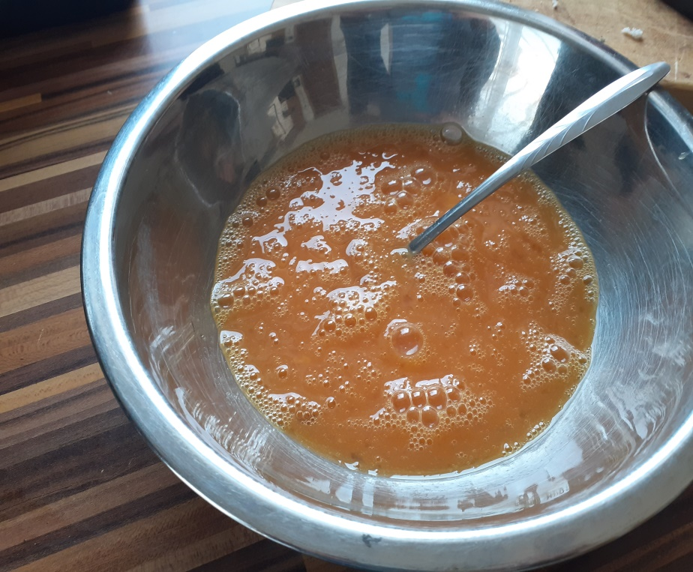
Crack the eggs into a bowl and beat until thoroughly mixed.

Slide 7
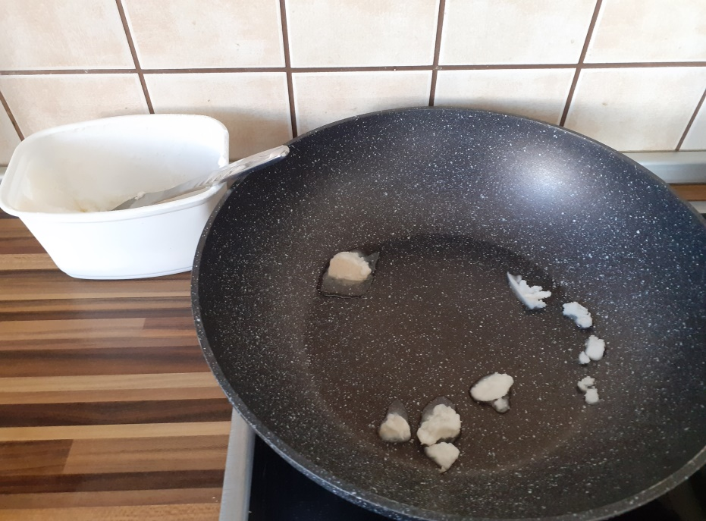
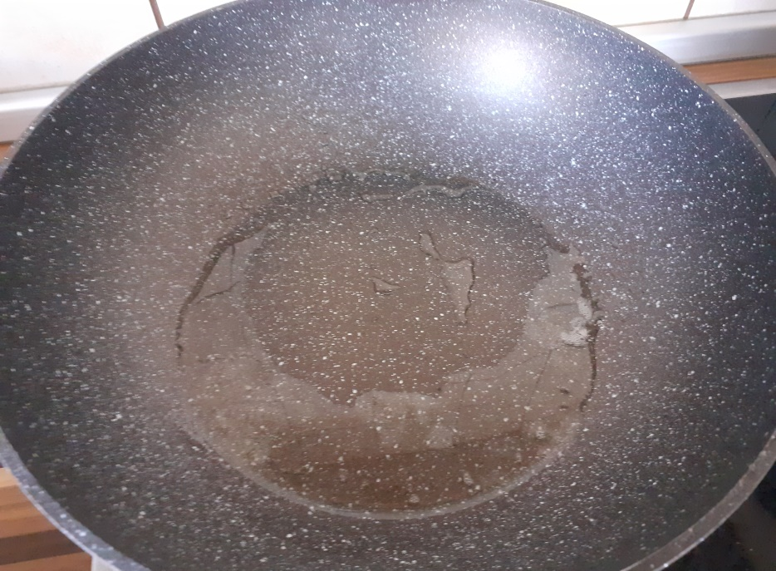
Place a pan on a high heat and add the lard.

Slide 8
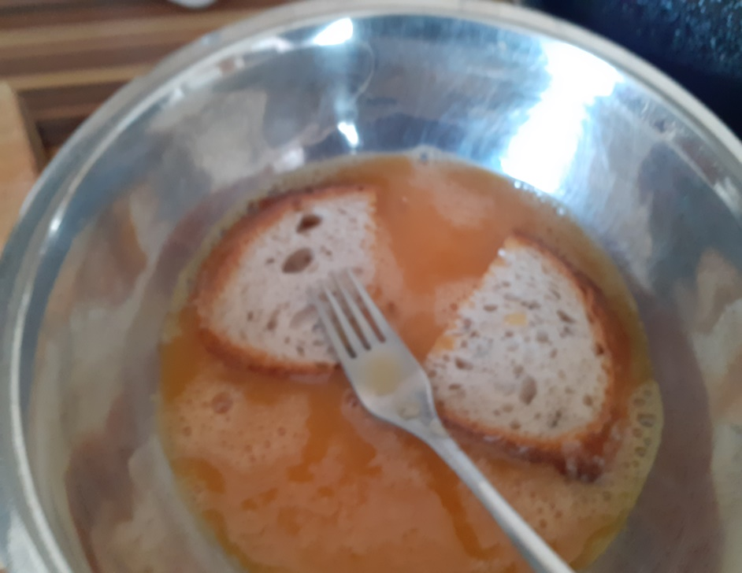
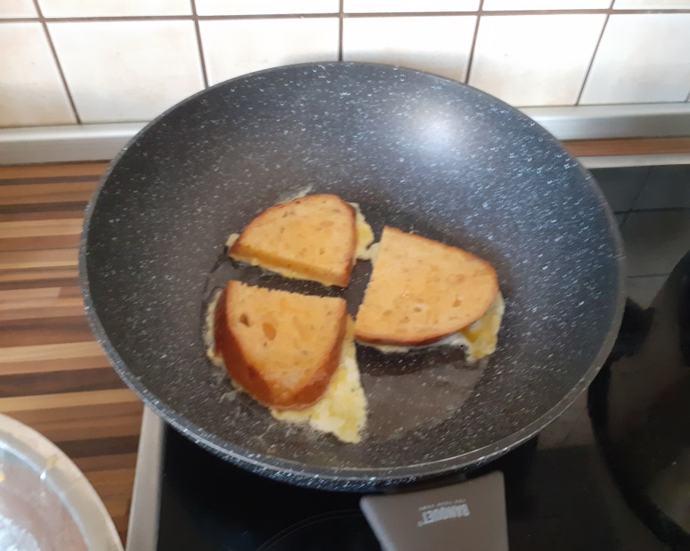
Soak the bread in the egg mixture. Place the bread into the pan and fry until golden brown.

Slide 9
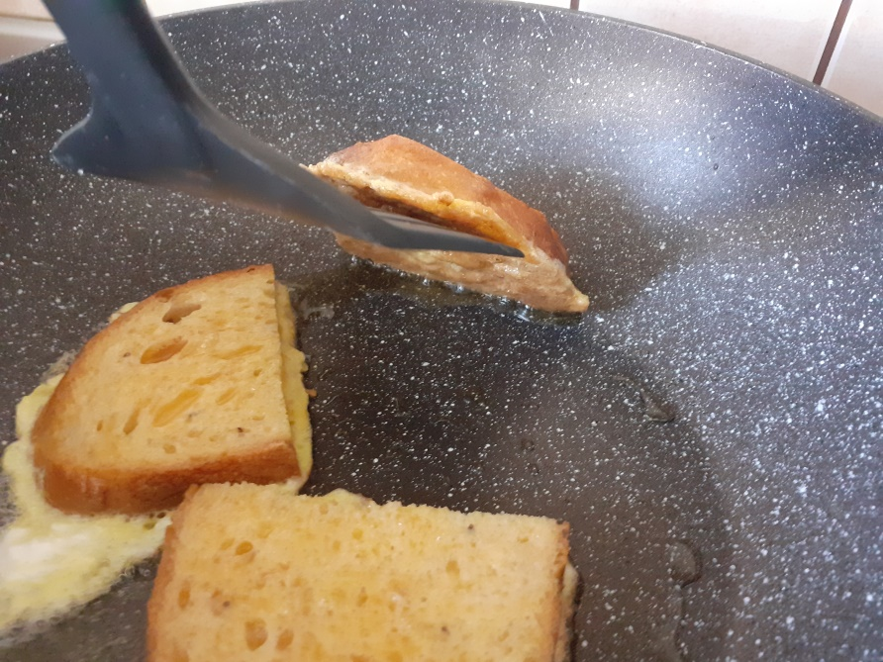
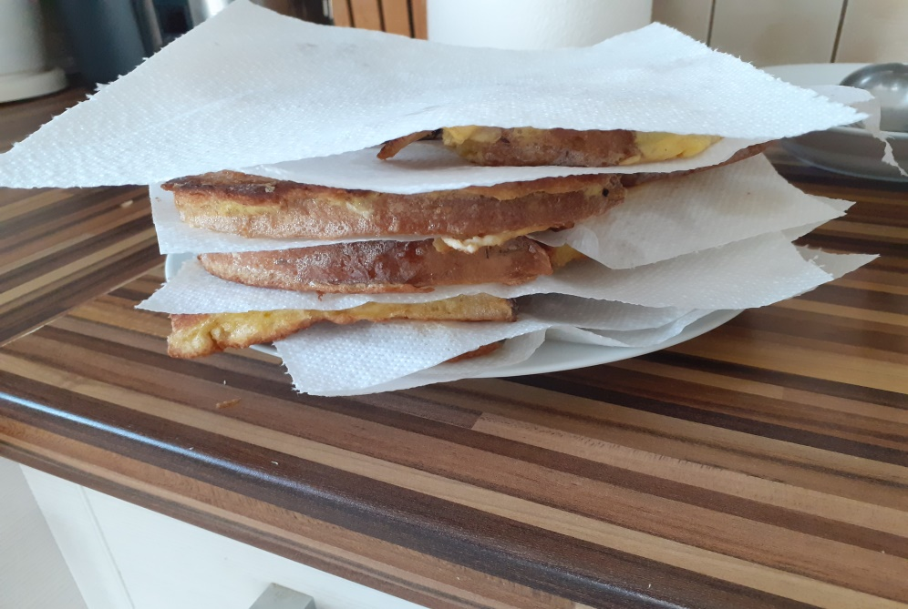
Remove the bread for pan and place on a plate with paper doily.

Slide 10
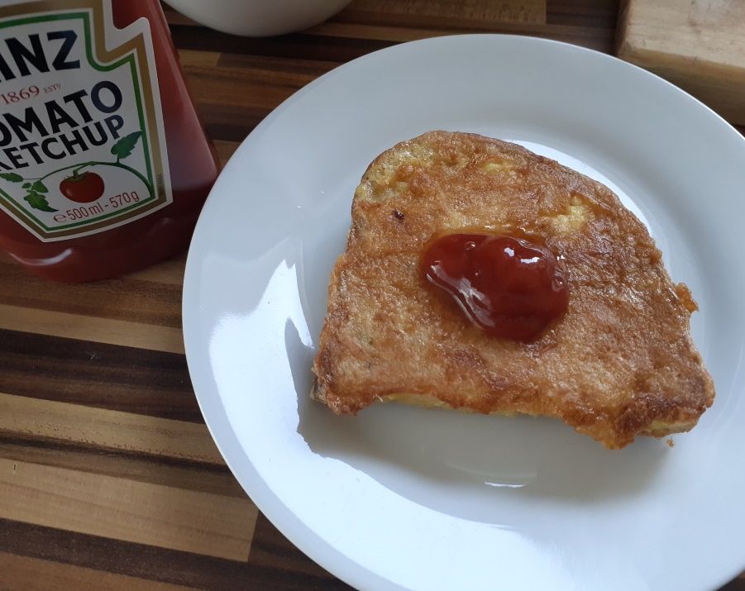
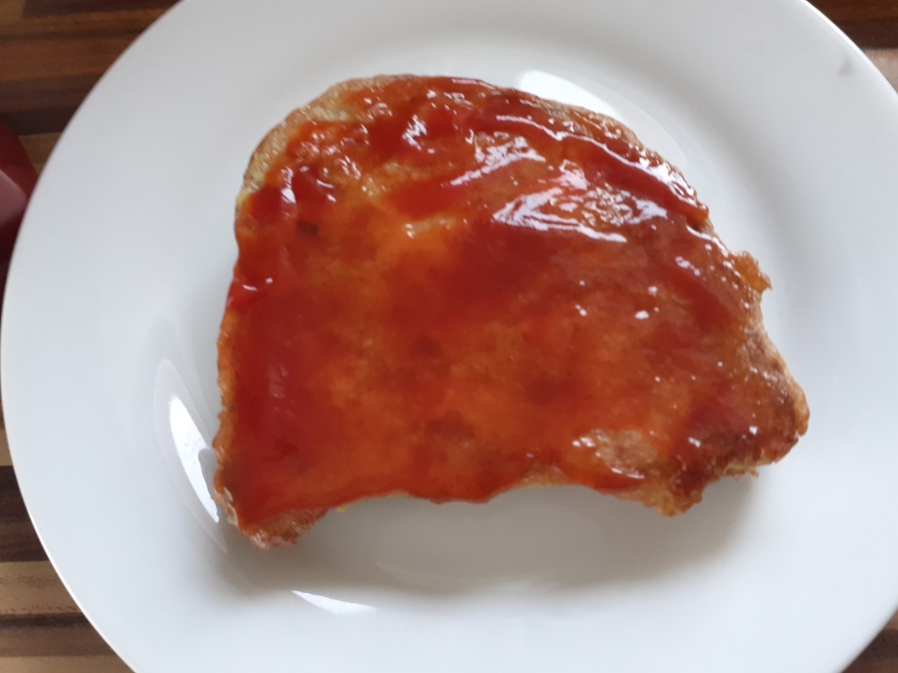
Add ketchup to taste on the bread

Slide 11
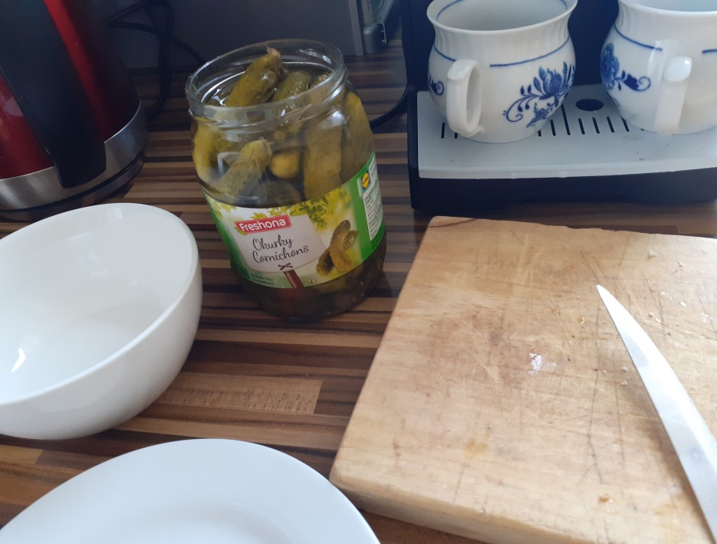
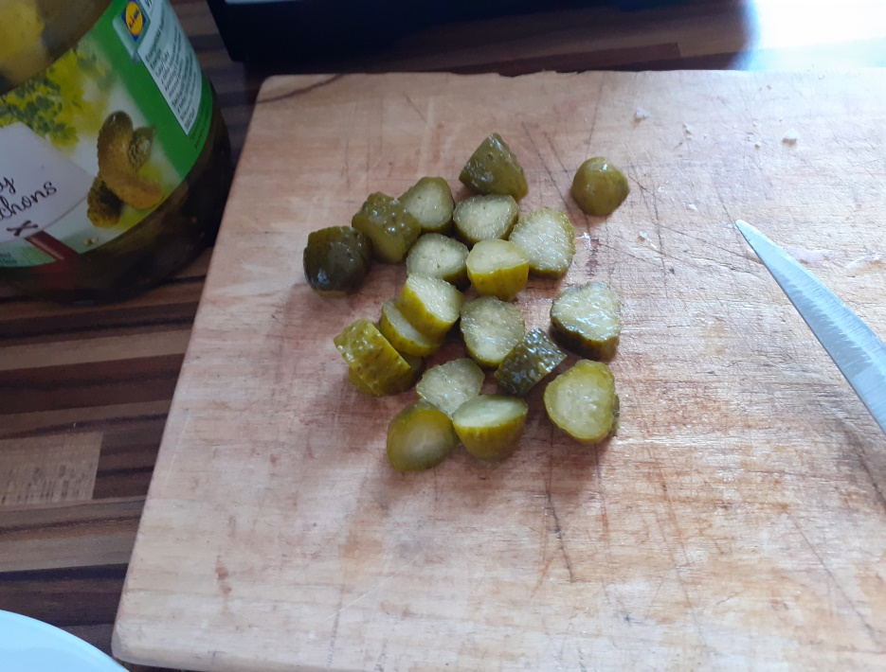
Take the cucumber and cut into slices and put on the bread.

Slide 12
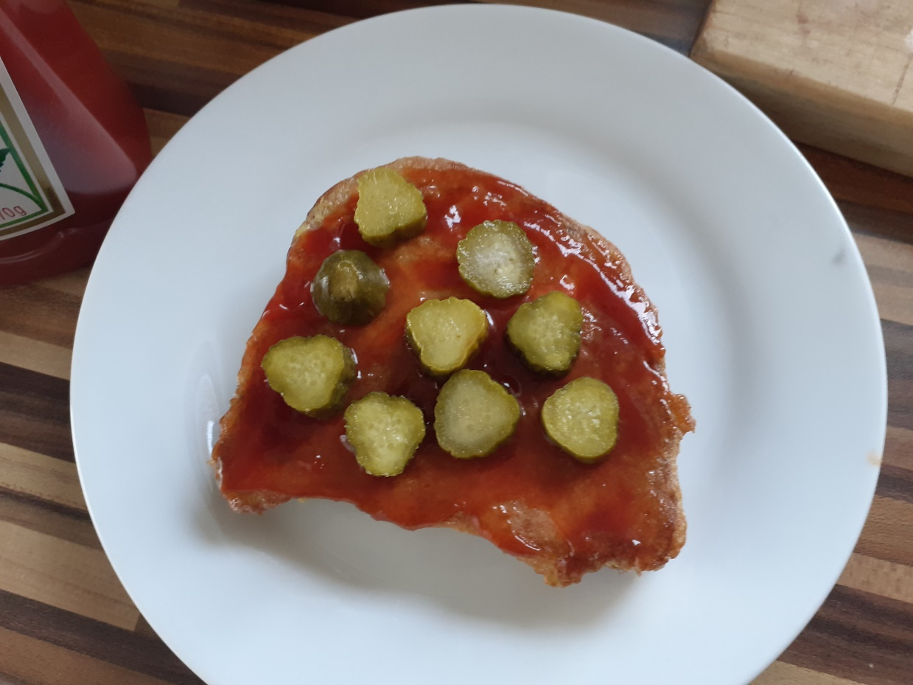
Enjoy your meal!

