Slide 1
Apple strudel

Slide 2
Ingredients:
1 pack of puff pastry
9 apples
1 egg
3 tablespoons sugar
3 tablespoons ground walnuts
3 tablespoons breadcrumbs
3 teaspoons ground cinnamon

Slide 3
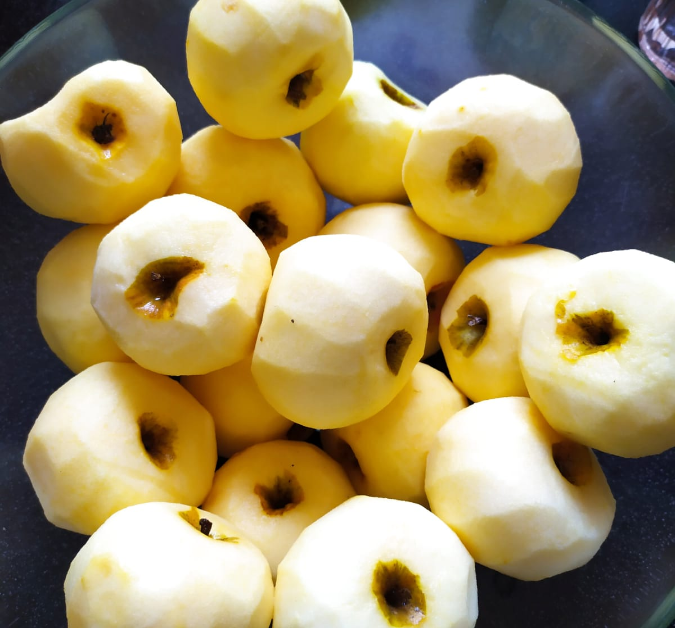
Peel the apples, remove the pips and grate them.

Slide 4
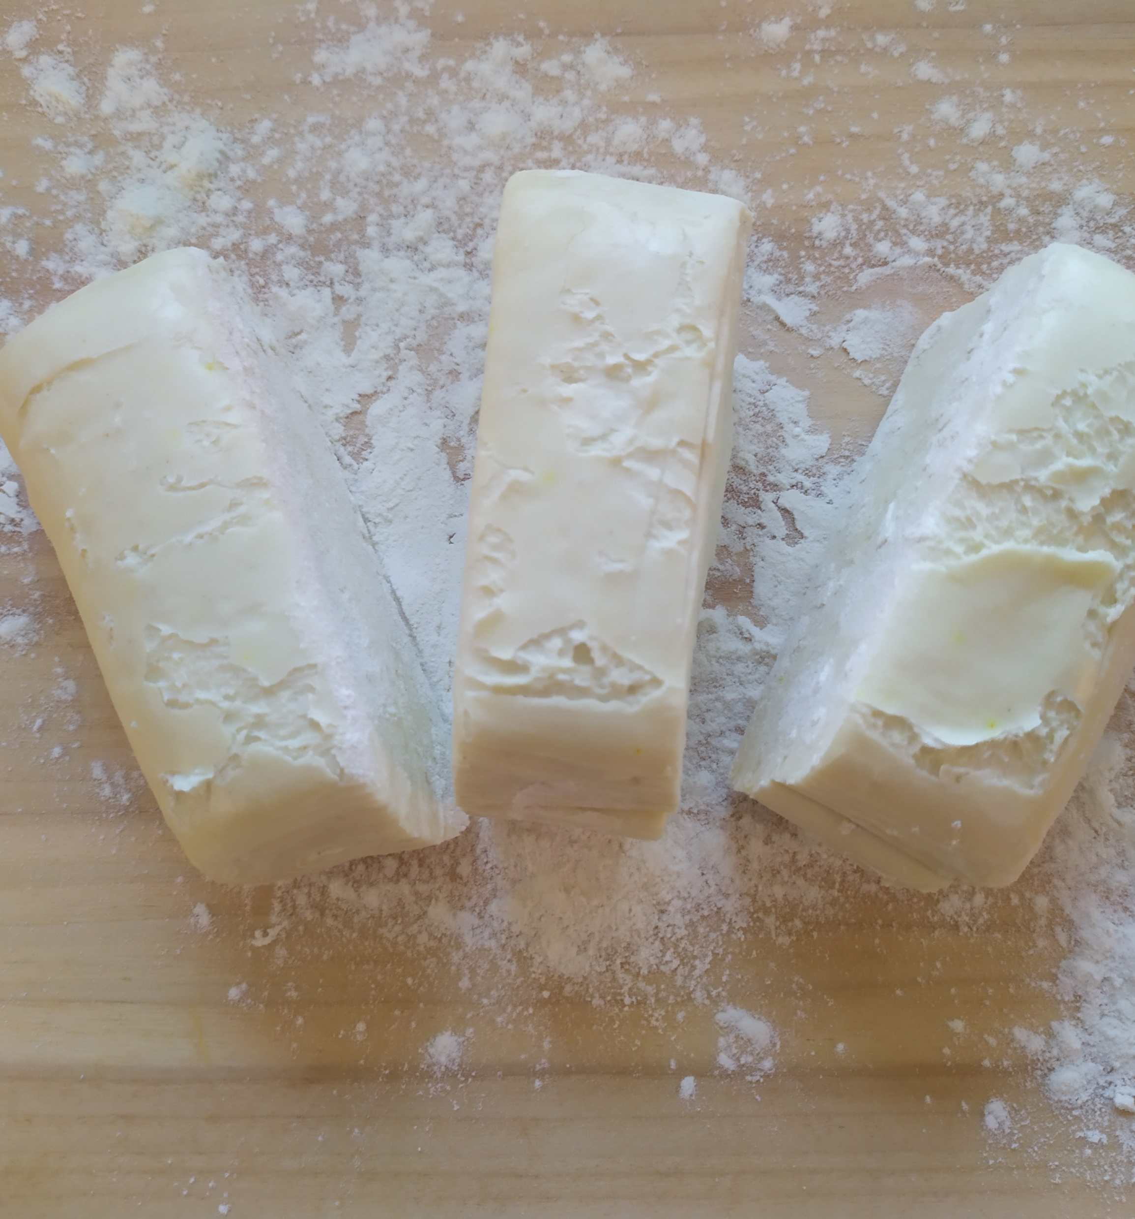
Divide the puff pastry into 3 equal parts

Slide 5
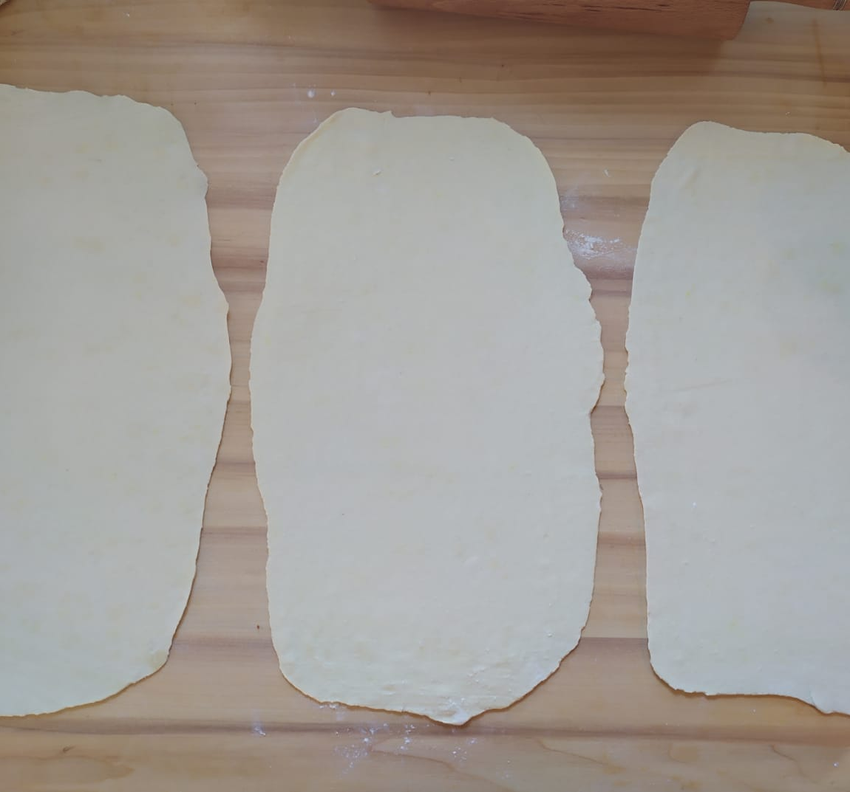
and roll them into thin rectangular shapes.

Slide 6
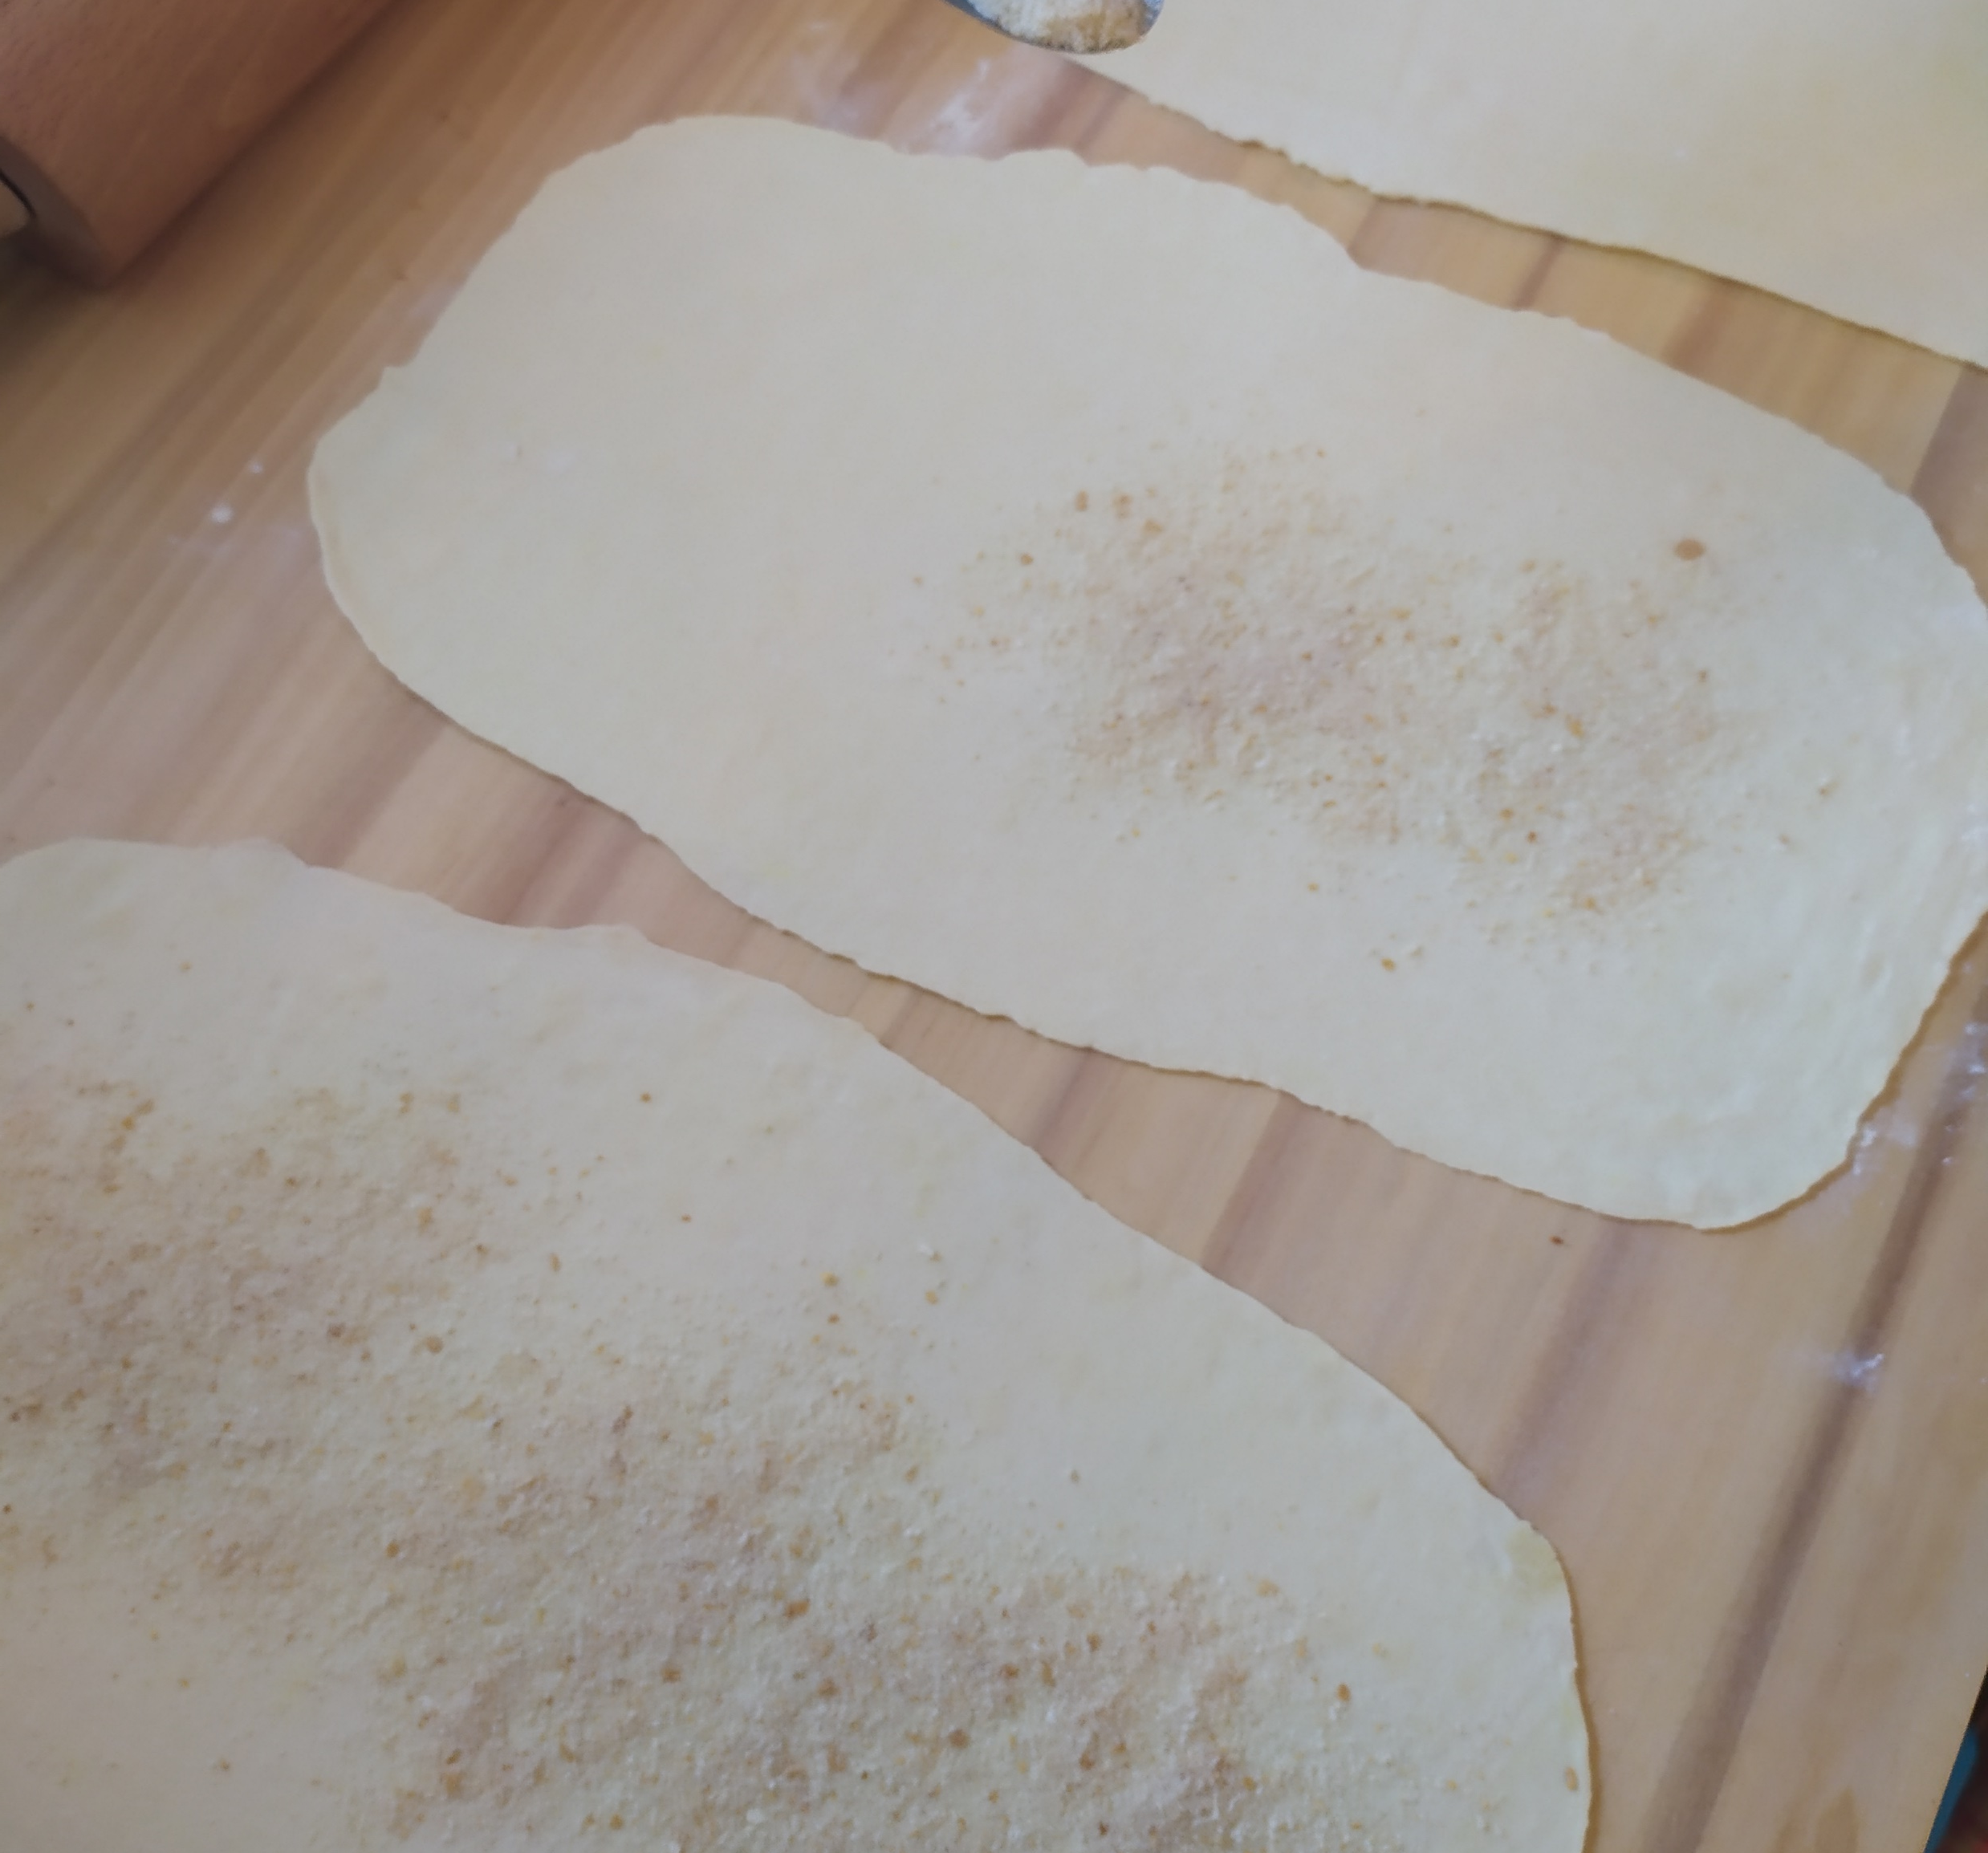
Lightly dust the puff pastry with breadcrumbs,

Slide 7
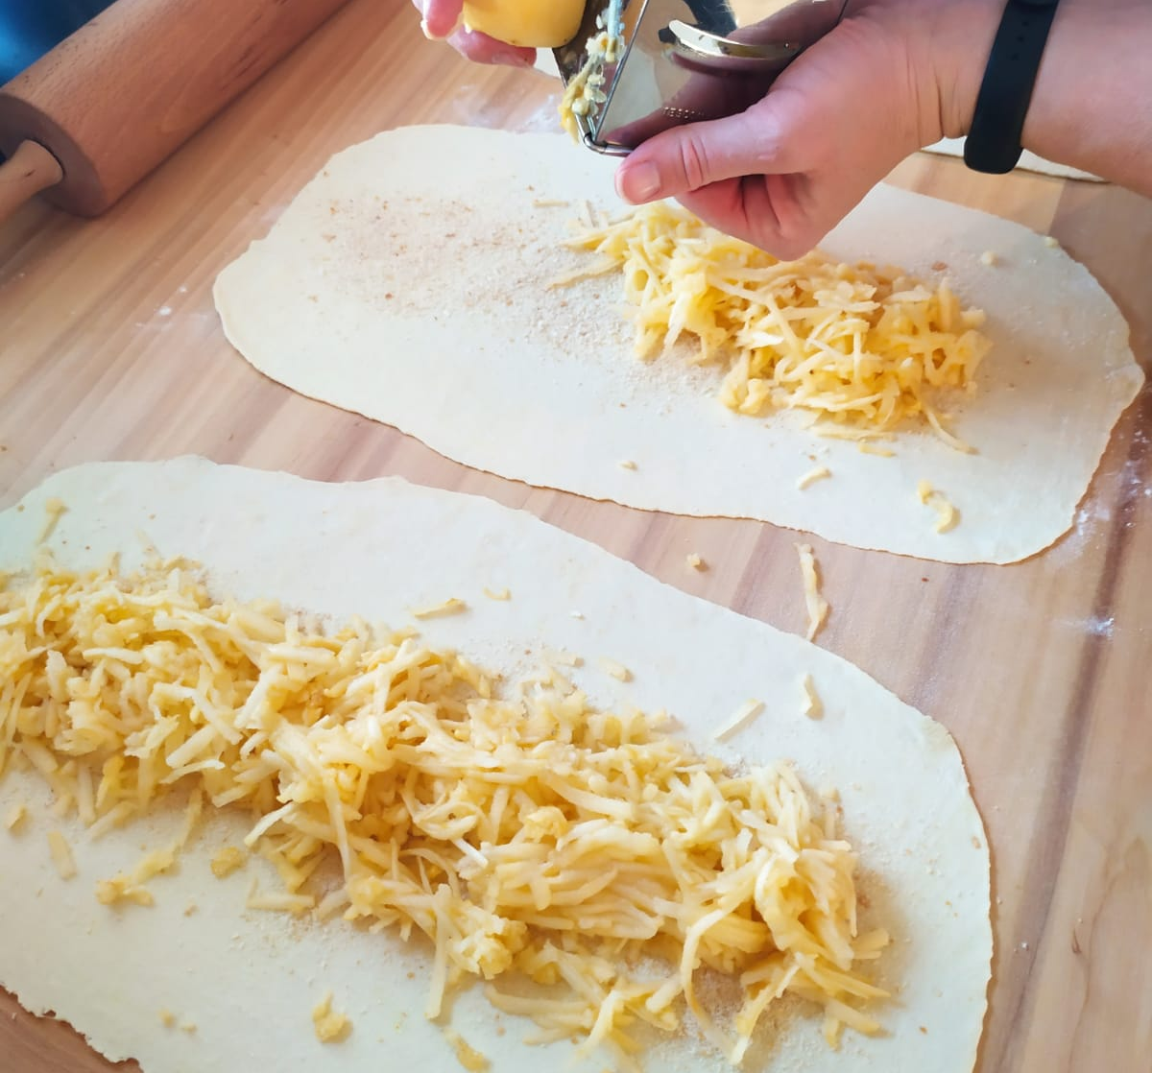
place apples in the middle,

Slide 8
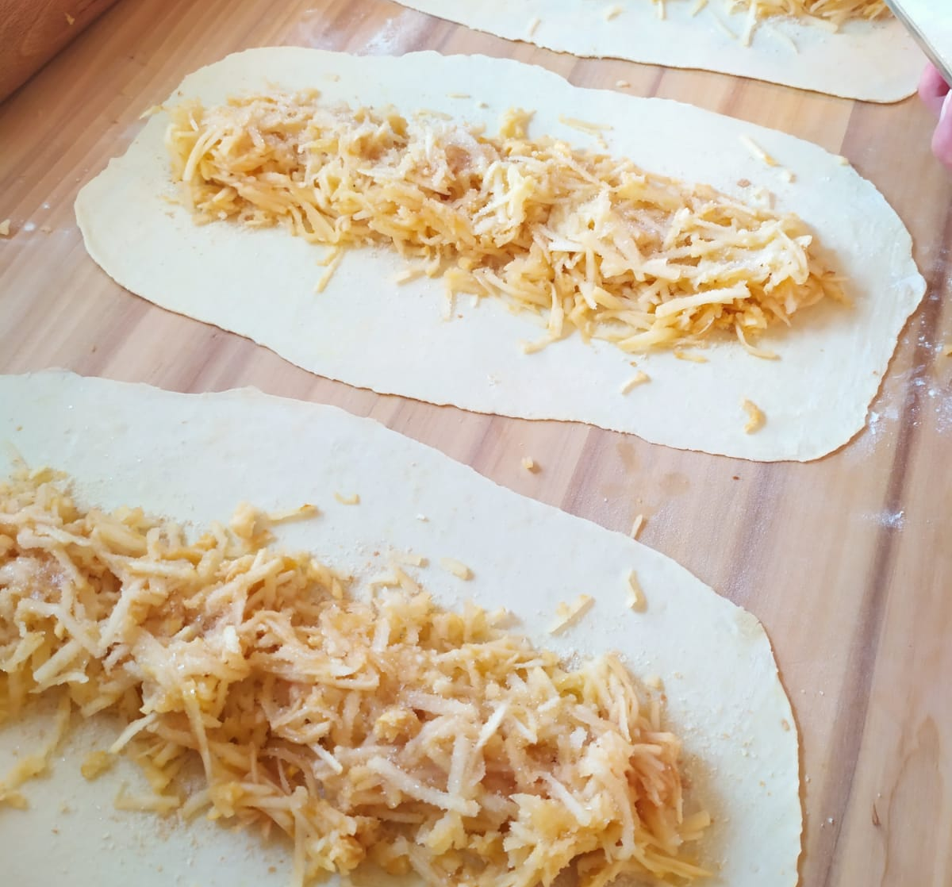
sprinkle with sugar,

Slide 9
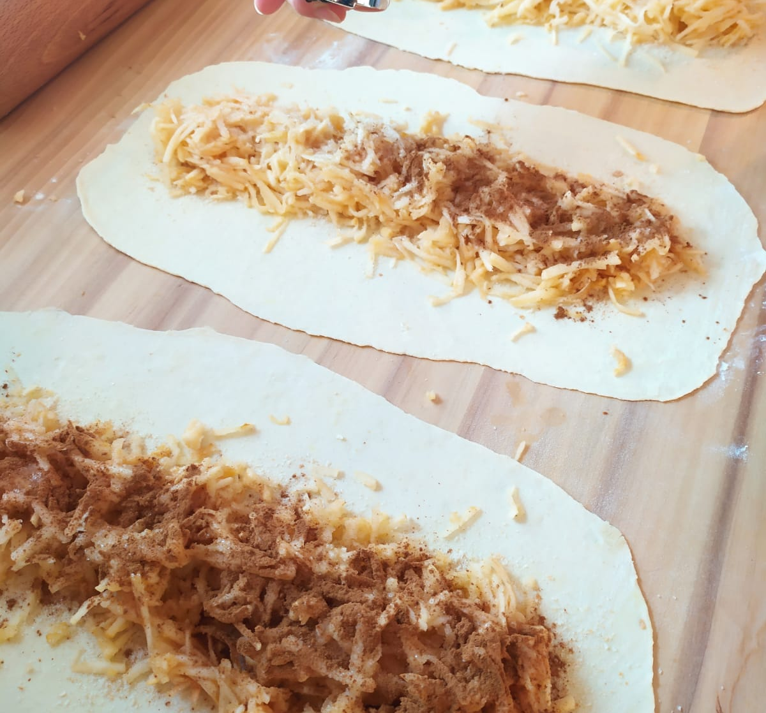
ground cinnamon

Slide 10
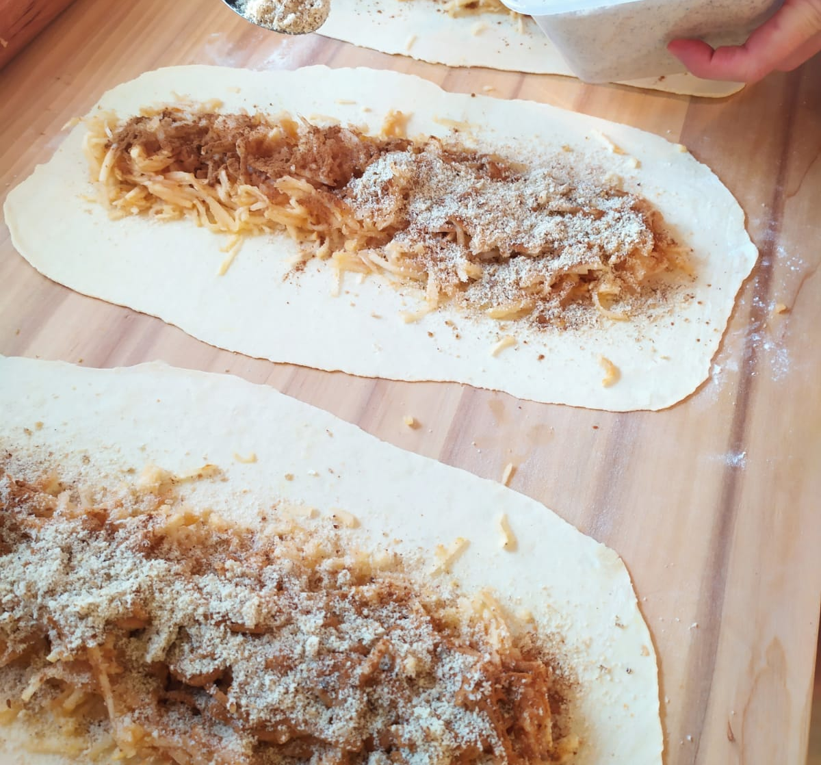
and walnuts

Slide 11
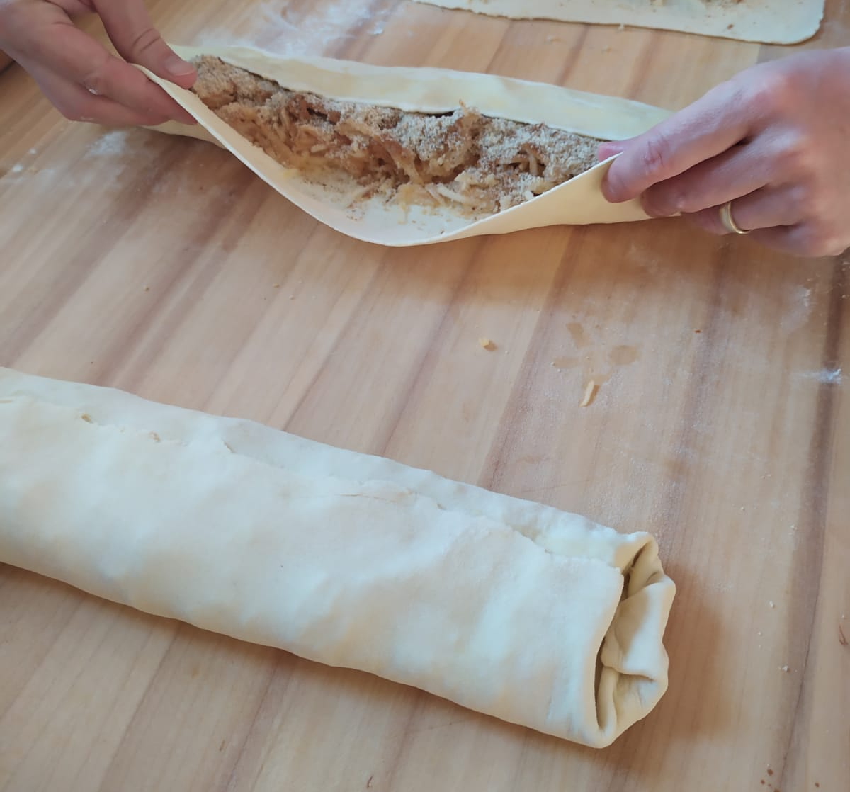
and wrap.

Slide 12
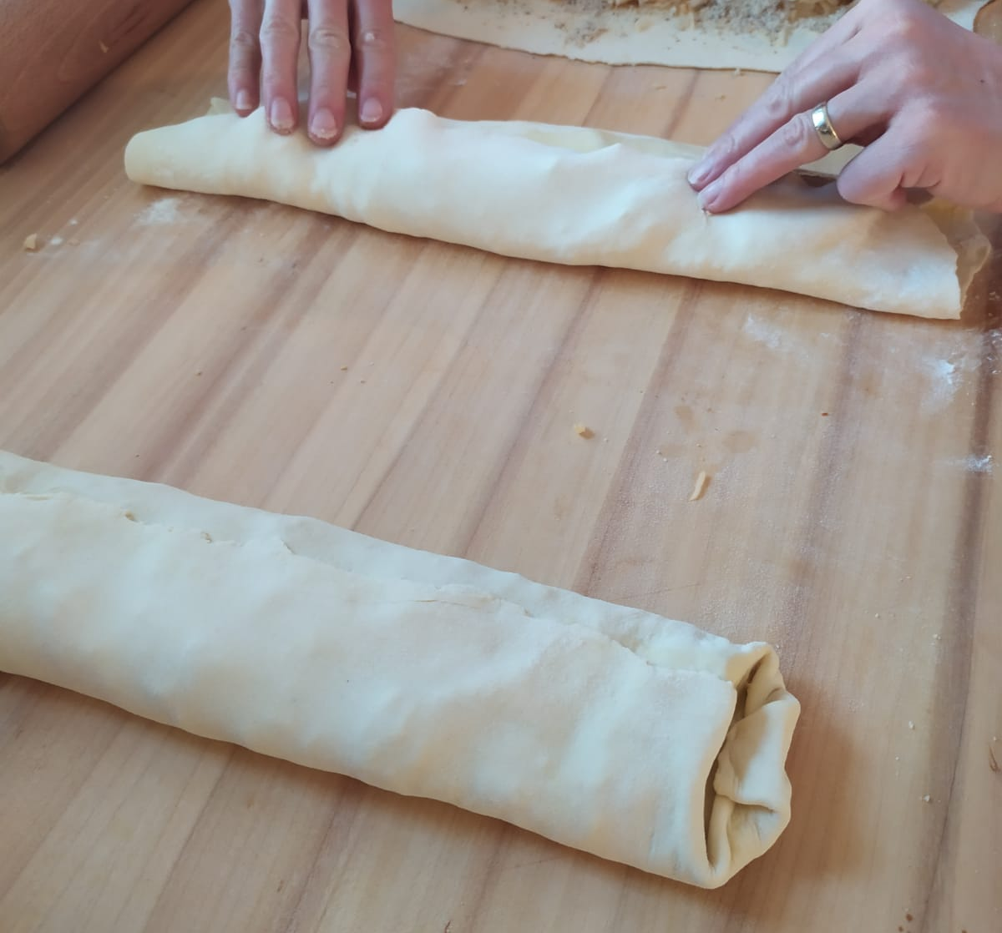

Slide 13
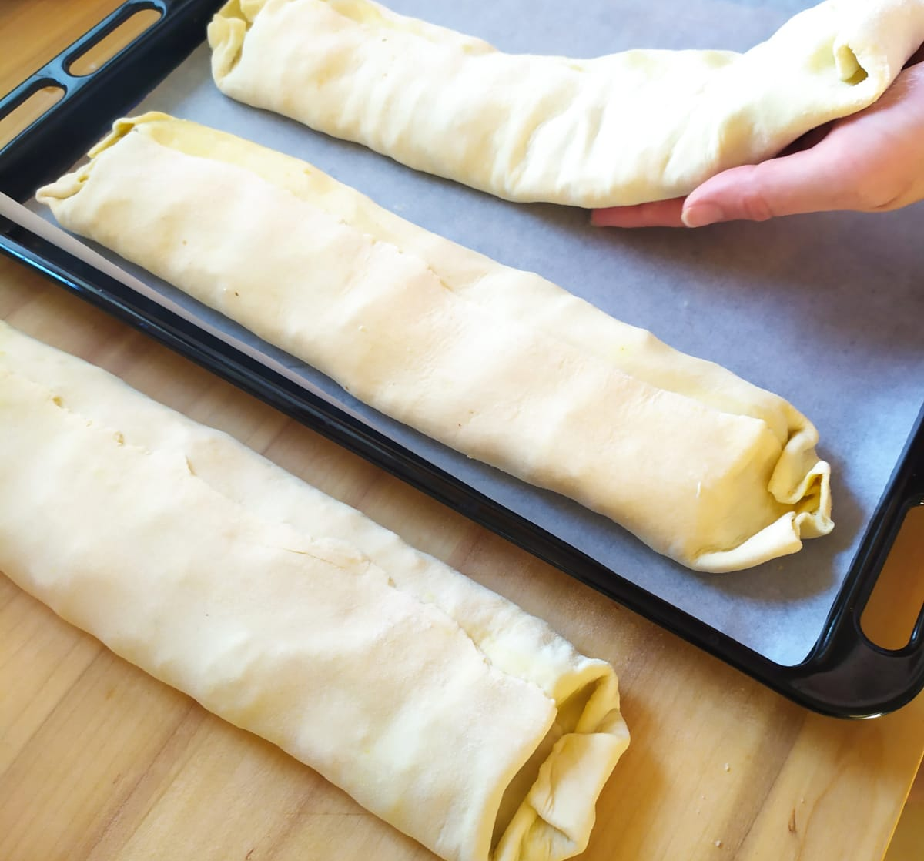
Fold the ends so that the mixture does not come out and carefully transfer the finished strudel to a baking sheet

Slide 14
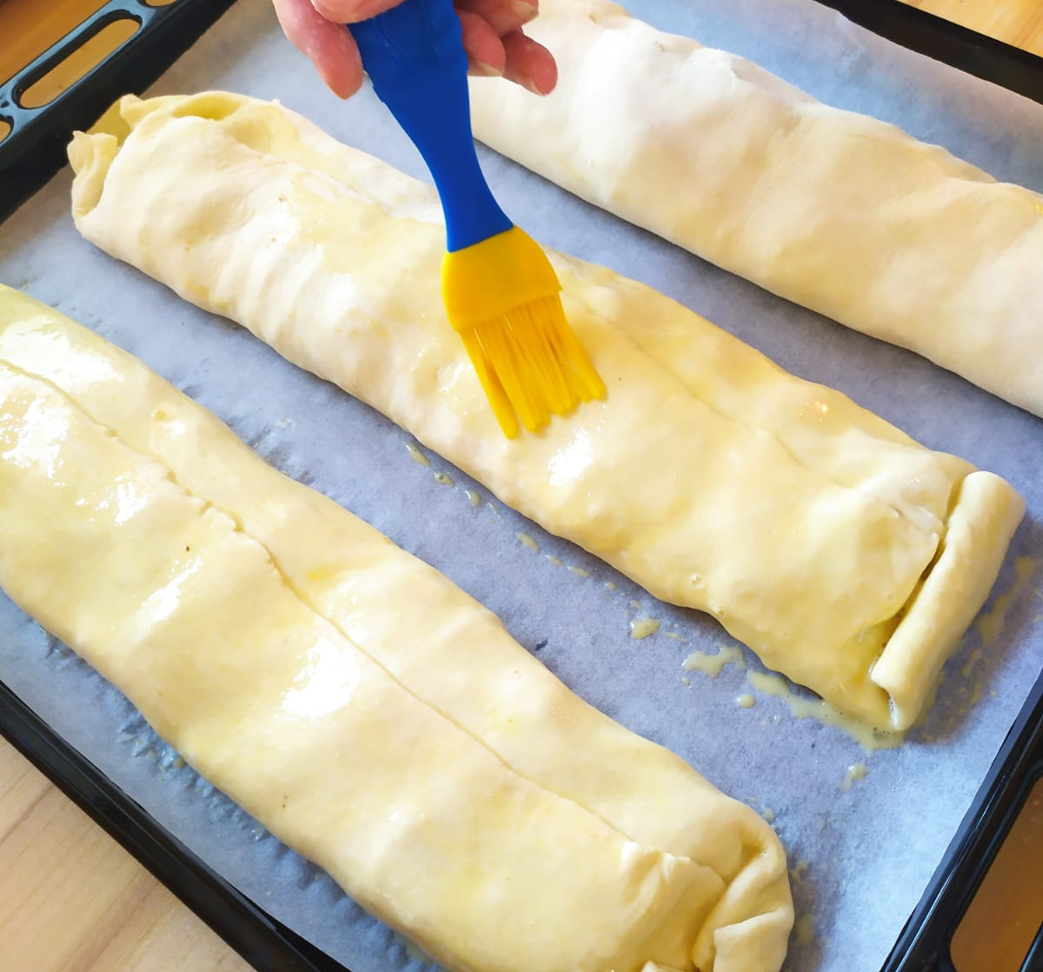
Brush with beaten egg.

Slide 15
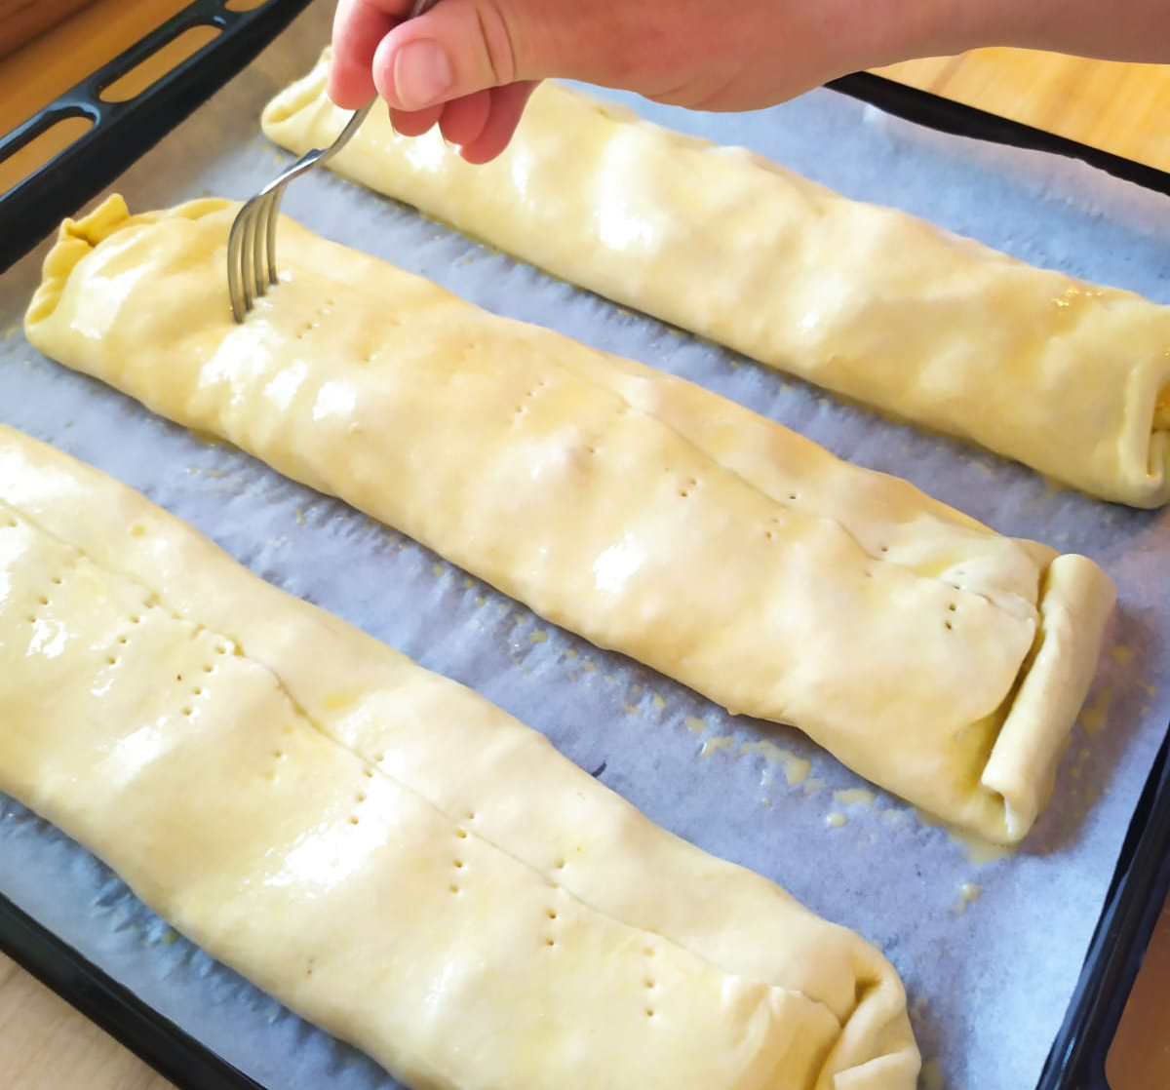
Pierce with a fork so that the strudel does not crack.

Slide 16
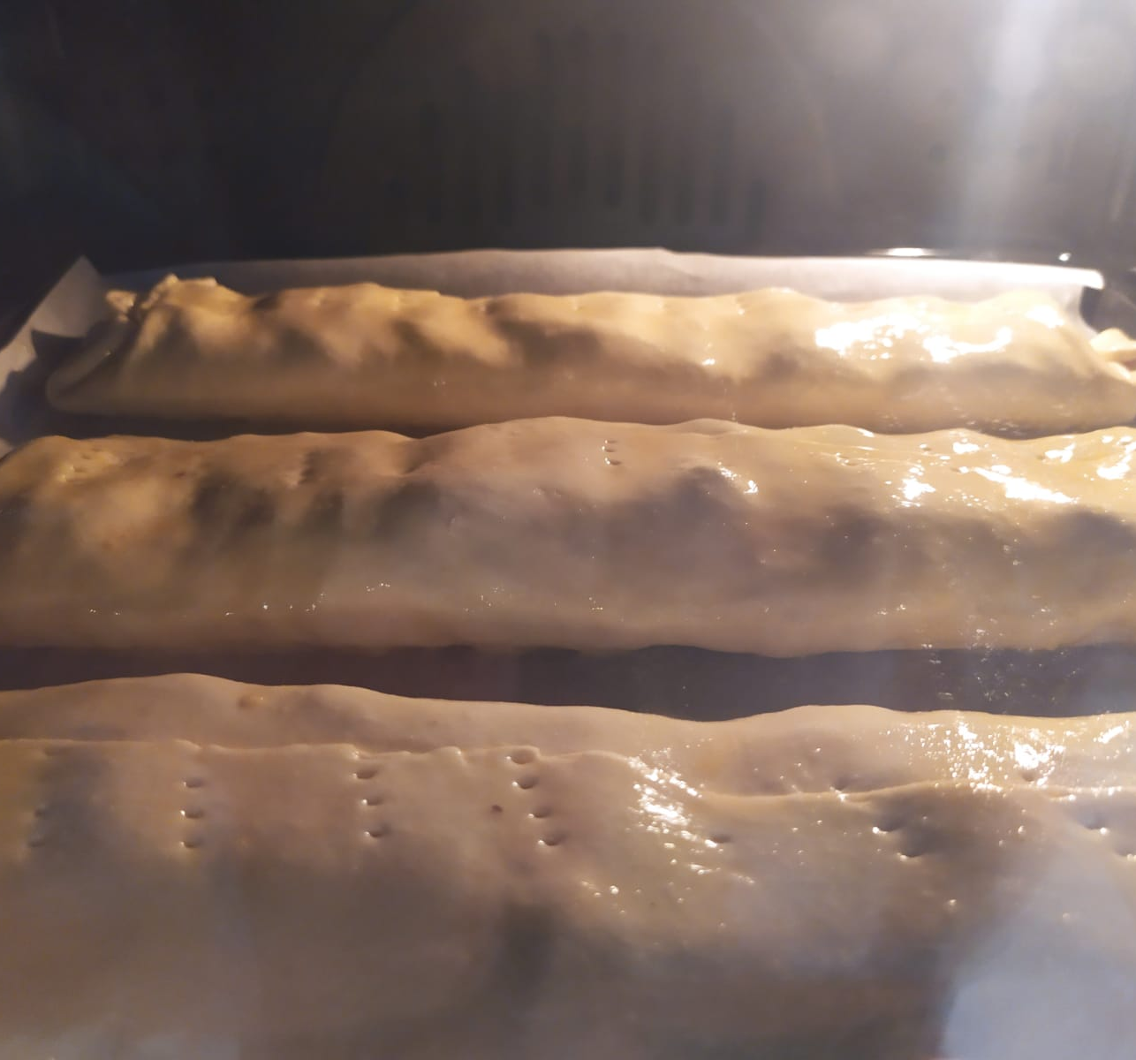
Bake in a preheated oven of 180 ° C for about 15 to 20 minutes.

Slide 17
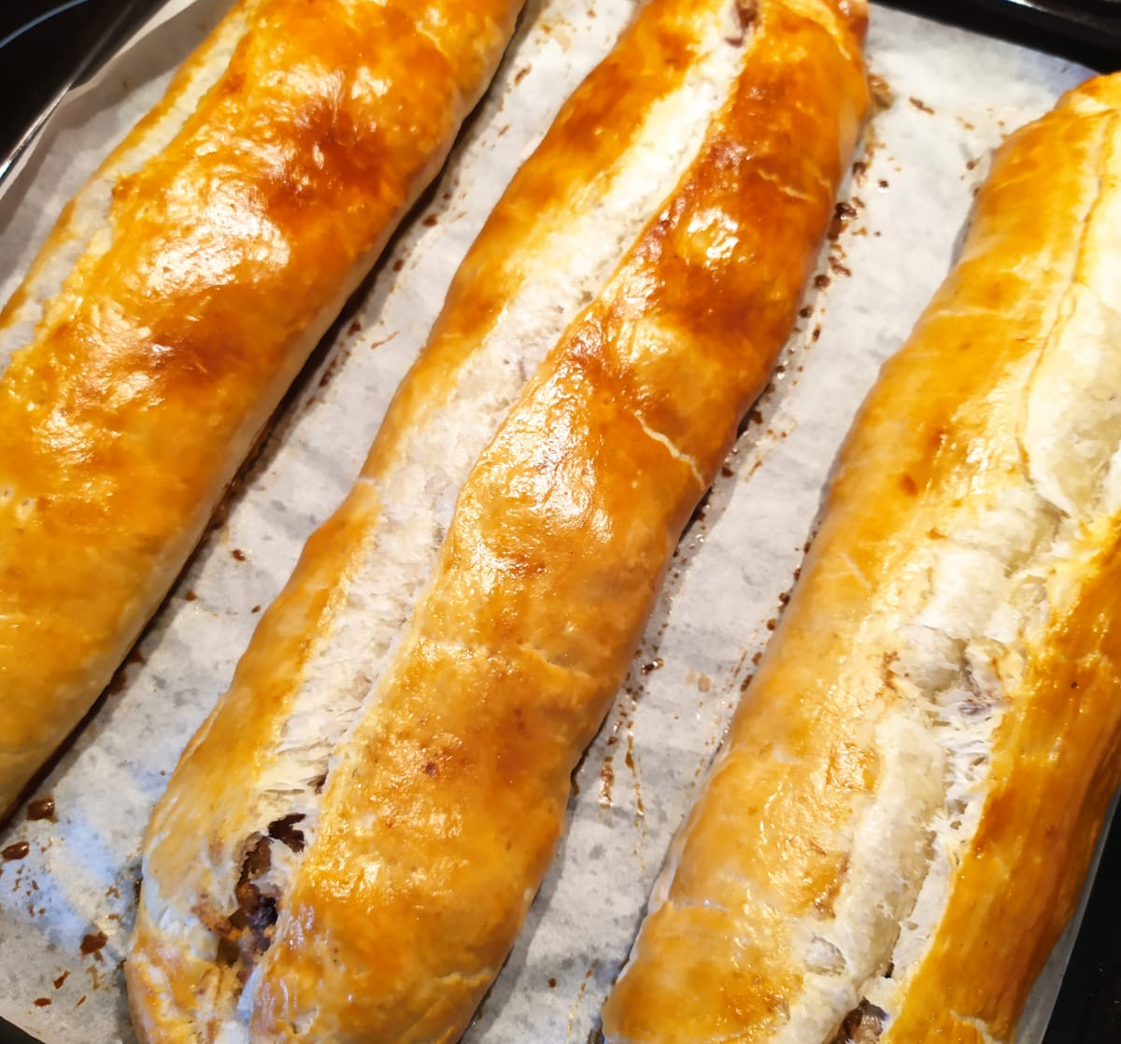
Cut the cooled strudel into portions, sprinkle with icing sugar and serve.

